Slide 1
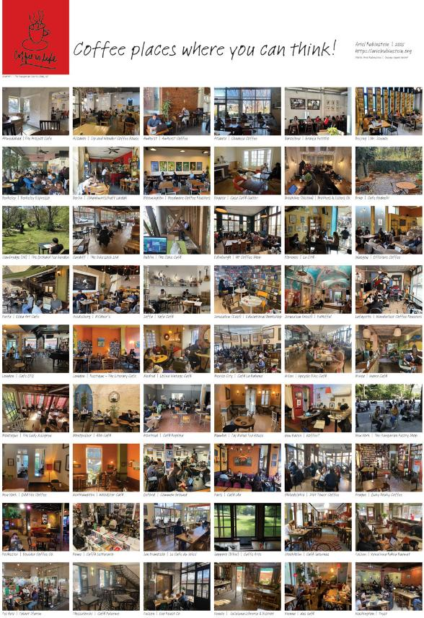
Café Poster 2025
“Coffee places where you can think!”
Ariel Rubinstein

Slide 2
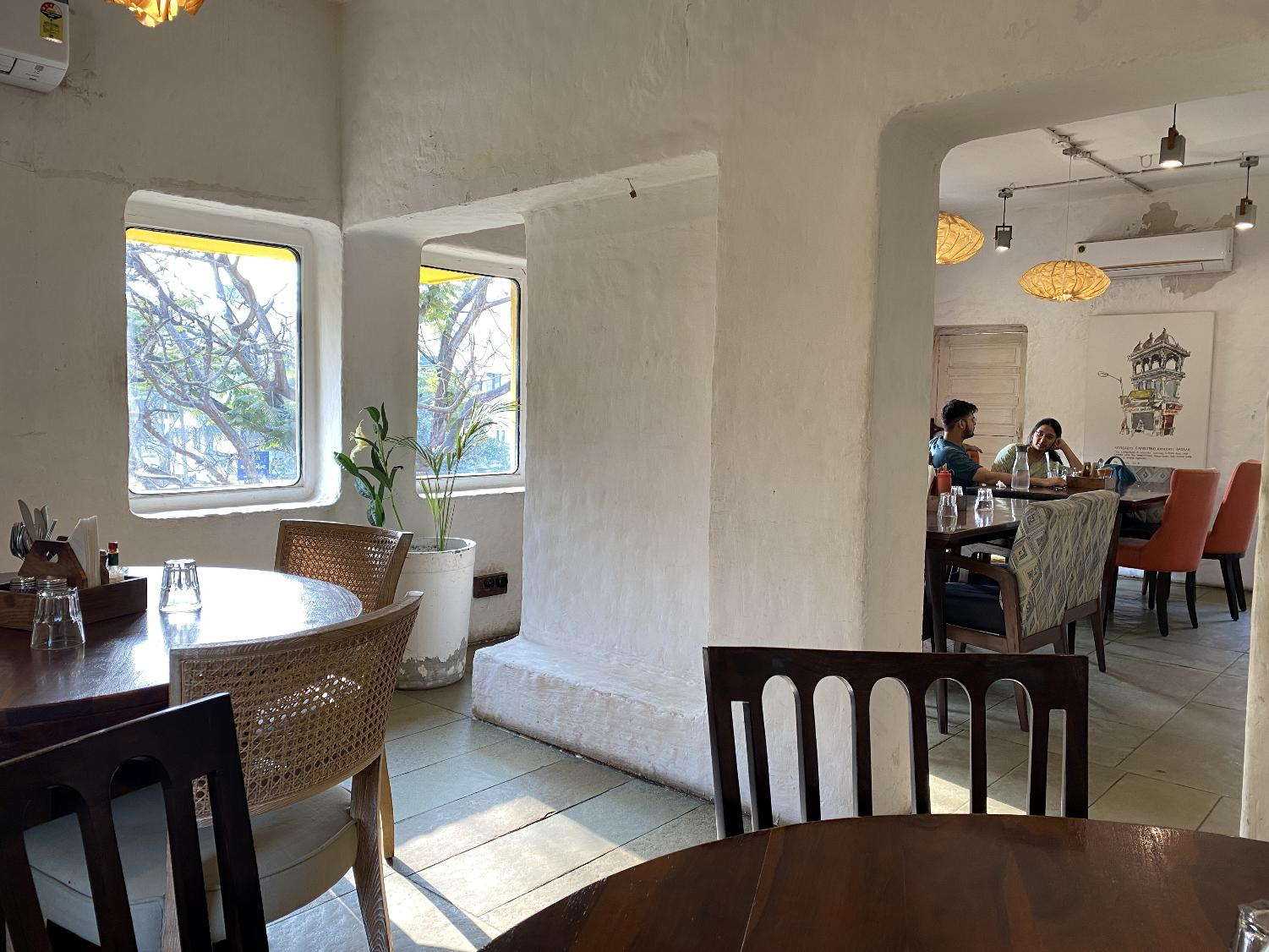
Ahmedabad | The Project Café

Slide 3
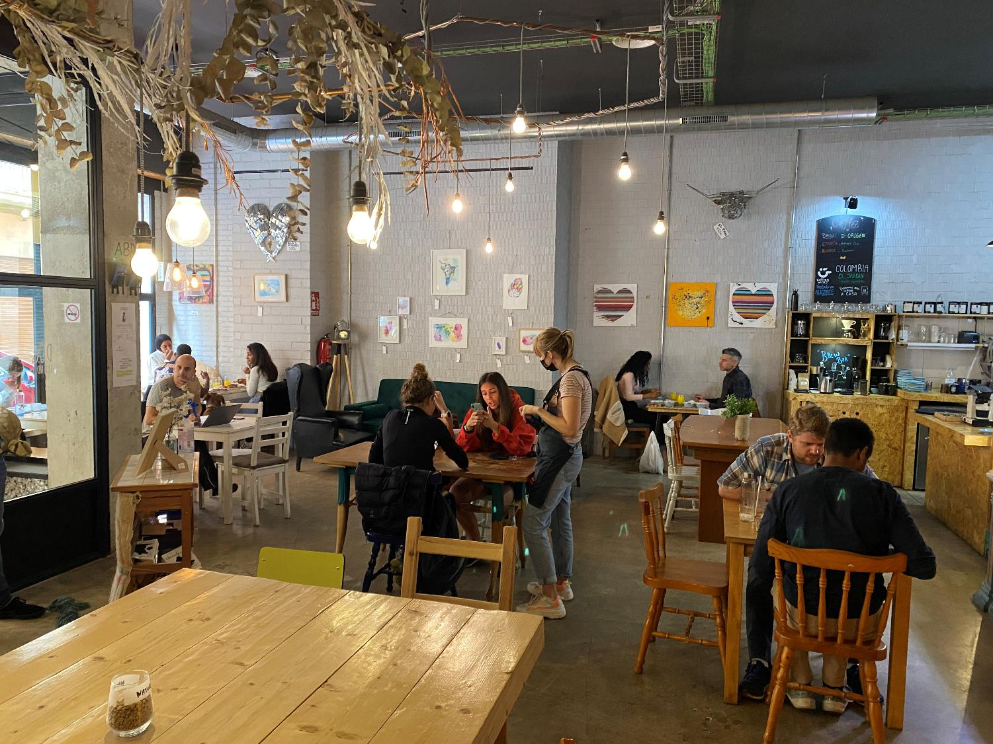
Alicante | Sip and Wonder Coffee House

Slide 4
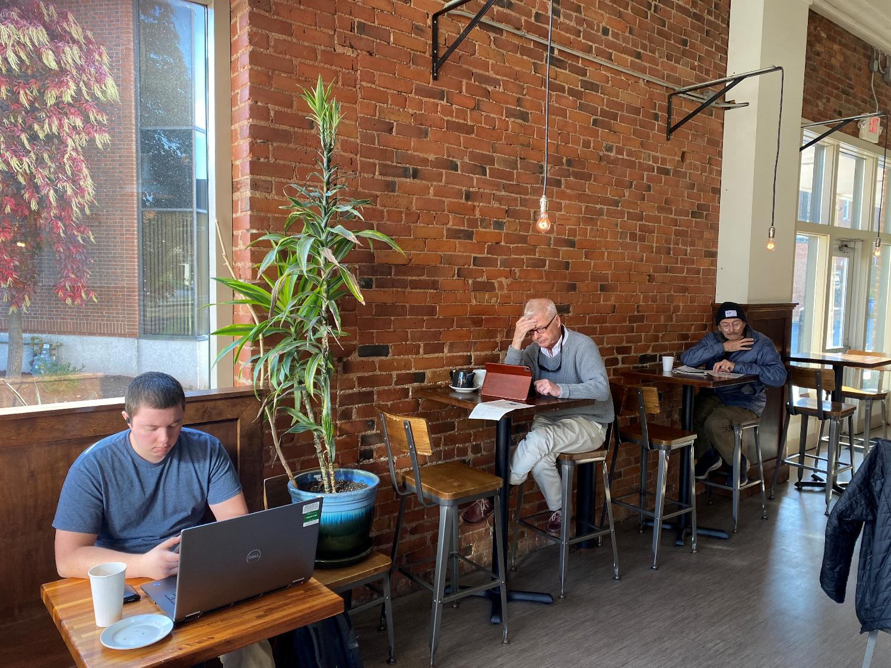
Amherst | Amherst Coffee

Slide 5
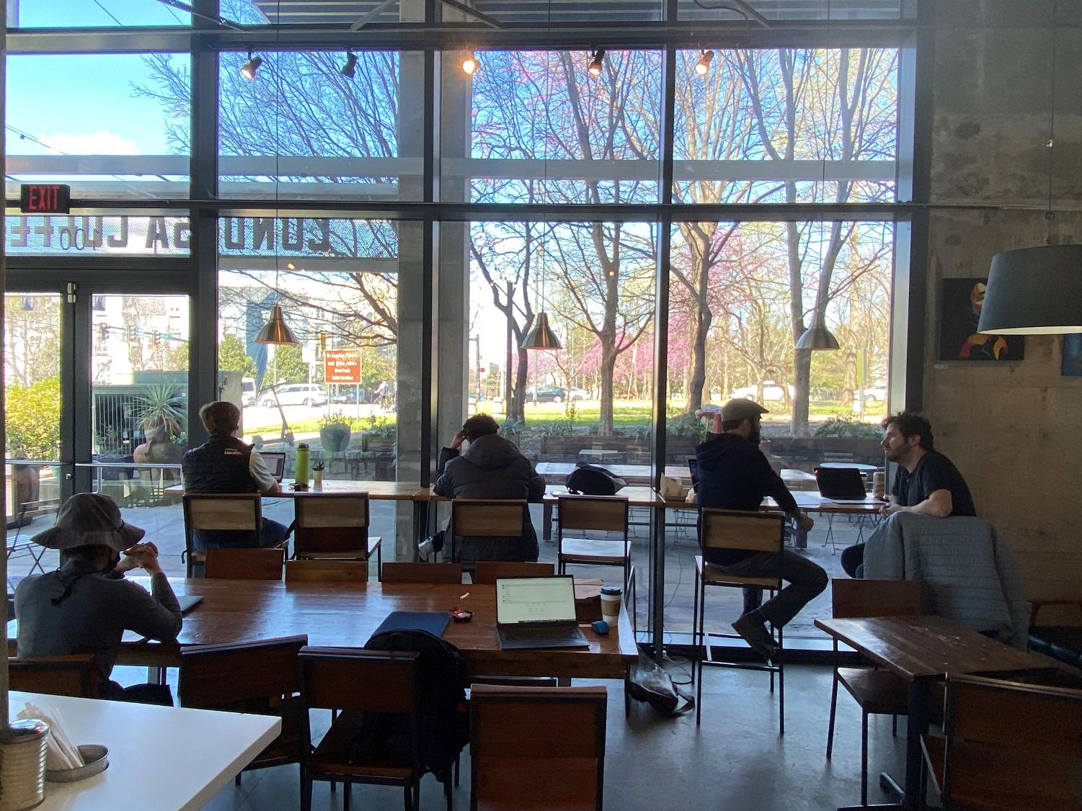
Atlanta | Condesa Coffee

Slide 6
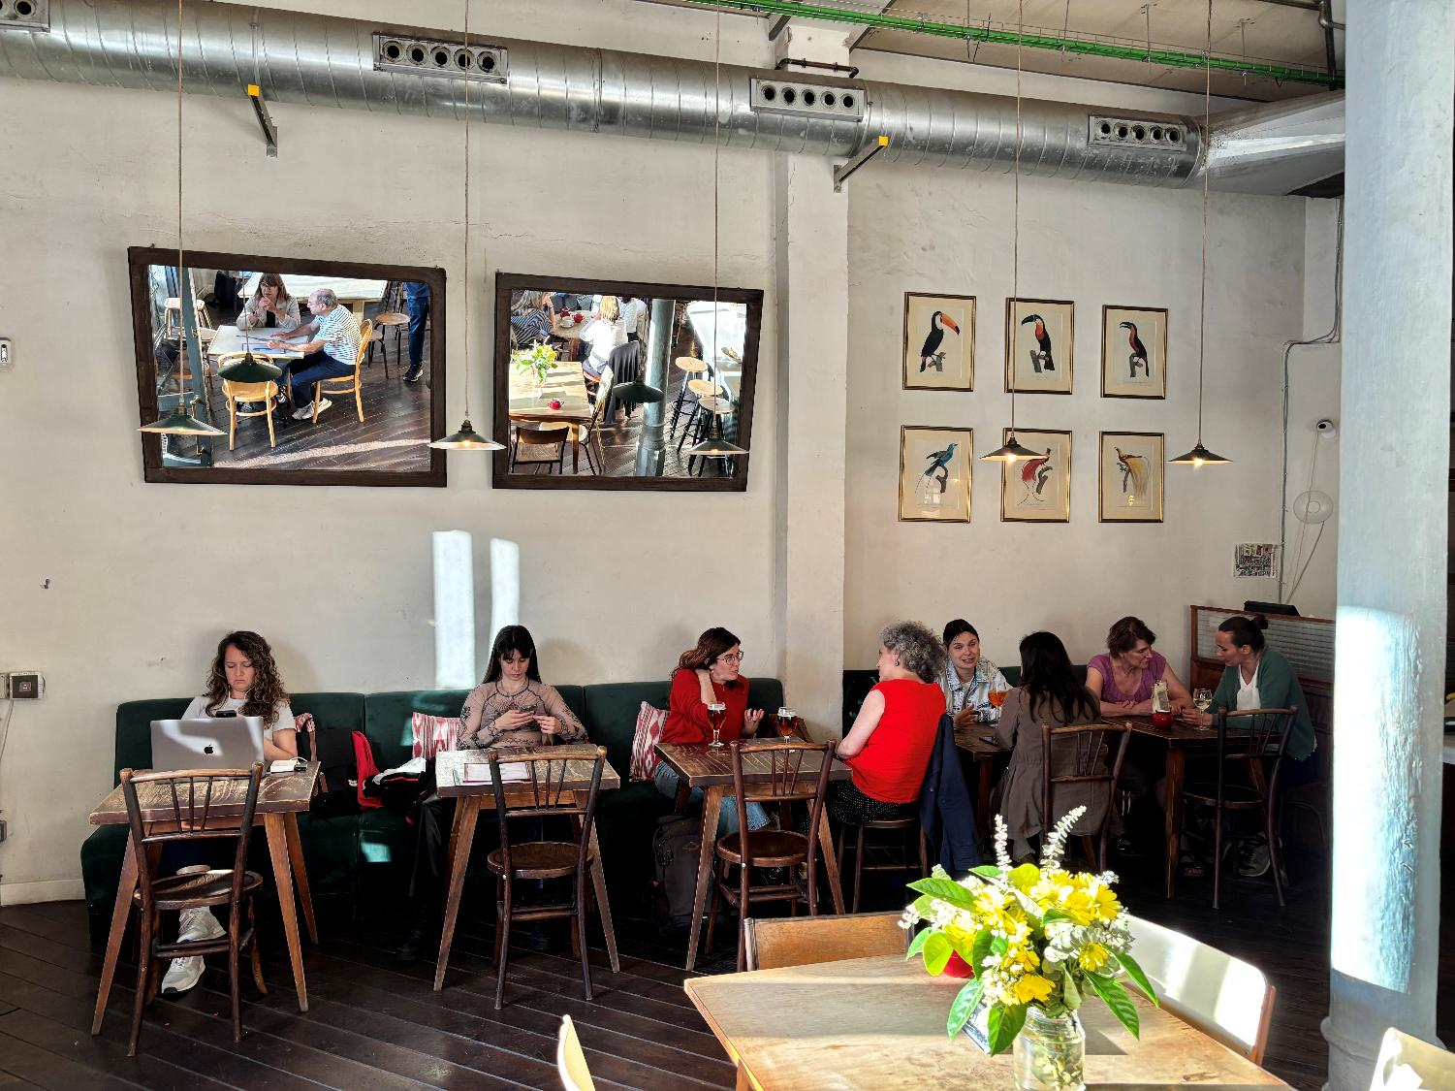
Barcelona | Granja Petitbo

Slide 7
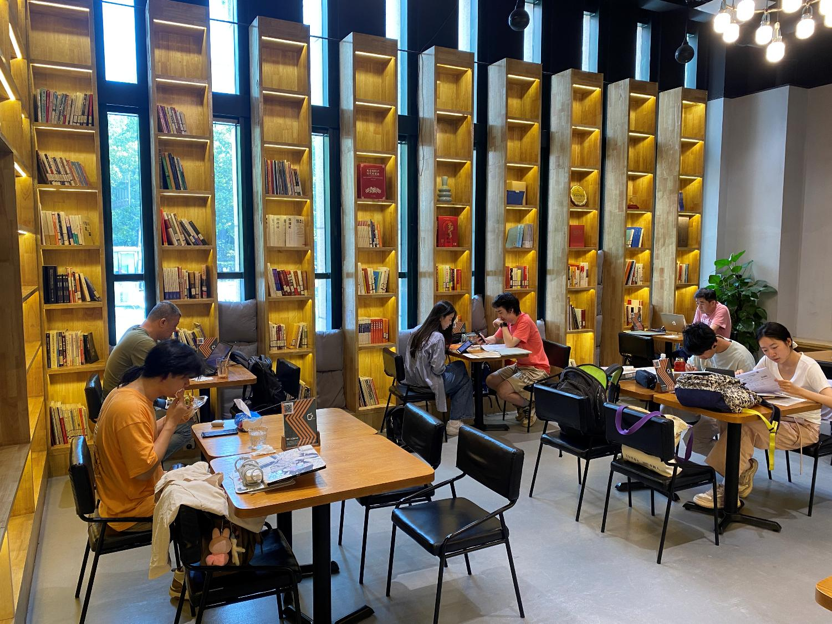
Beijing | Mr. Science

Slide 8
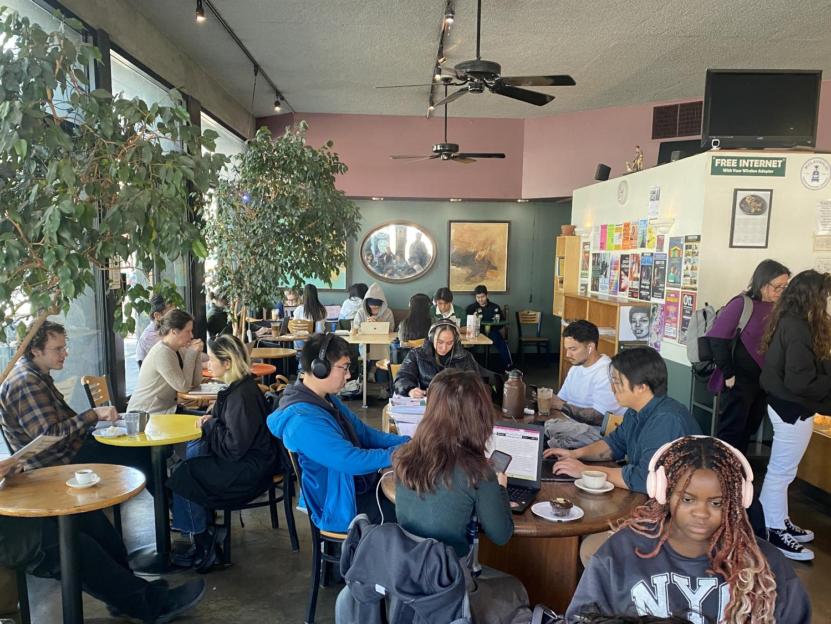
Berkeley | Berkeley Espresso

Slide 9
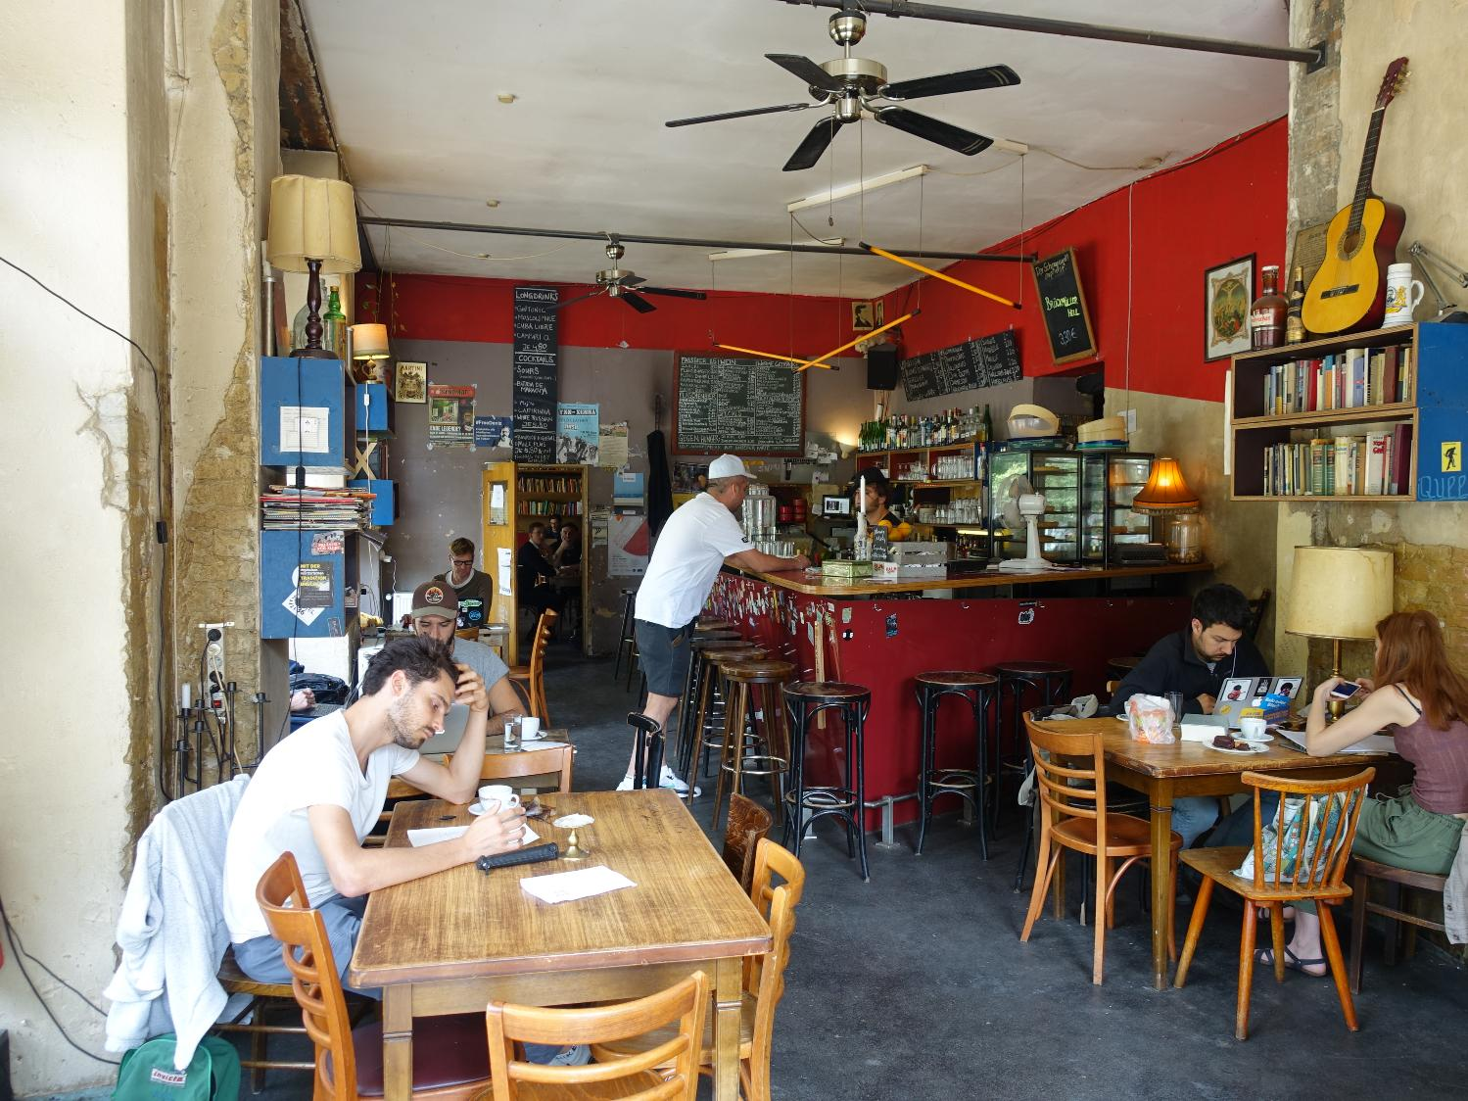
Berlin | Schankwirtschaft Laidak

Slide 10
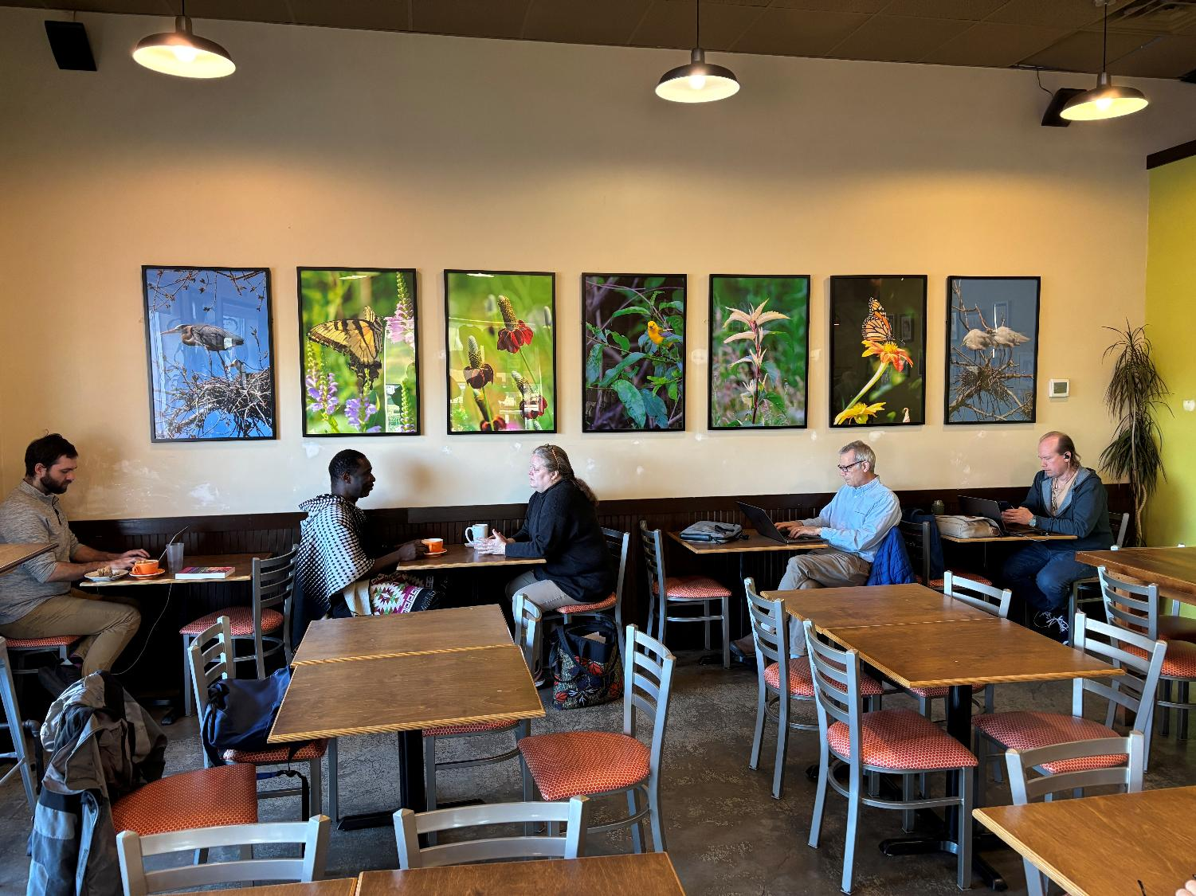
Bloomington | Needmore Coffee Roasters

Slide 11
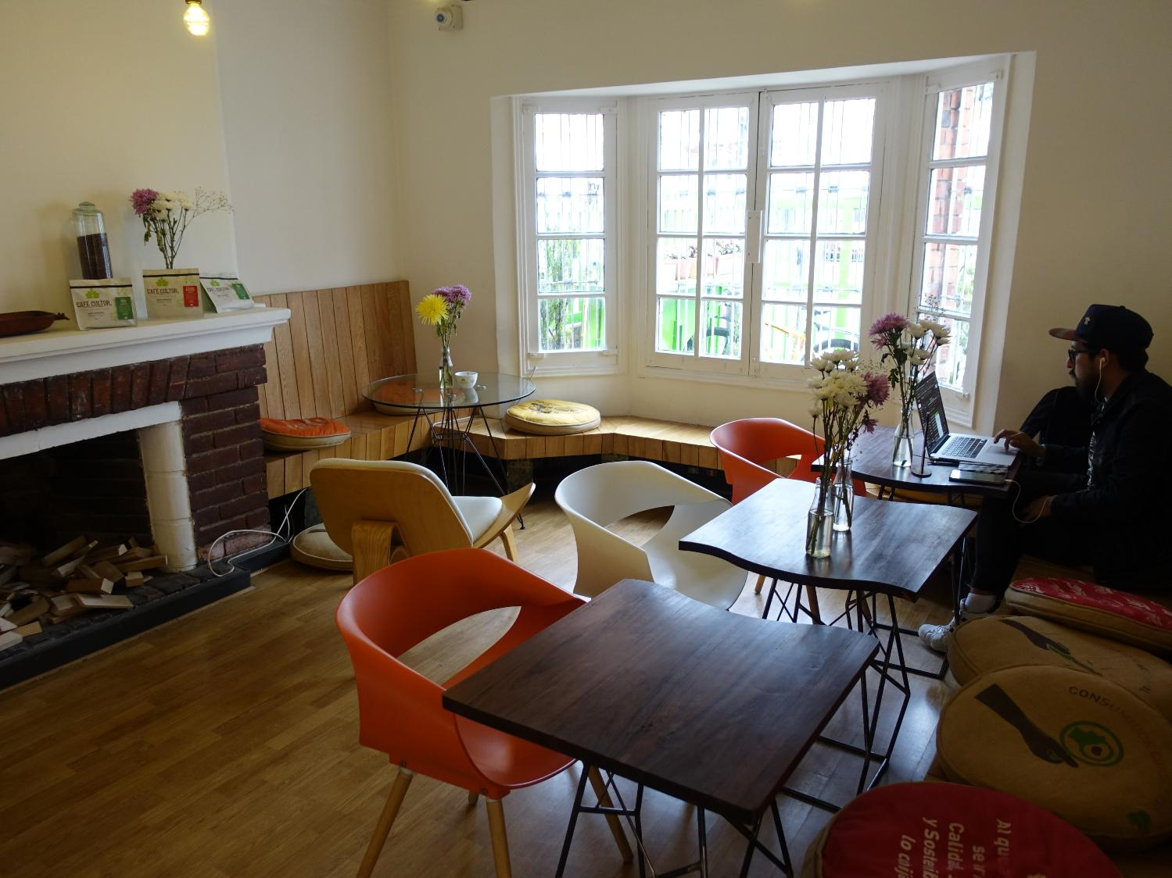
Bogotá | Café Cultor

Slide 12
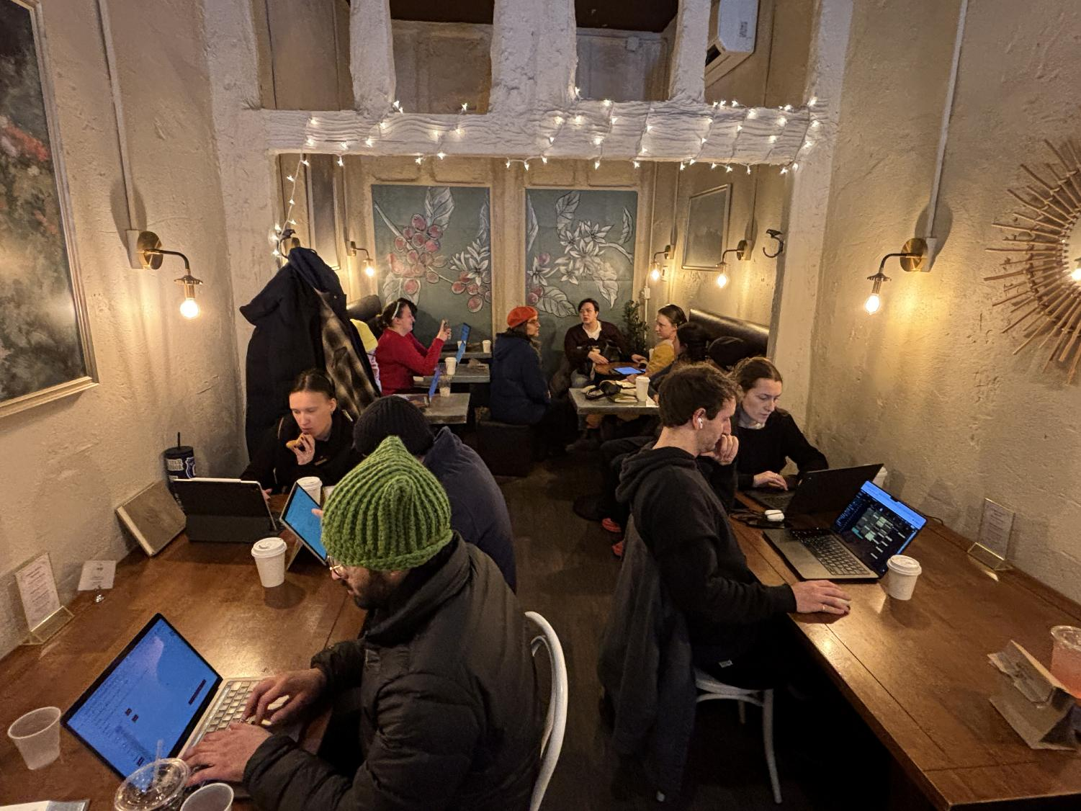
Brookline (Boston) | Brothers & Sisters

Slide 13
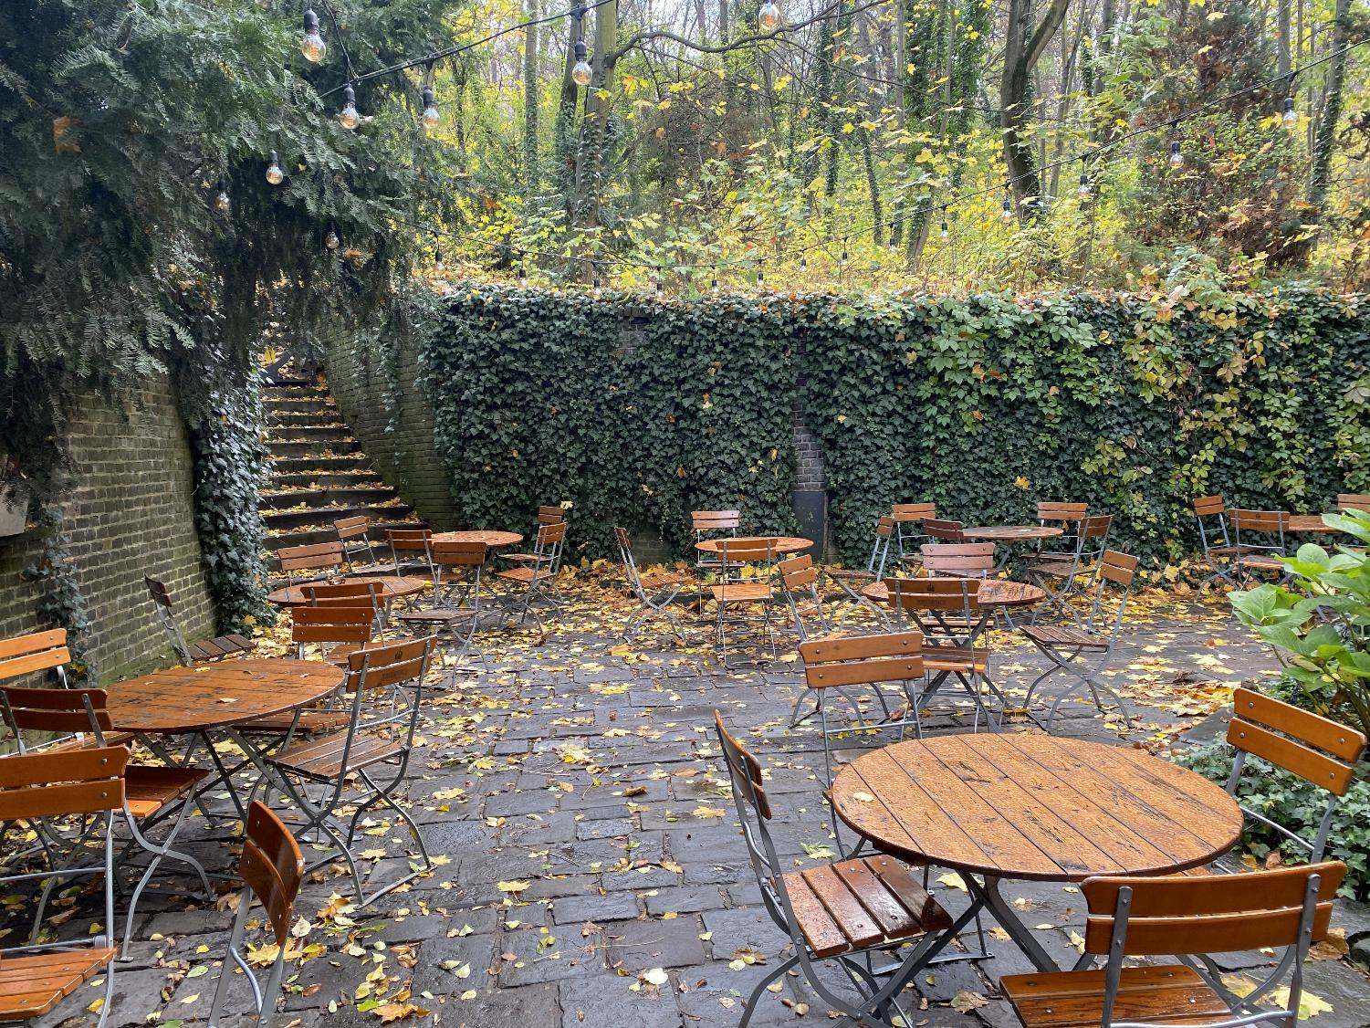
Brno | Cafe Podnebi

Slide 14
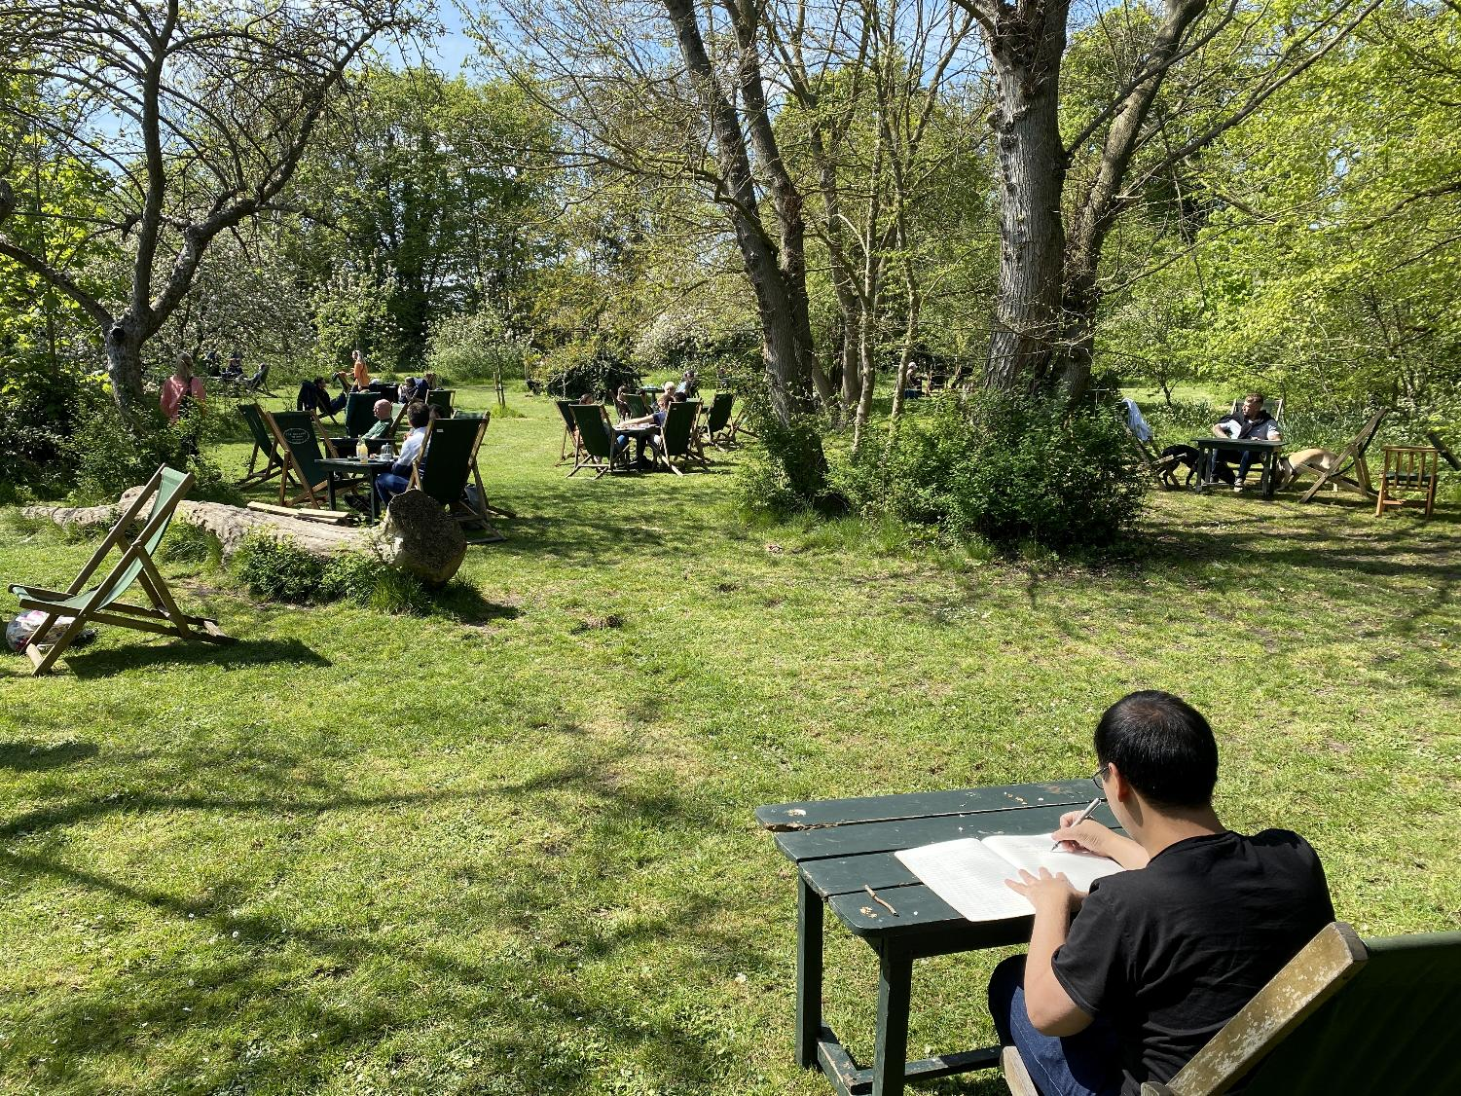
Cambridge (UK) | The Orchard Tea Garden

Slide 15
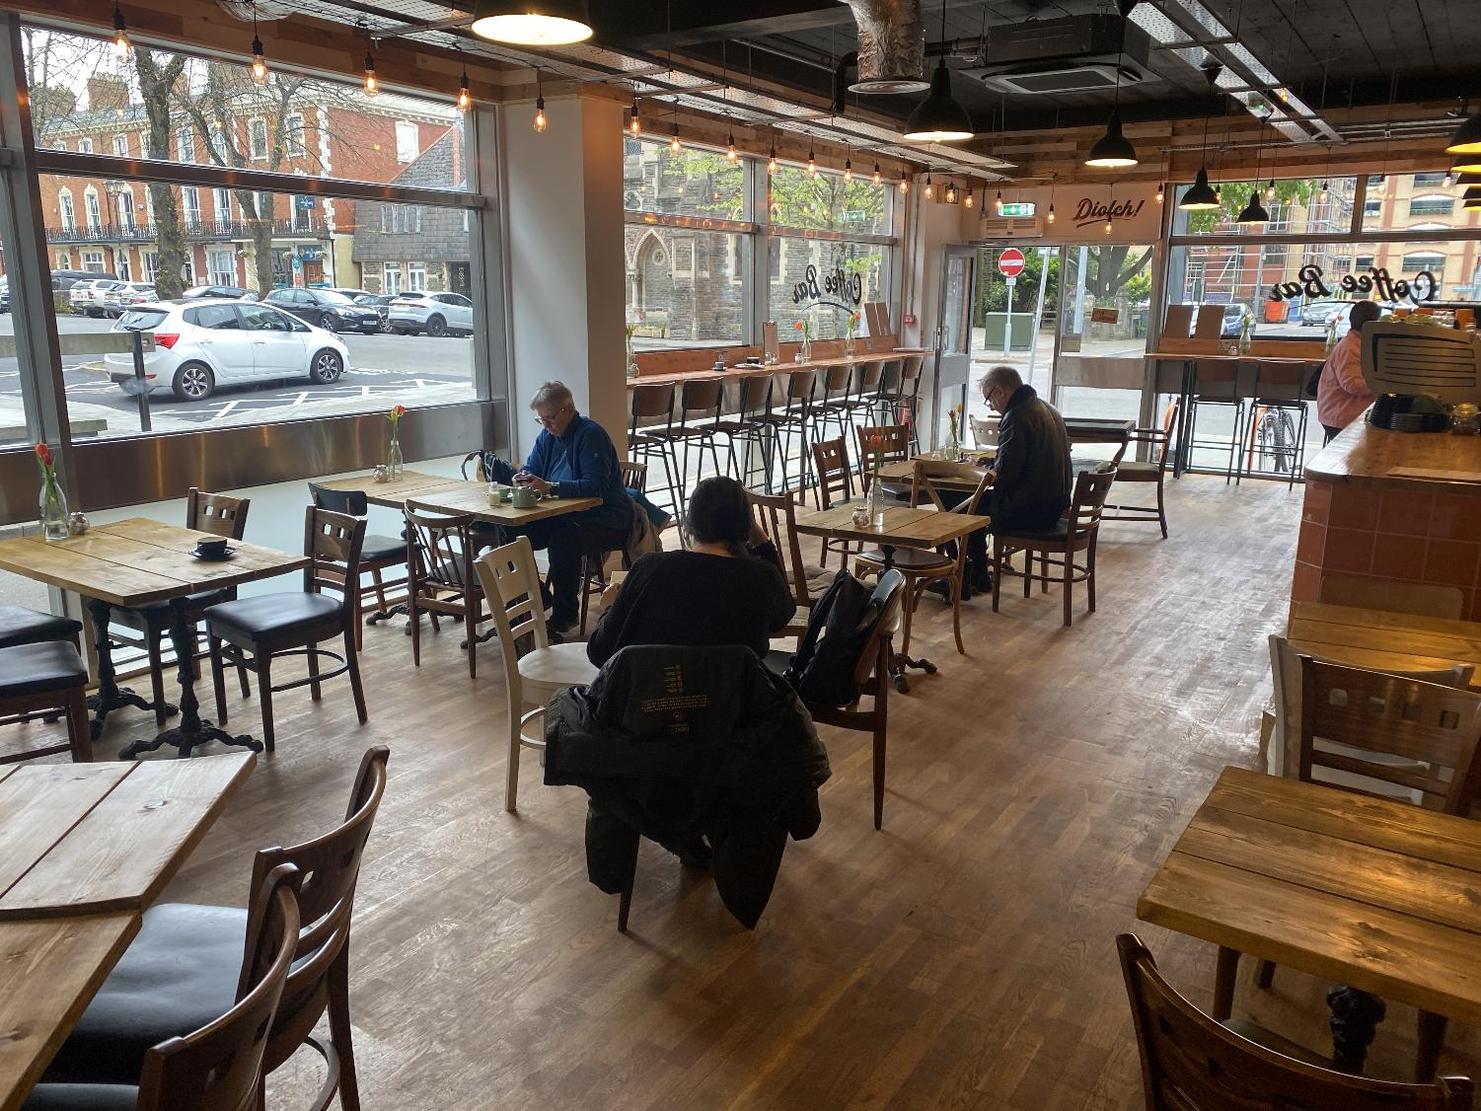
Cardiff | The Bike Lock Ltd

Slide 16
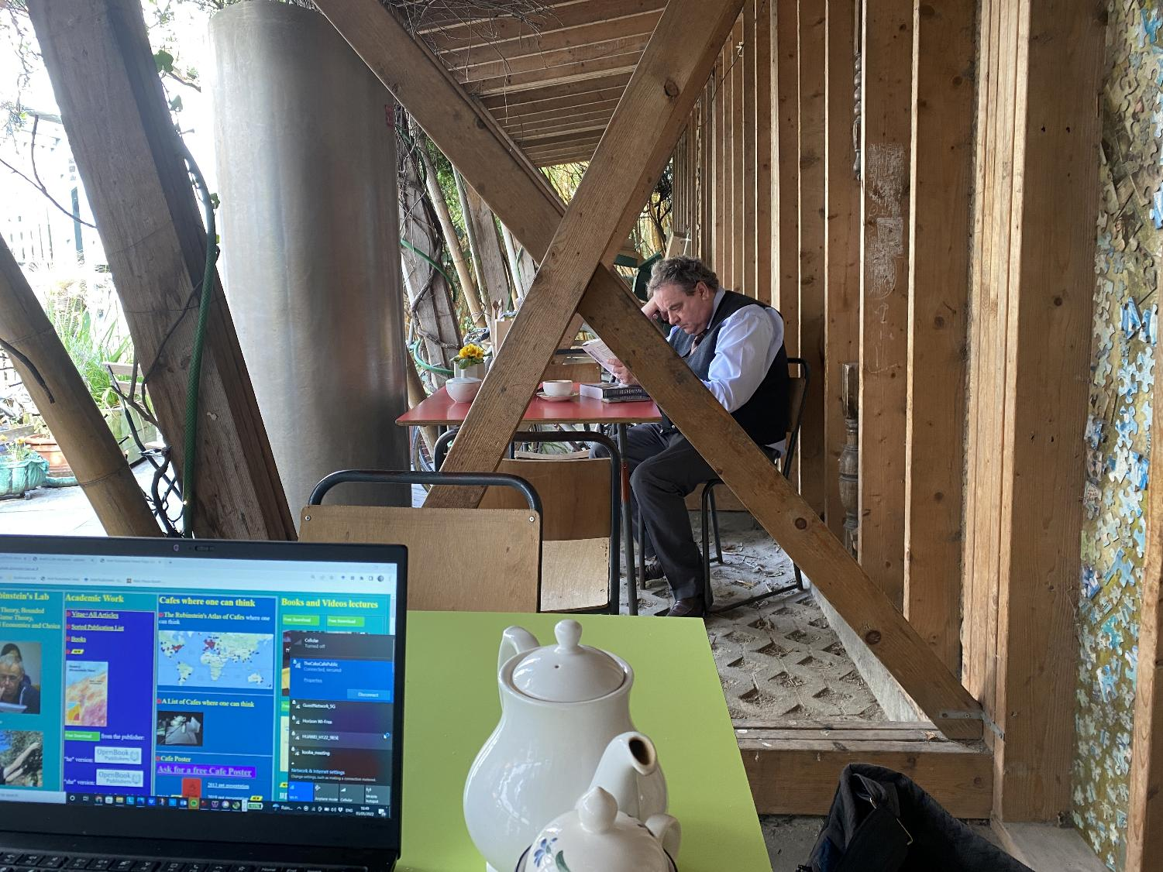
Dublin | The Cake Café

Slide 17
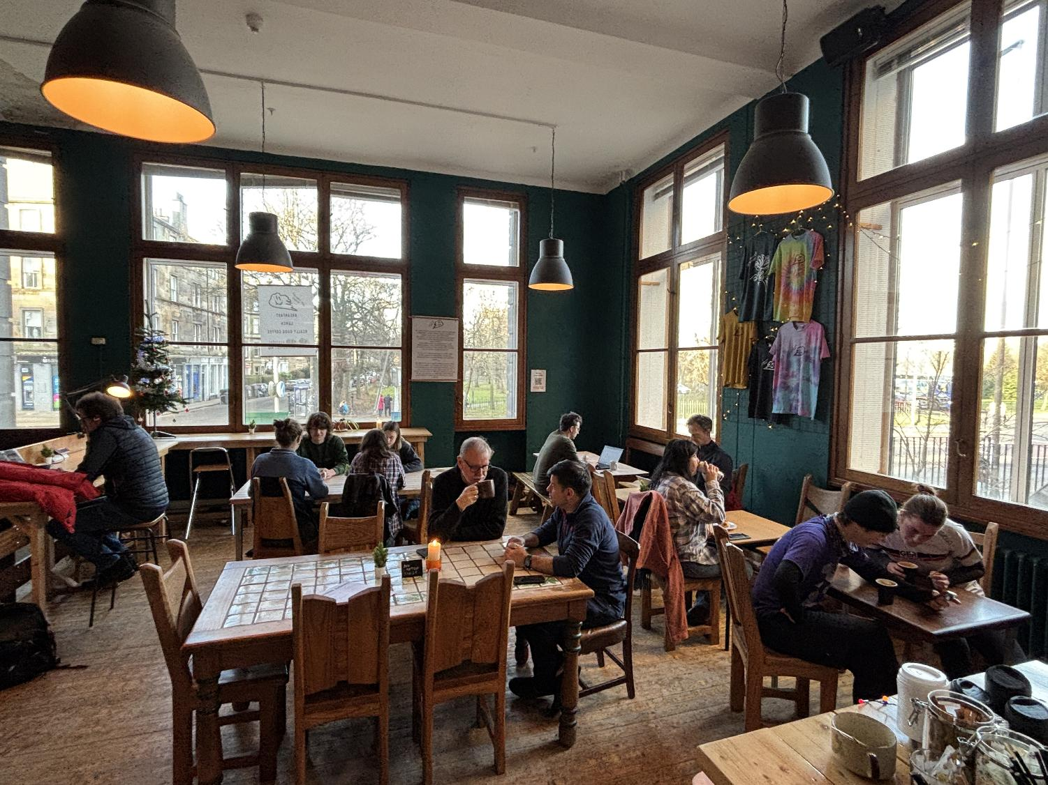
Edinburgh | MF Coffee Shop

Slide 18
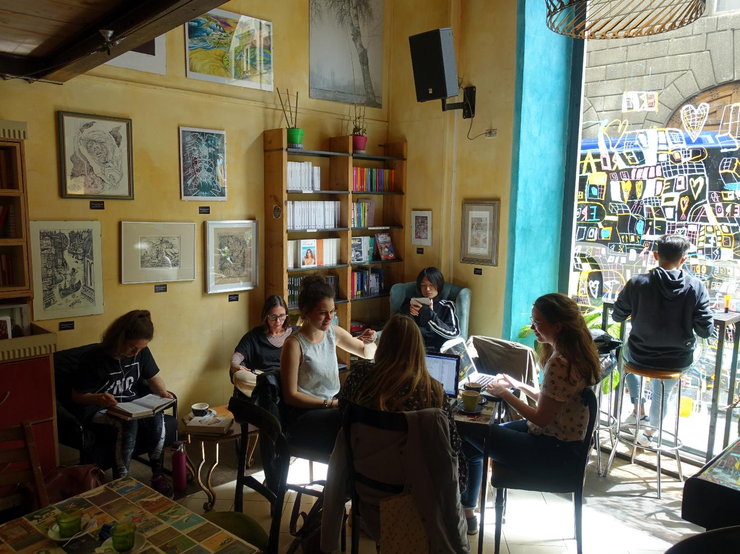
Florence | La Cité

Slide 19
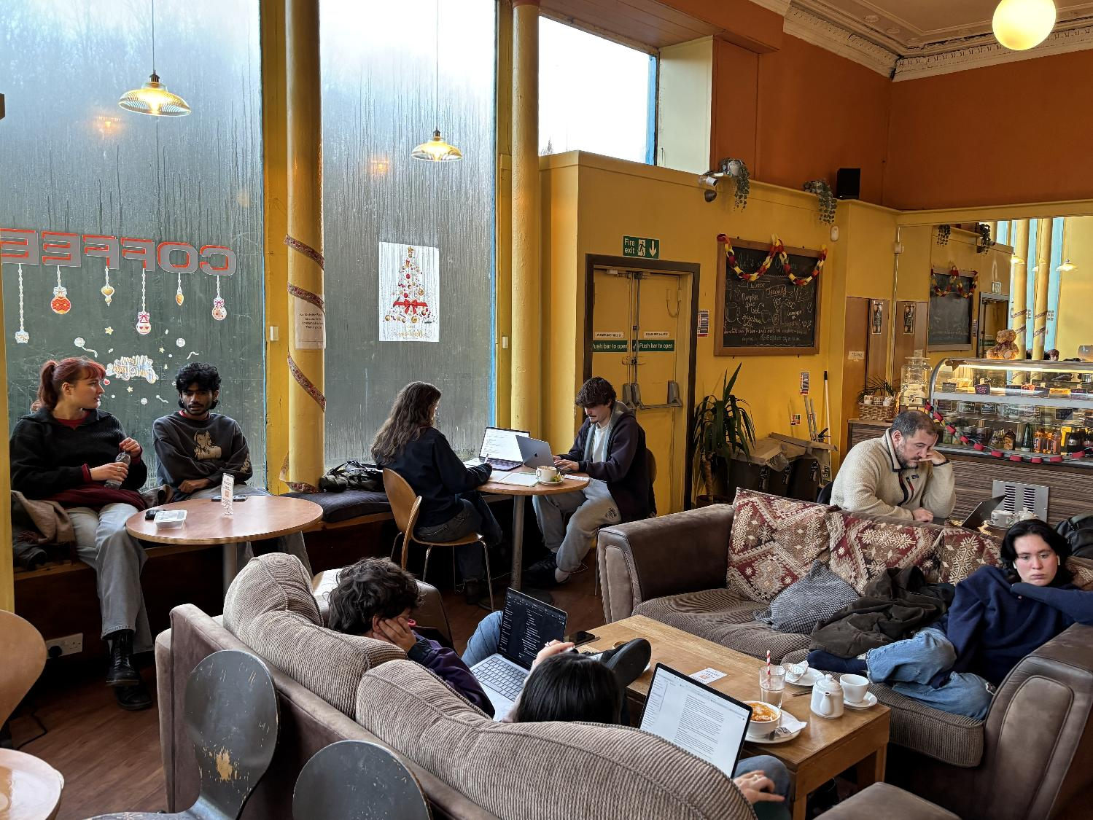
Glasgow | Offshore Coffee

Slide 20
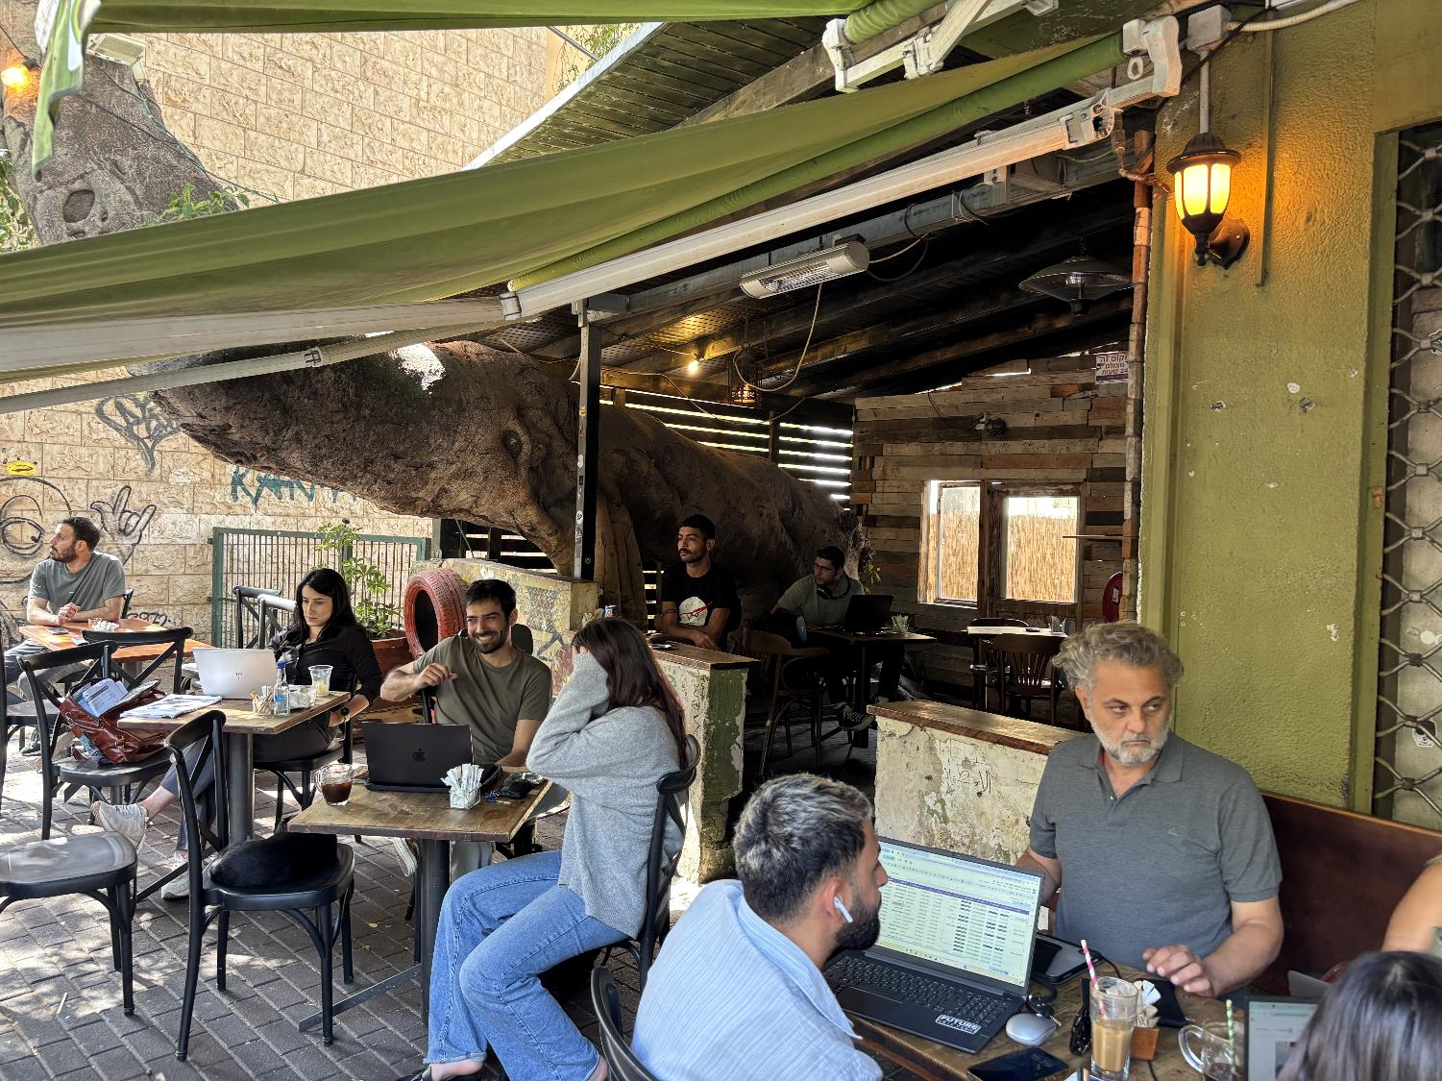
Haifa | Elika Artbar Cafe

Slide 21
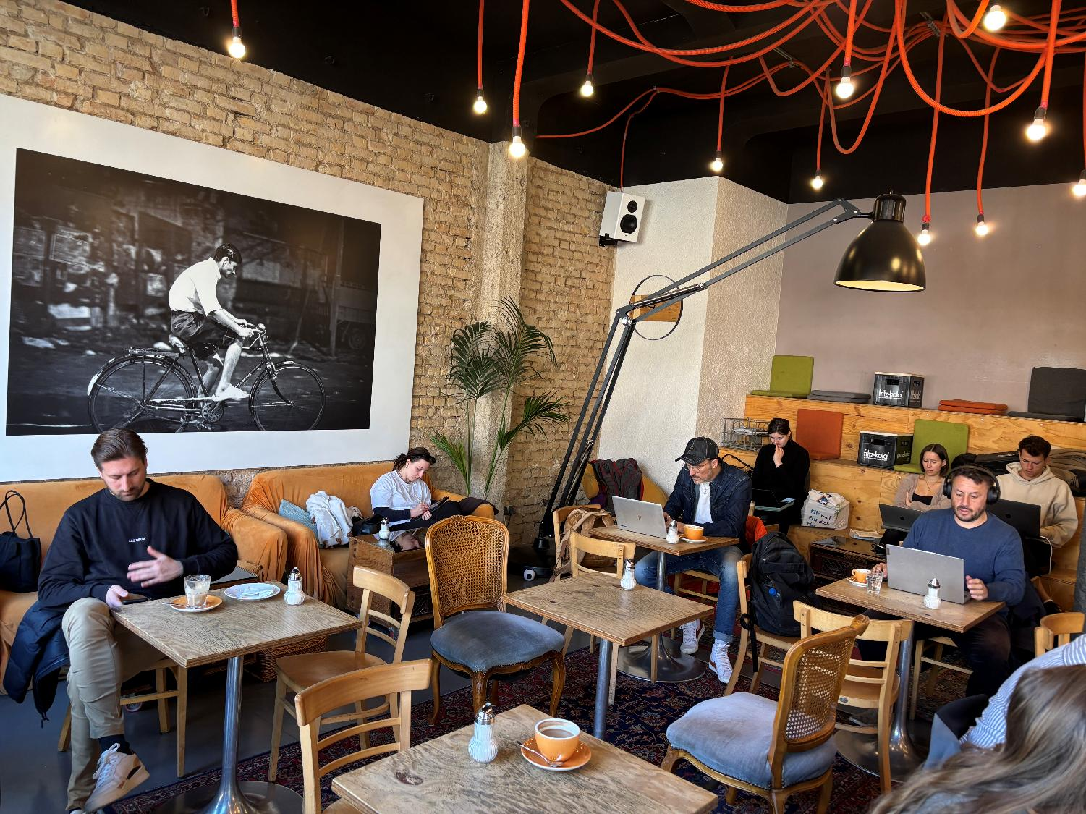
Heidelberg Mildner's
Heidelberg |Mildner's

Slide 22
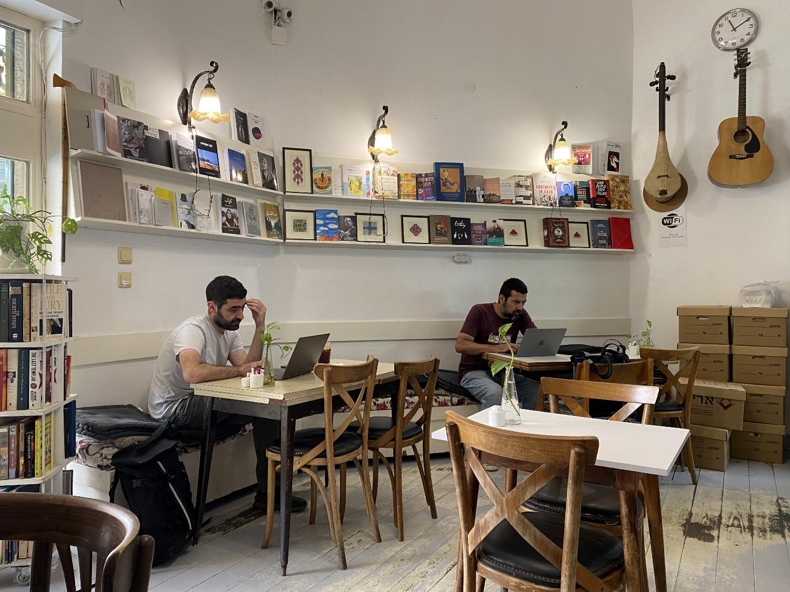
Jaffa | Yafa Café

Slide 23
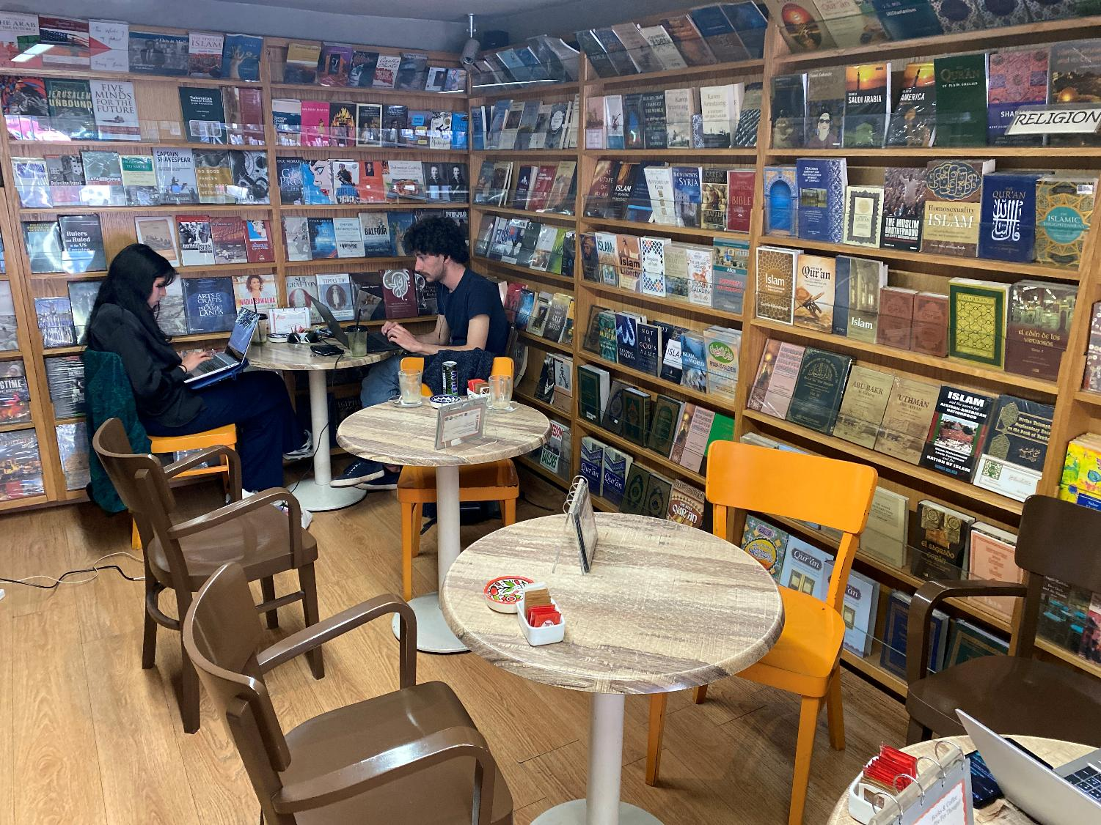
Jerusalem (East) | Educational Bookshop

Slide 24
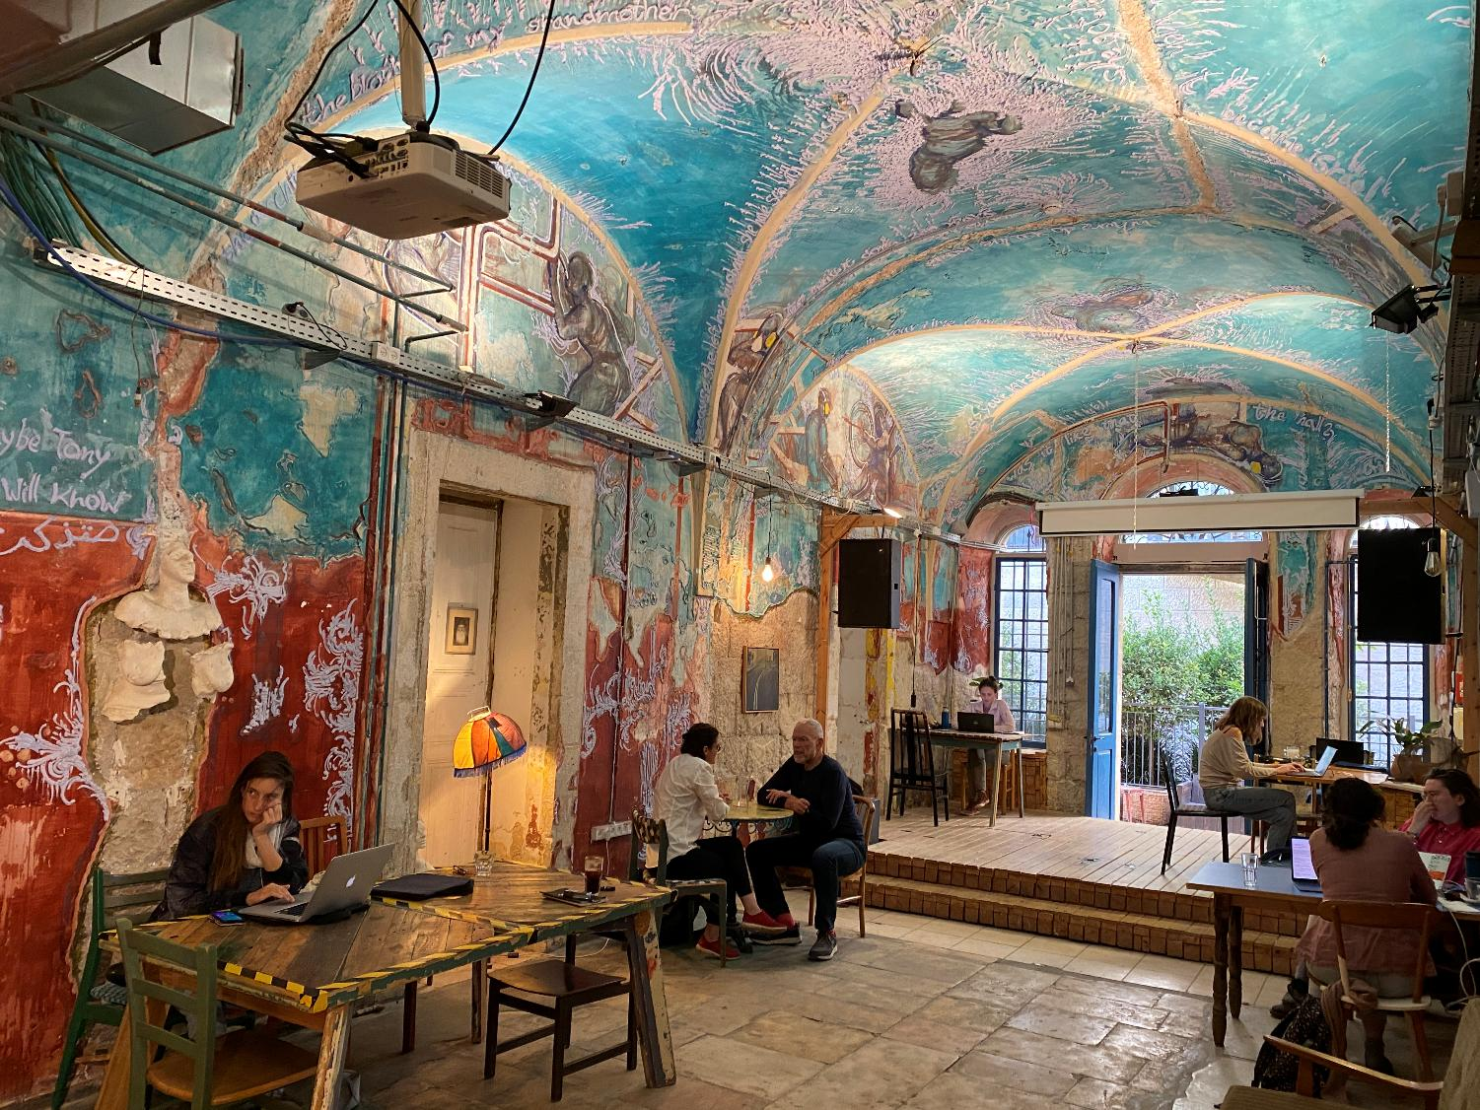
Jerusalem (West) | HaMiffal

Slide 25
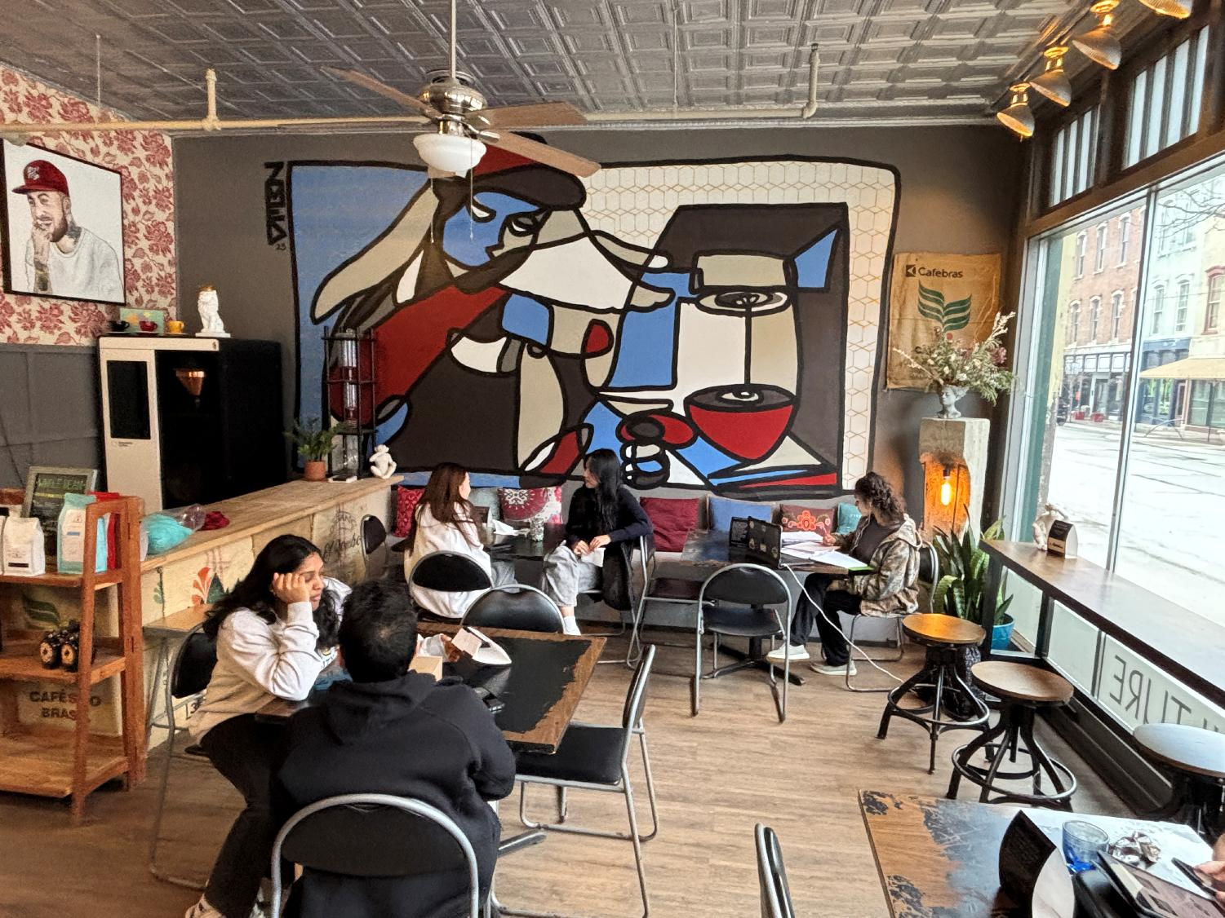
Lafayette | Wanderlust Coffee Roasters

Slide 26
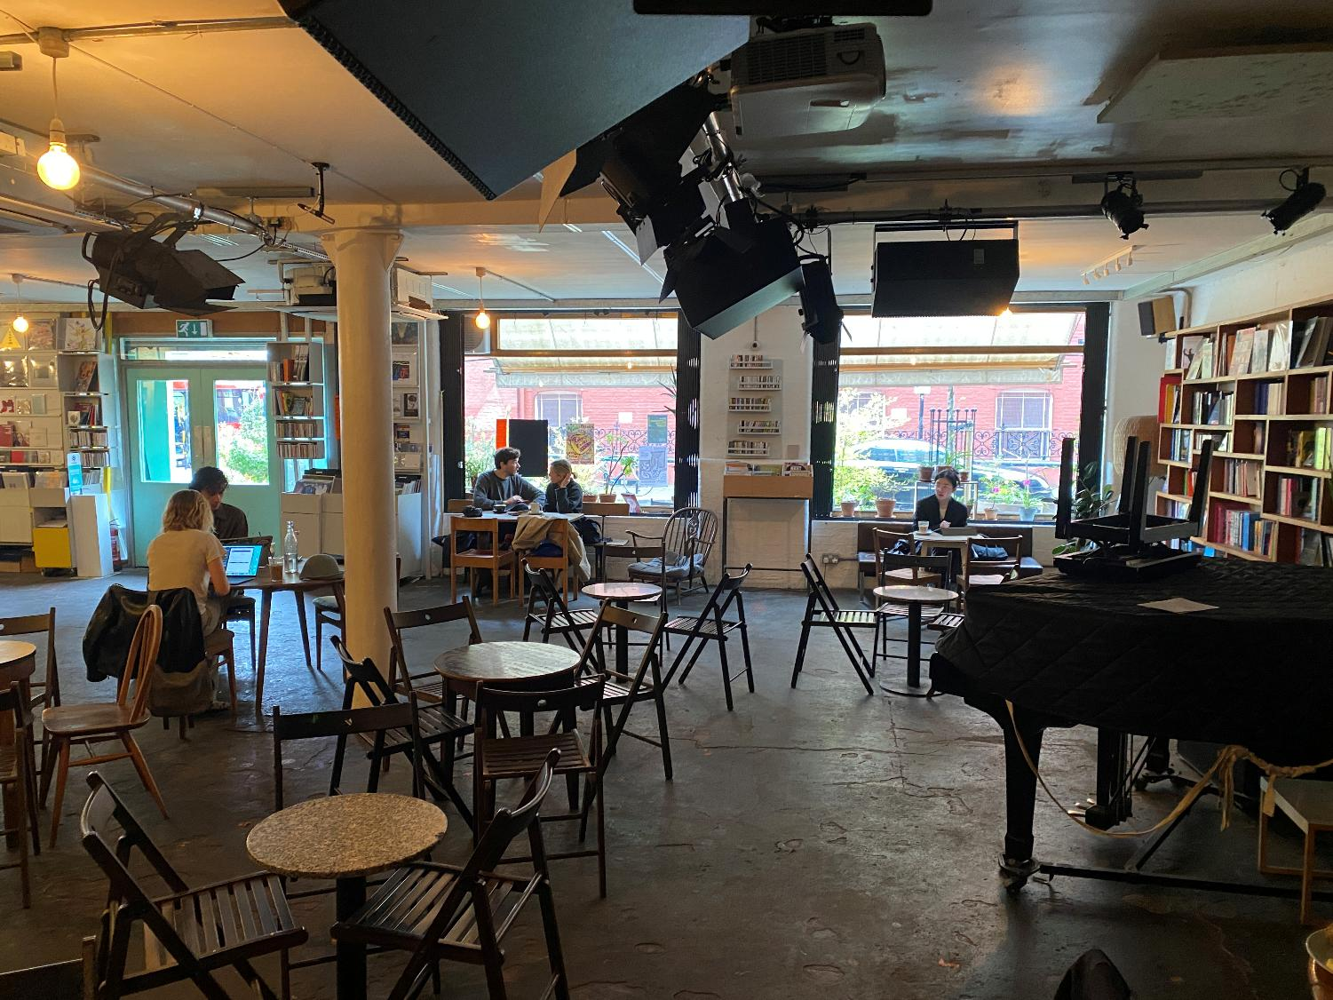
London | Café OTO

Slide 27
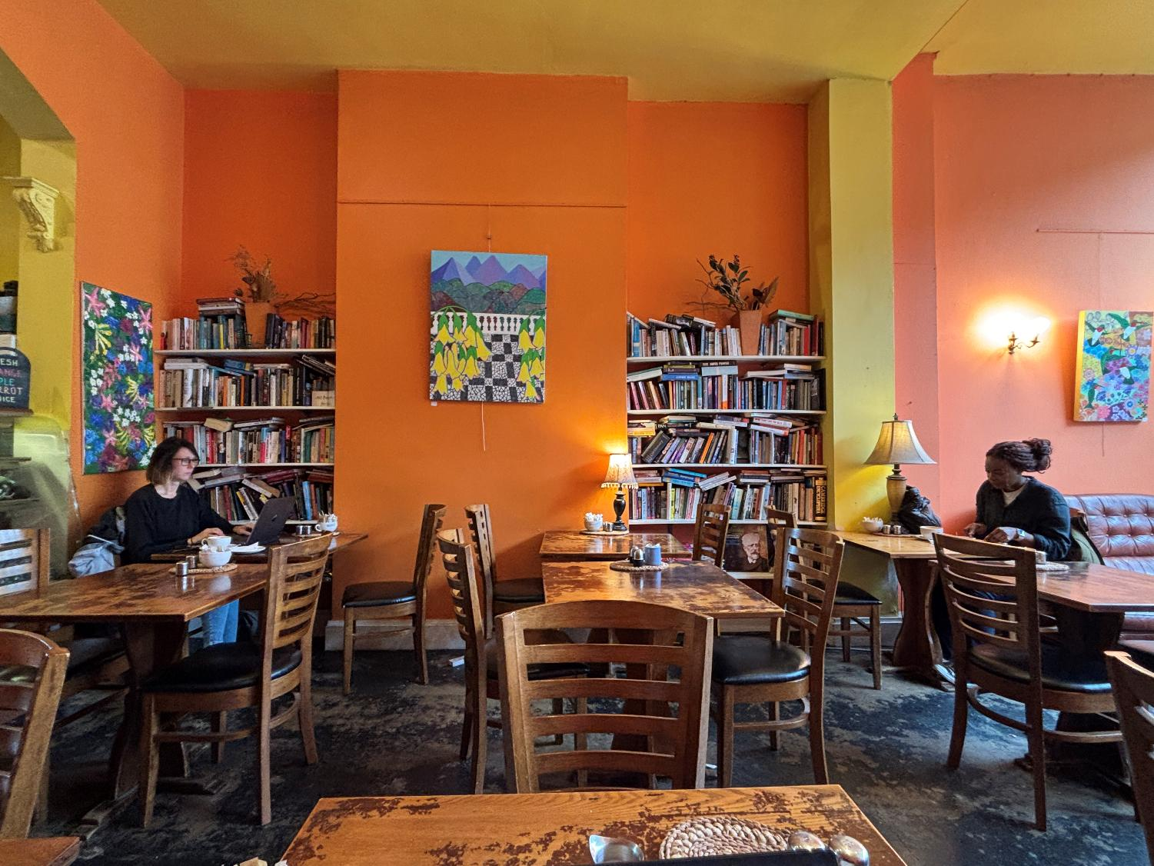
London | Rustique - The Literary Cafe

Slide 28
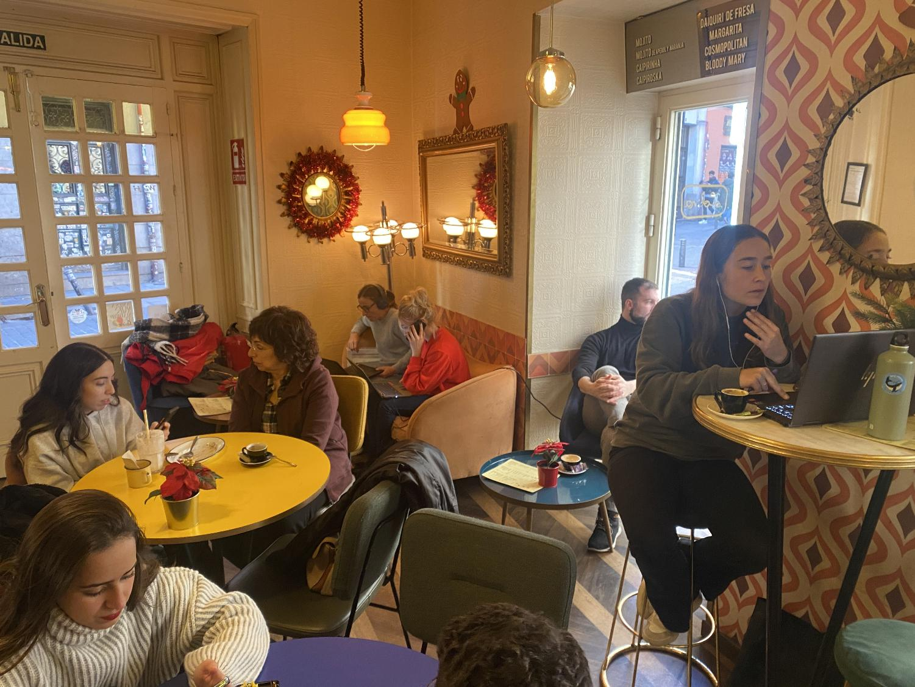
Madrid | Lolina Vintage Café

Slide 29
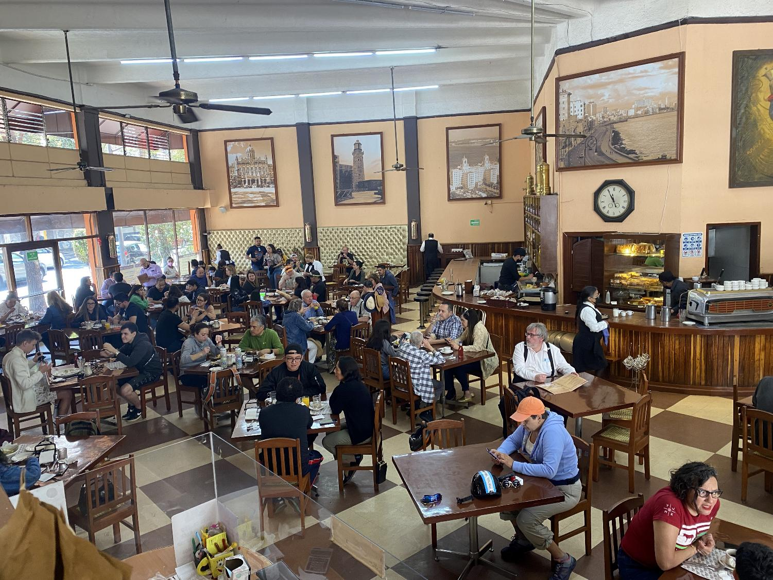
Mexico City| Café La Habana

Slide 30
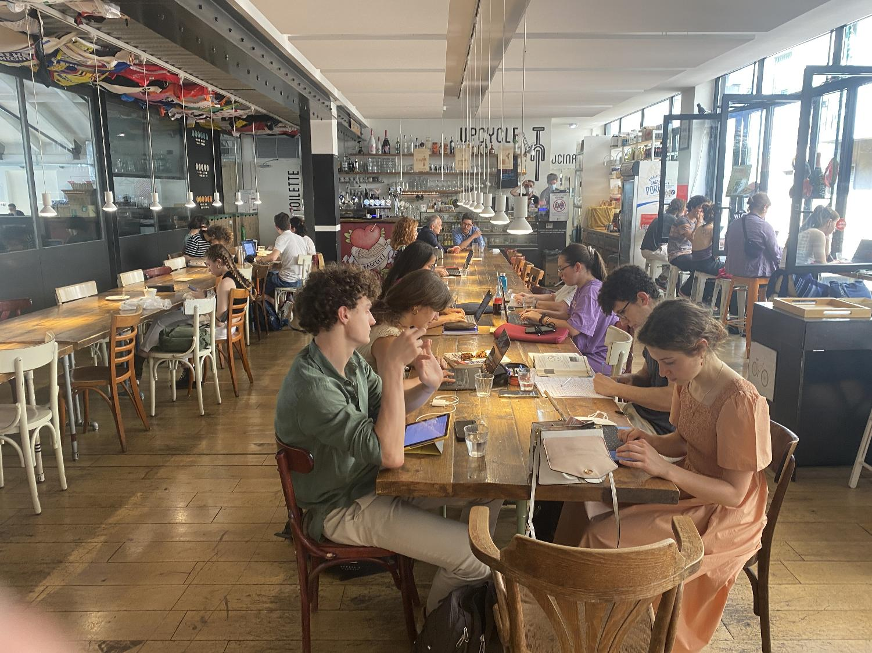
Milan | Upcycle Bike Café

Slide 31
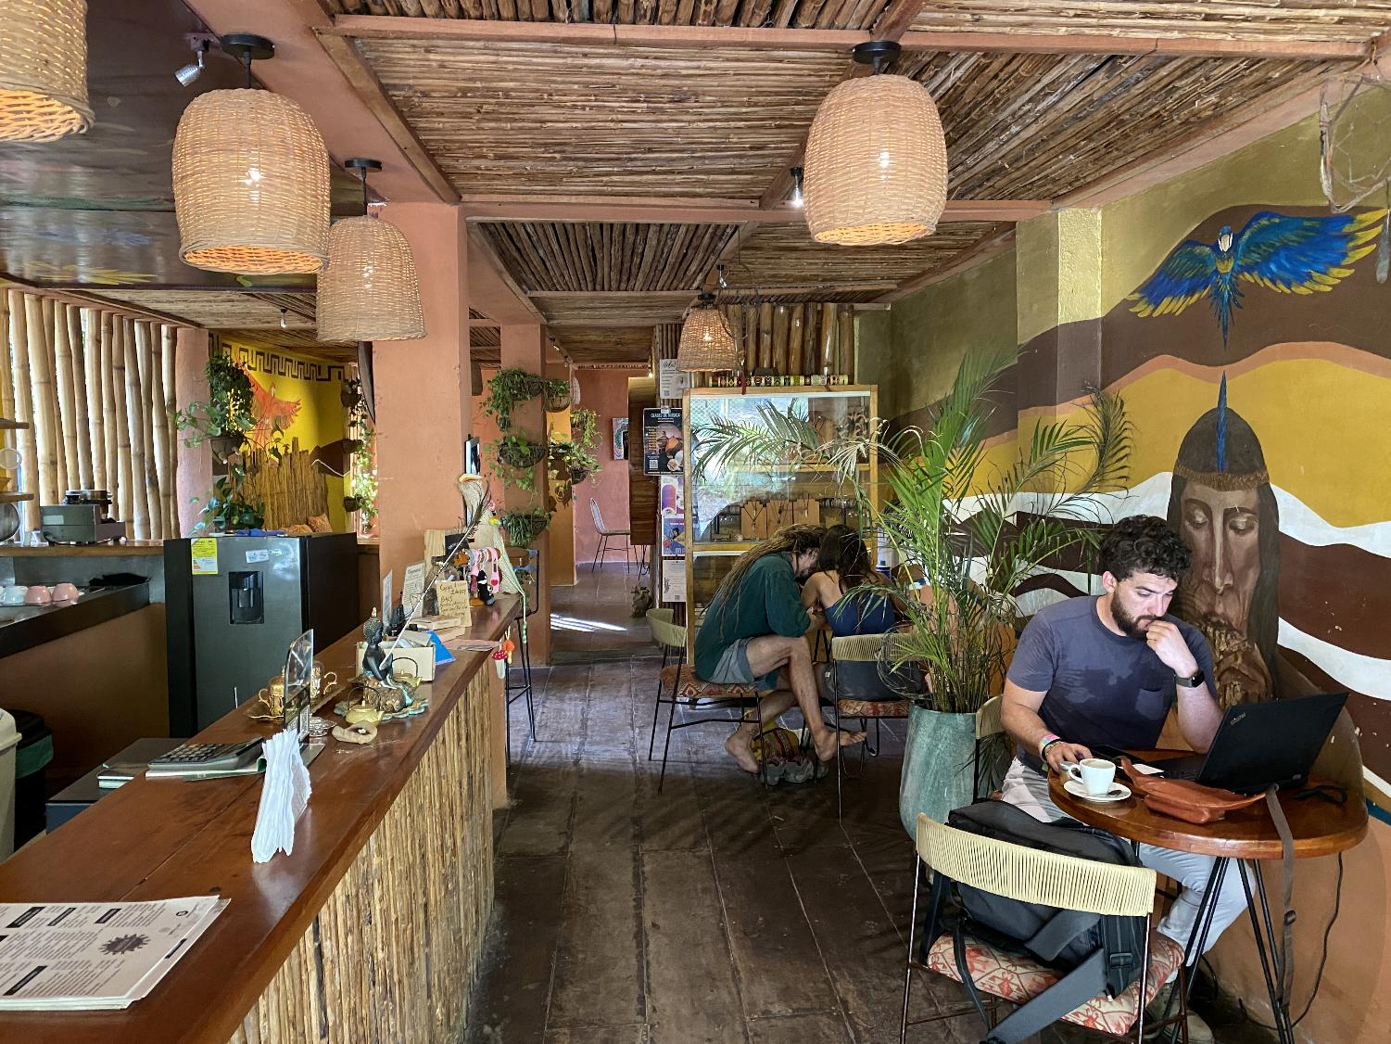
Minca | Waira Café

Slide 32
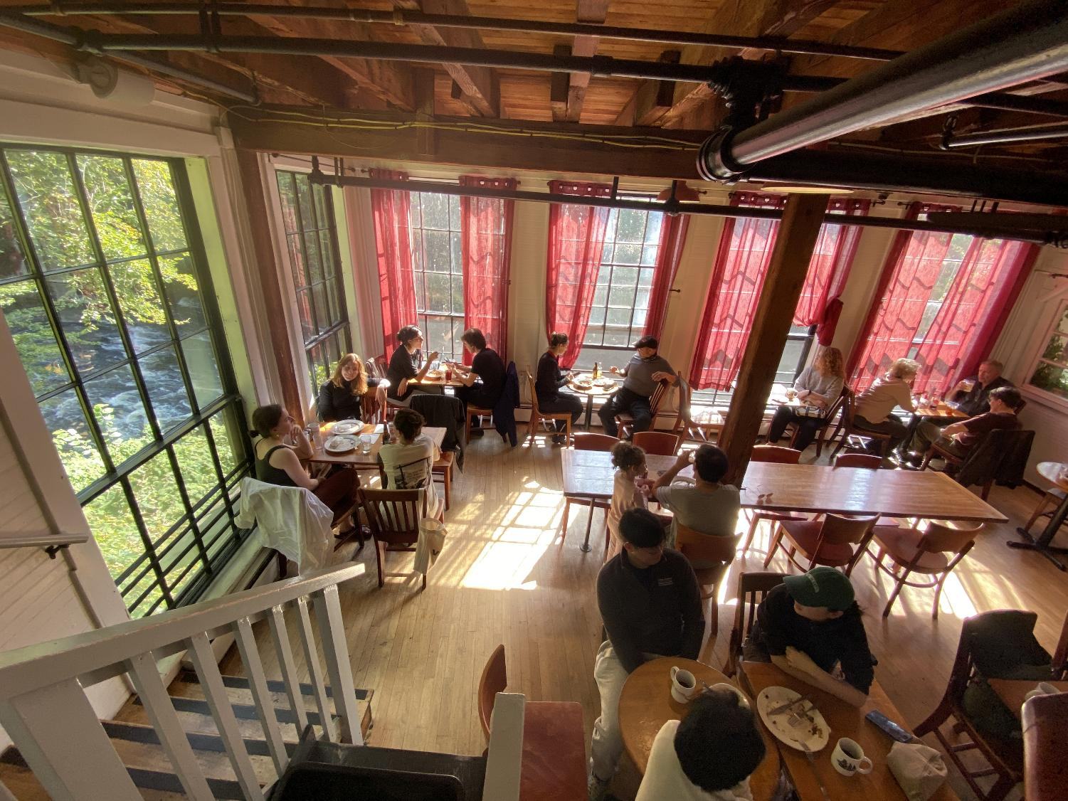
Montague | The Lady Killigrew

Slide 33
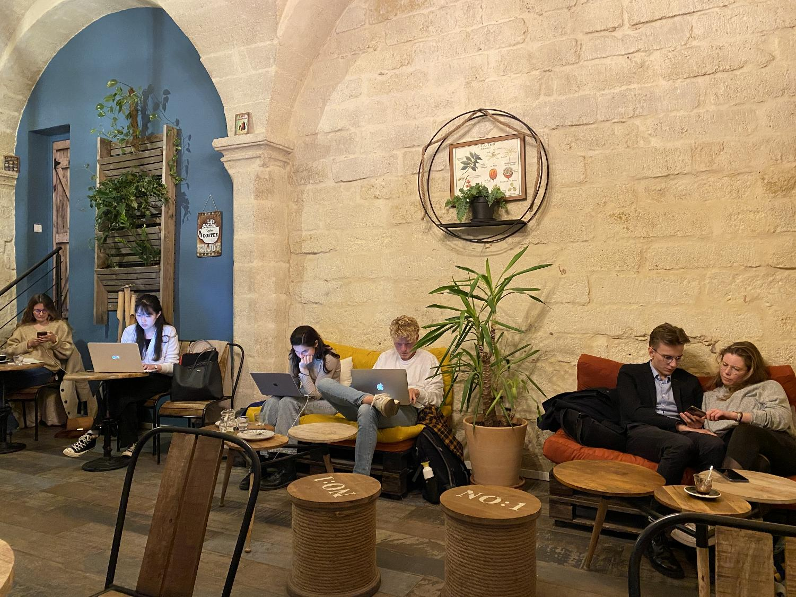
Montpellier | ADN Café

Slide 34
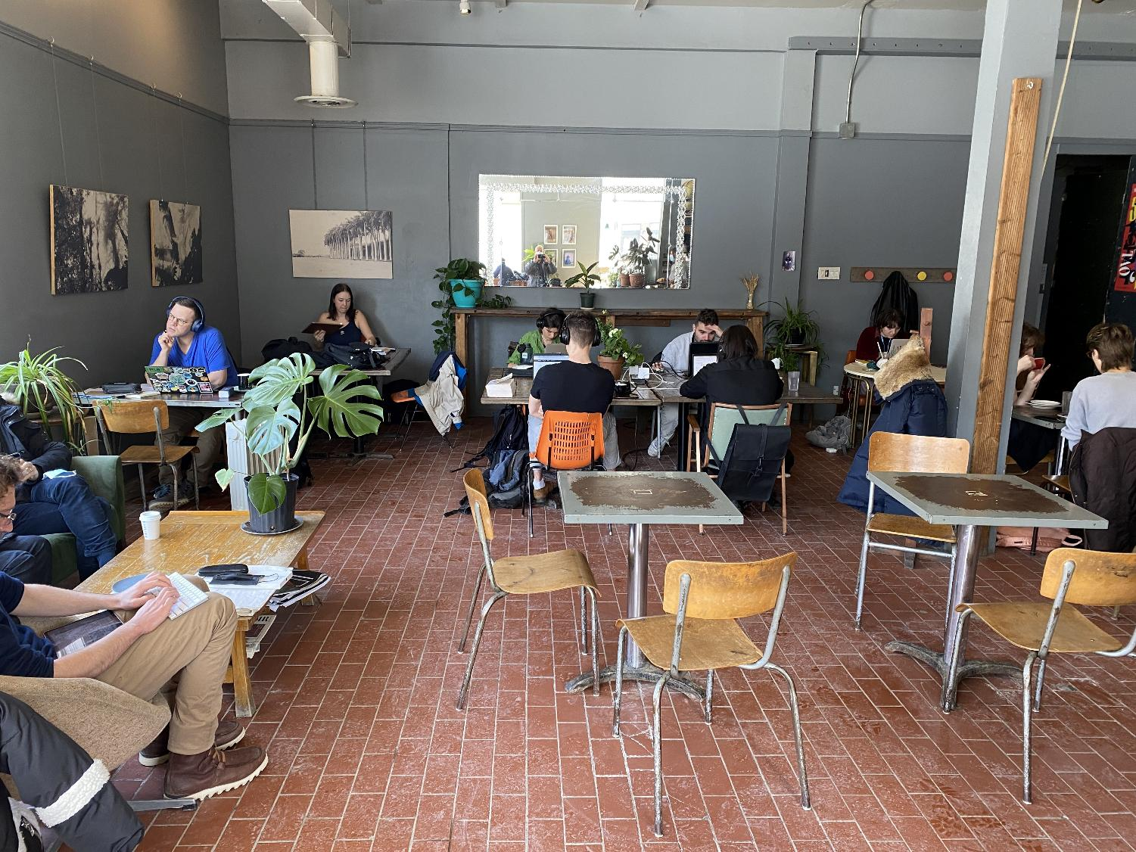
Montreal | Café Replika

Slide 35
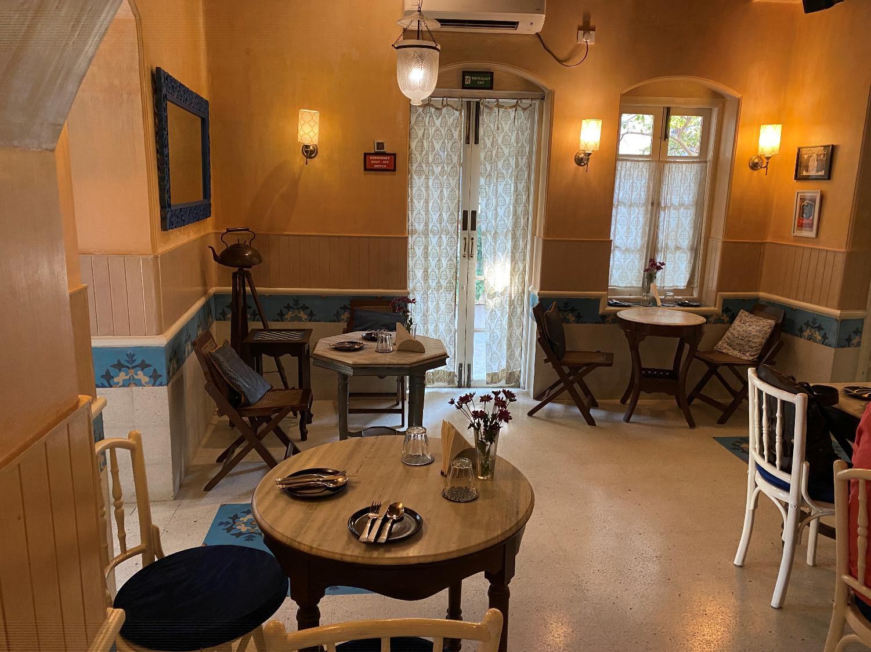
Mumbai | Taj Mahal Tea House

Slide 36
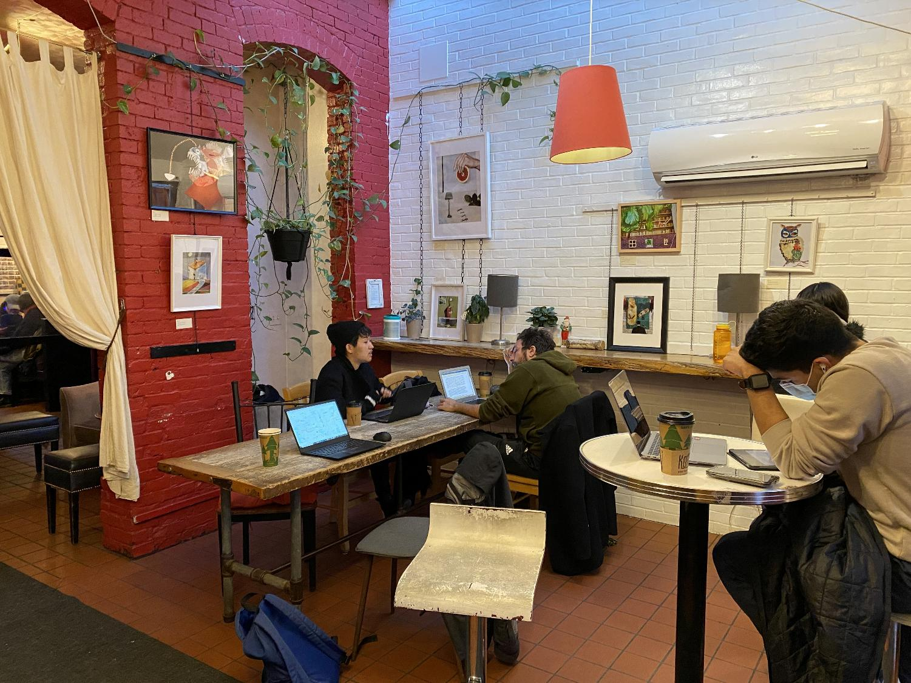
New Haven | Koffee?

Slide 37
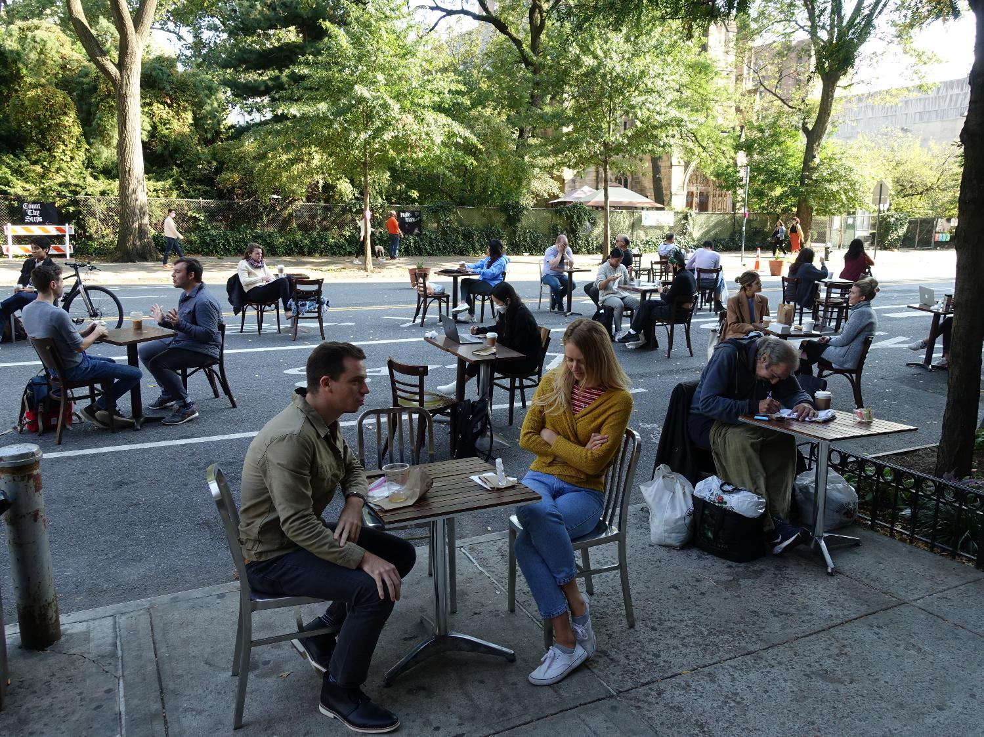
New York | The Hungarian Pastry Shop

Slide 38
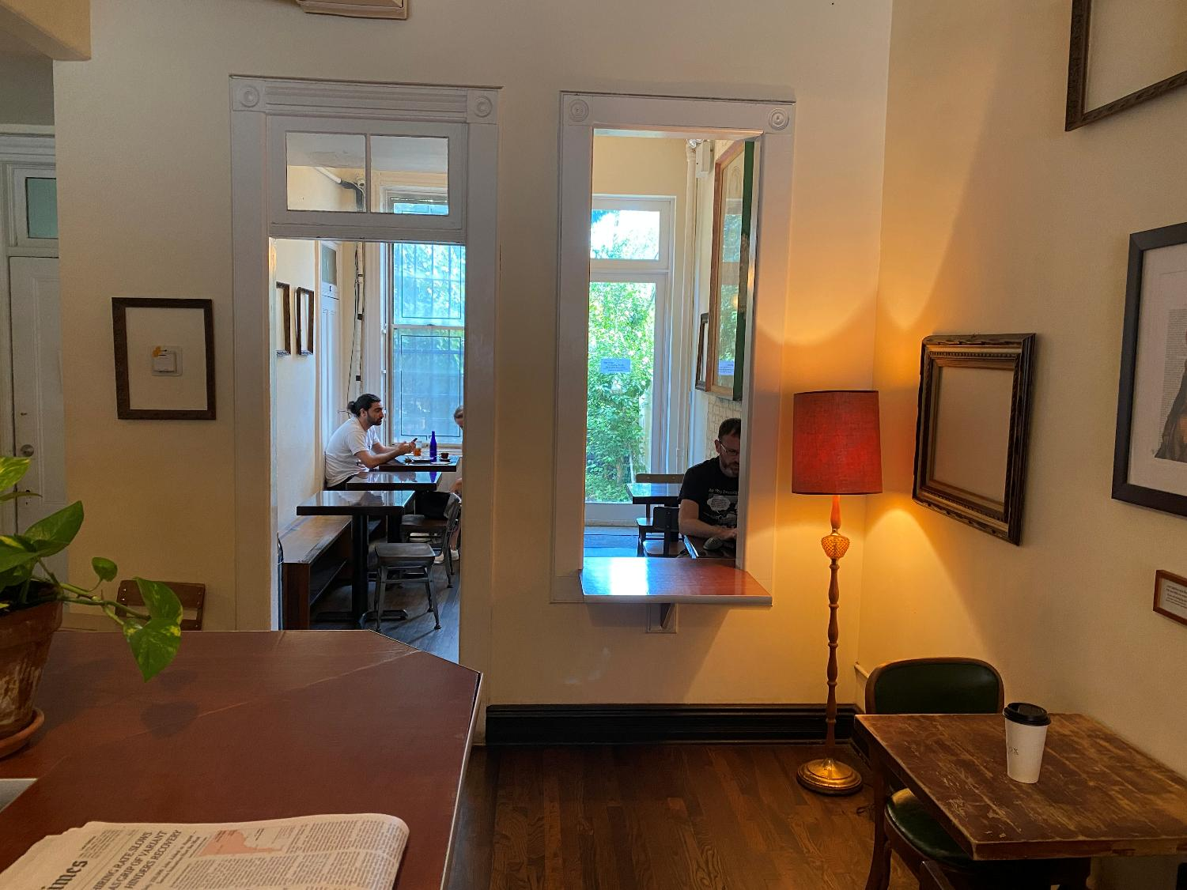
New York | Odd Fox

Slide 39
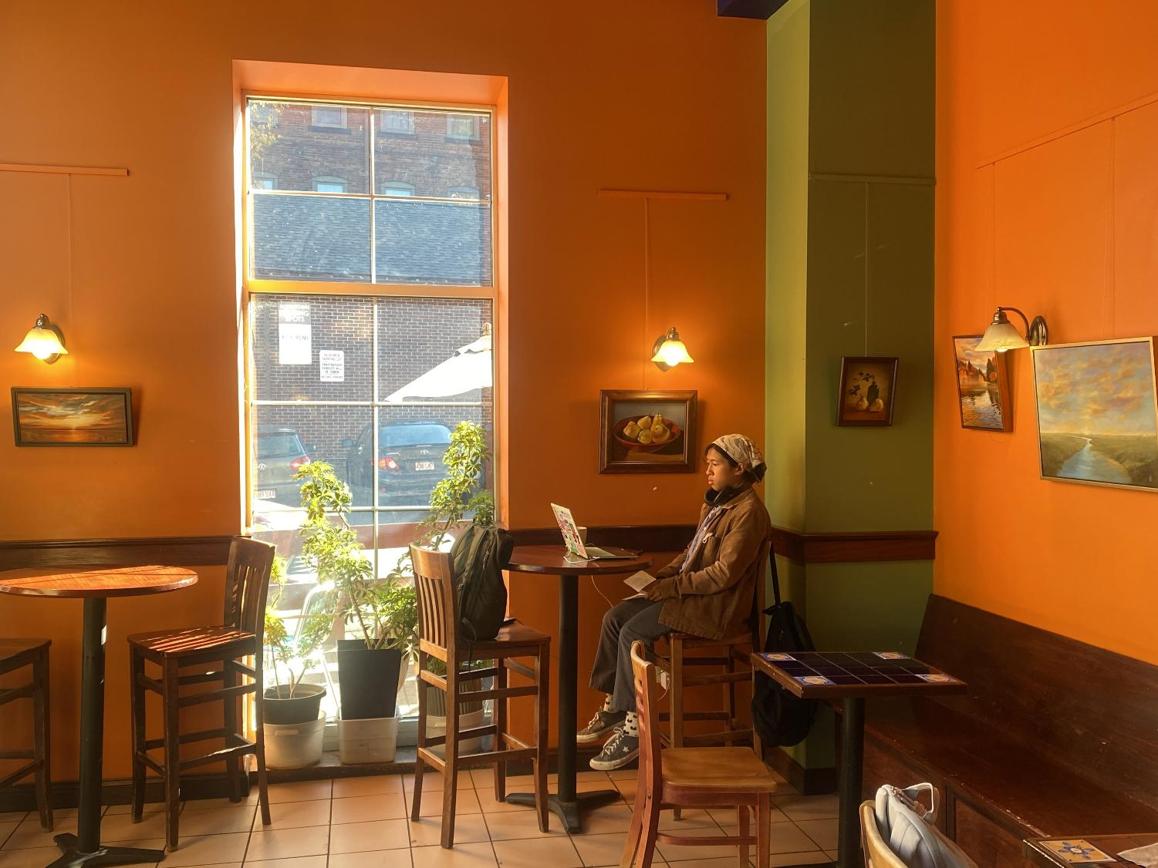
Northampton | Woodstar Cafe

Slide 40
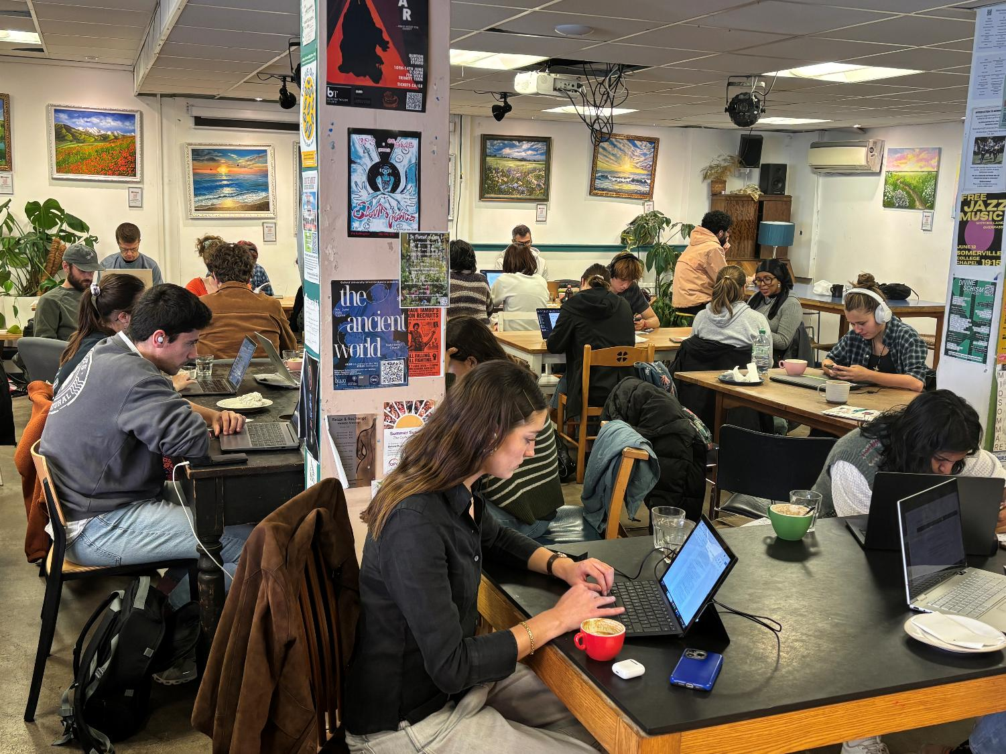
Oxford | Common Ground

Slide 41
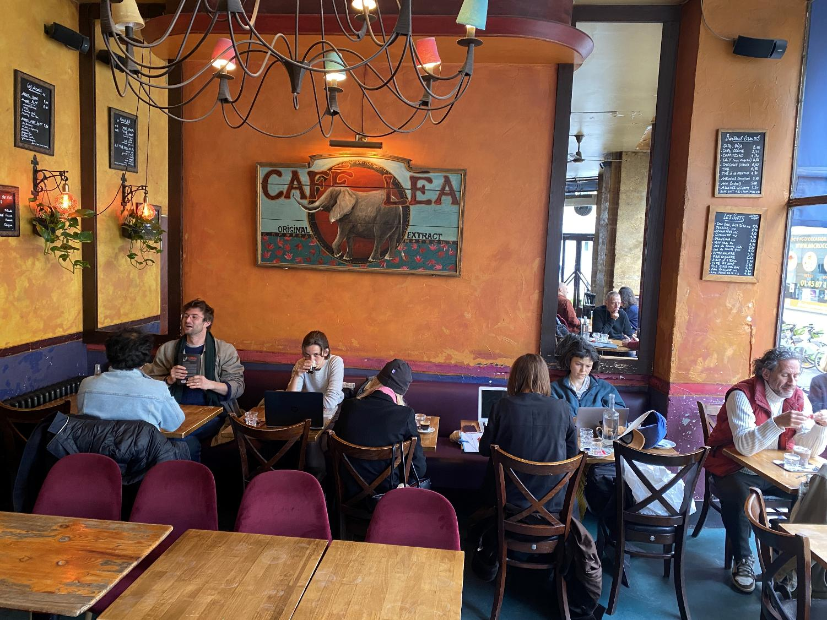
Paris | Café Léa

Slide 42
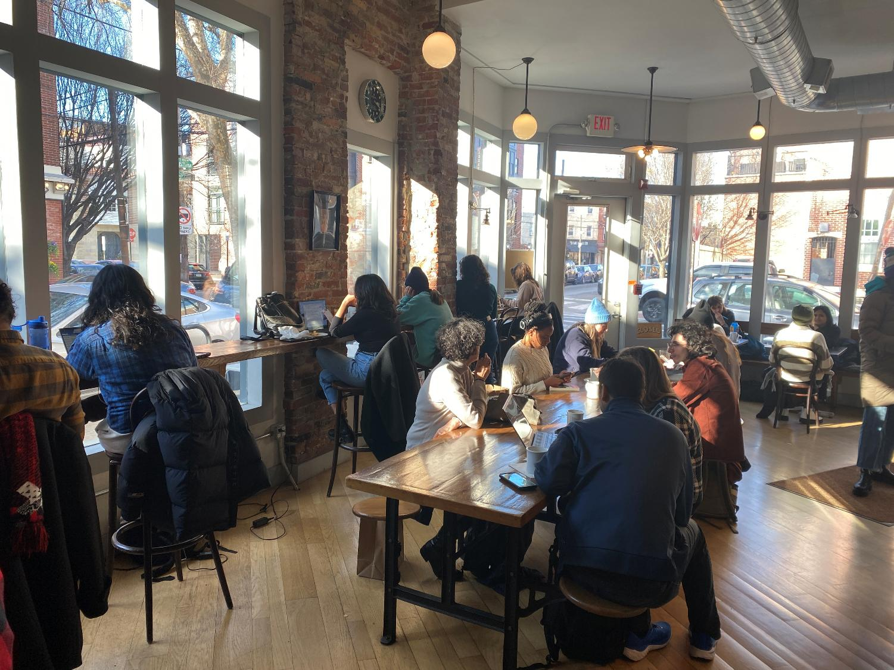
Philadelphia | Shot Tower Coffee

Slide 43
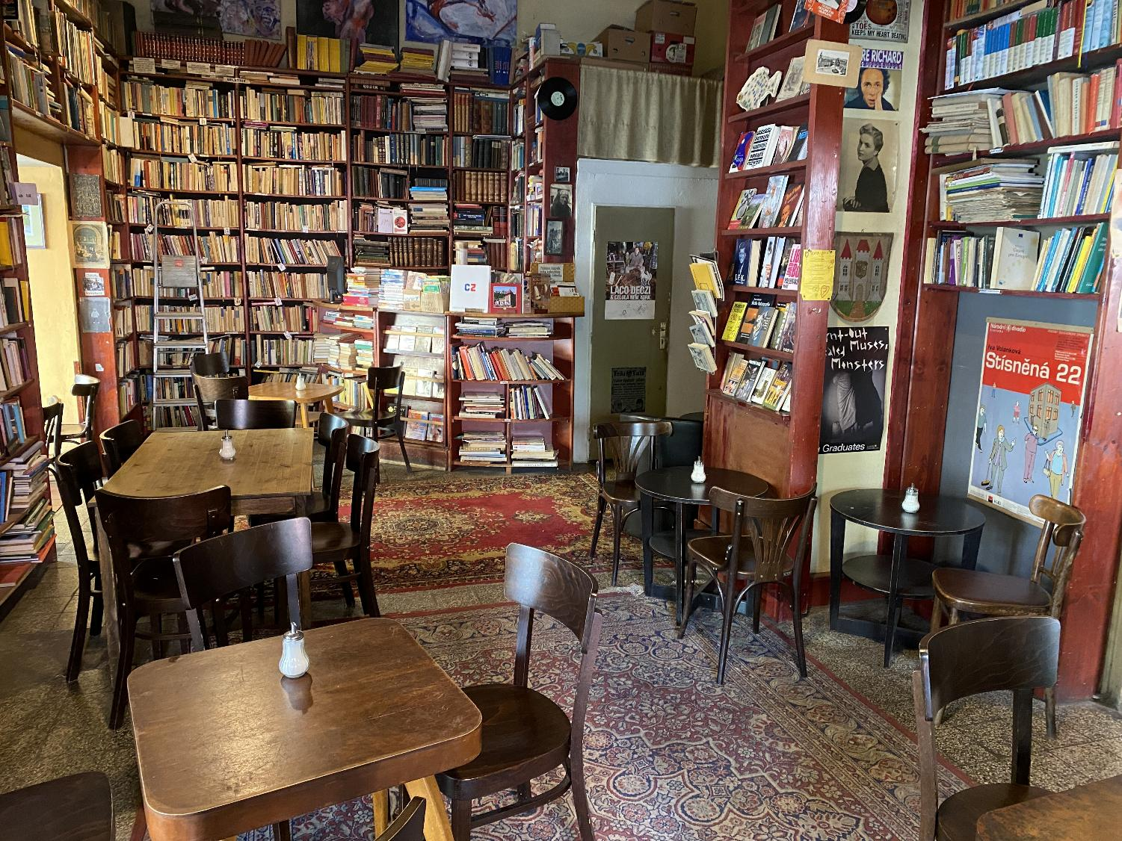
Prague | Ouky Douky Coffee

Slide 44
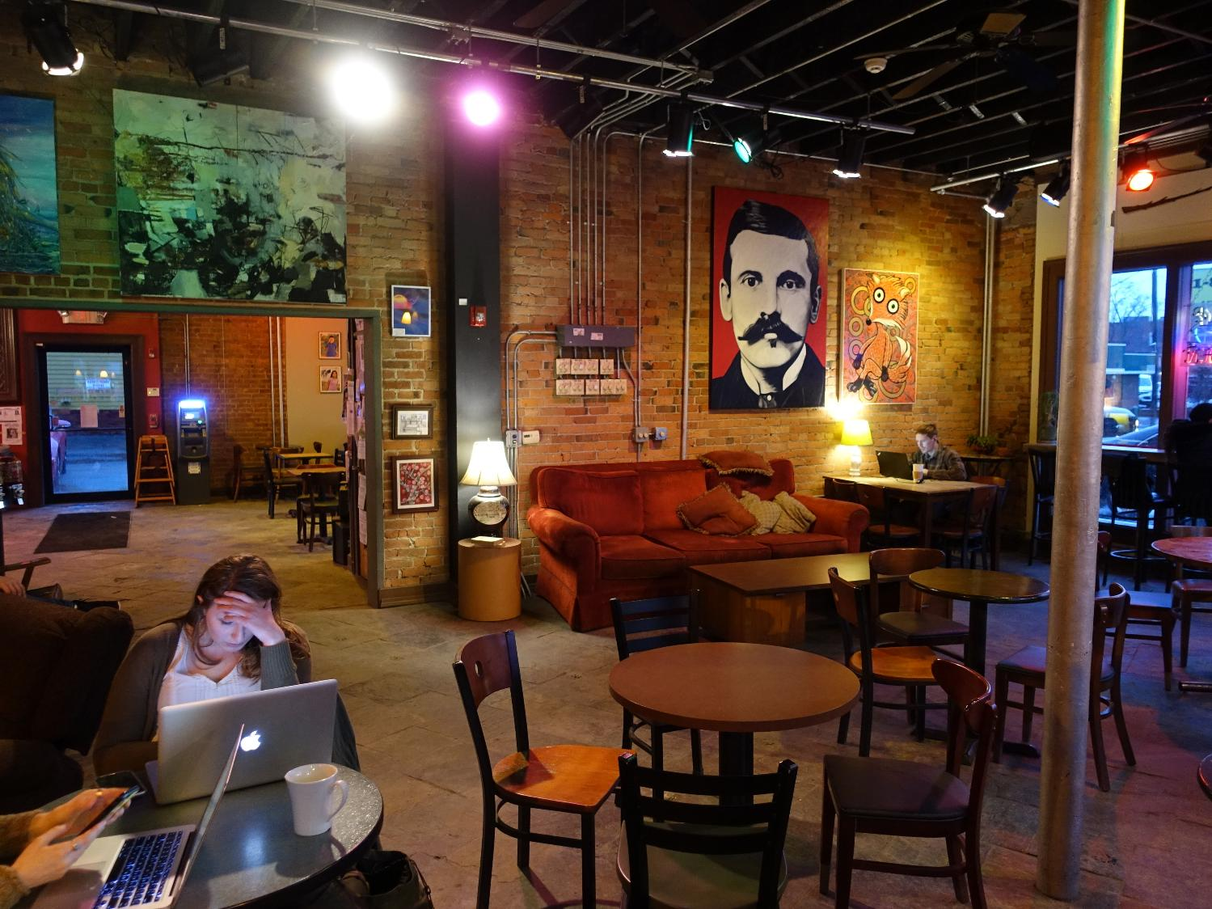
Rochester | Boulder

Slide 45
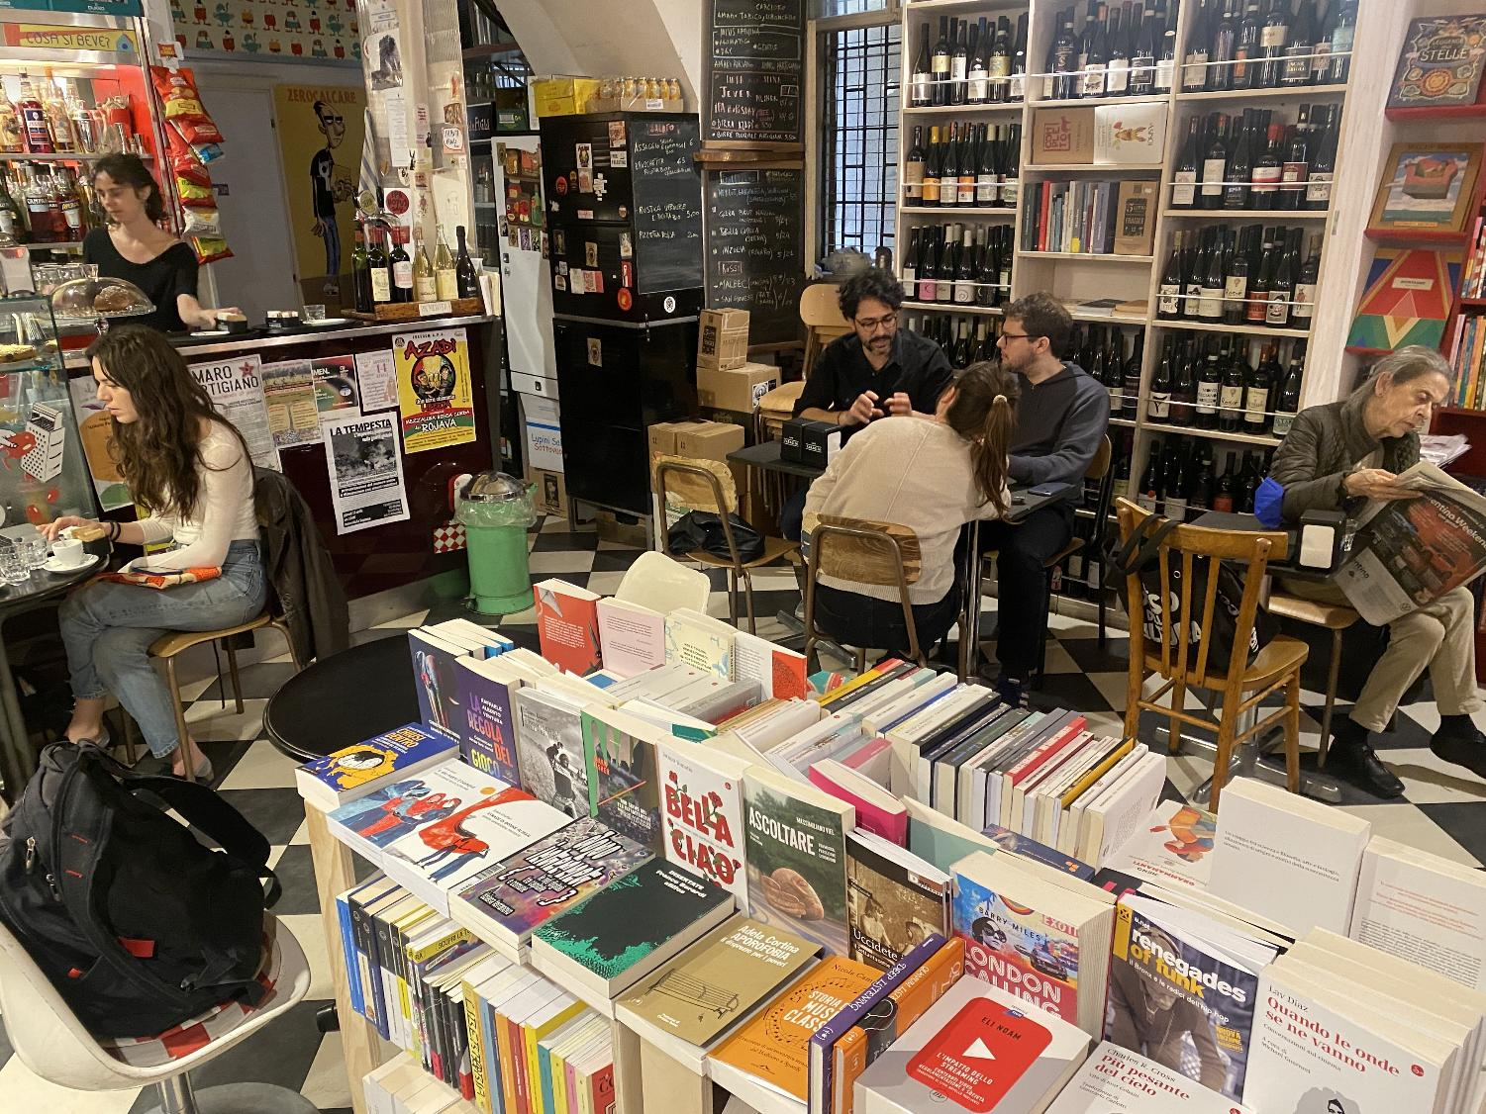
Rome | Caffè Letterario

Slide 46
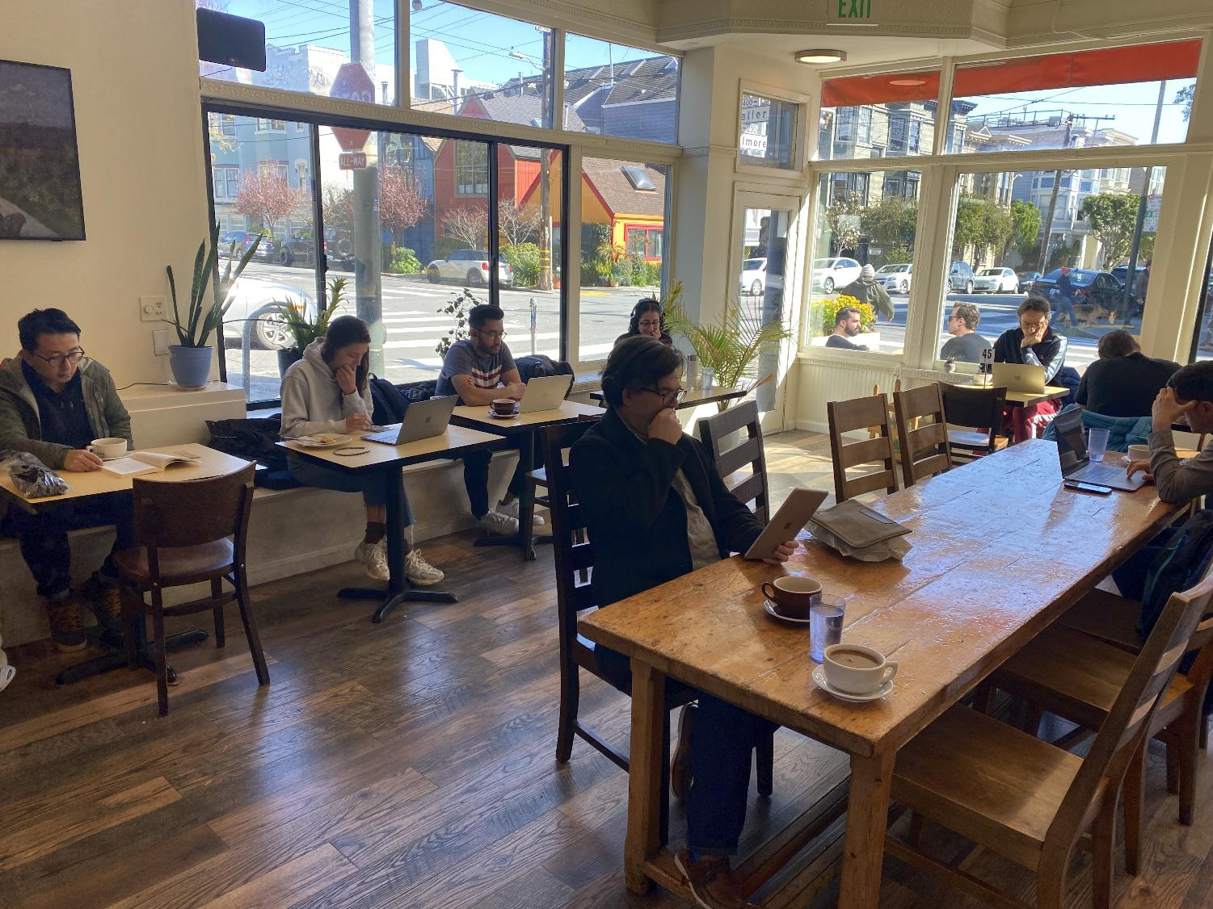
San Francisco | Le Cafe du Soleil

Slide 47
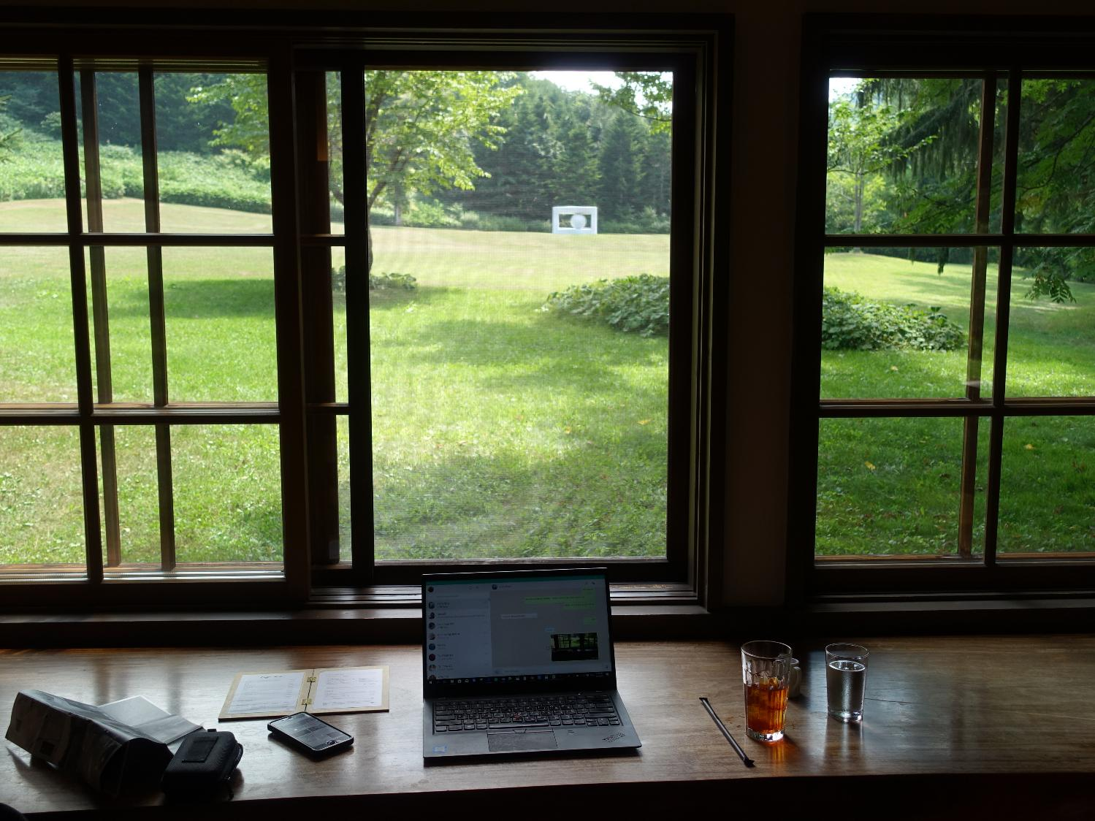
Sapporo (Bibai) | Caffe Arte

Slide 48
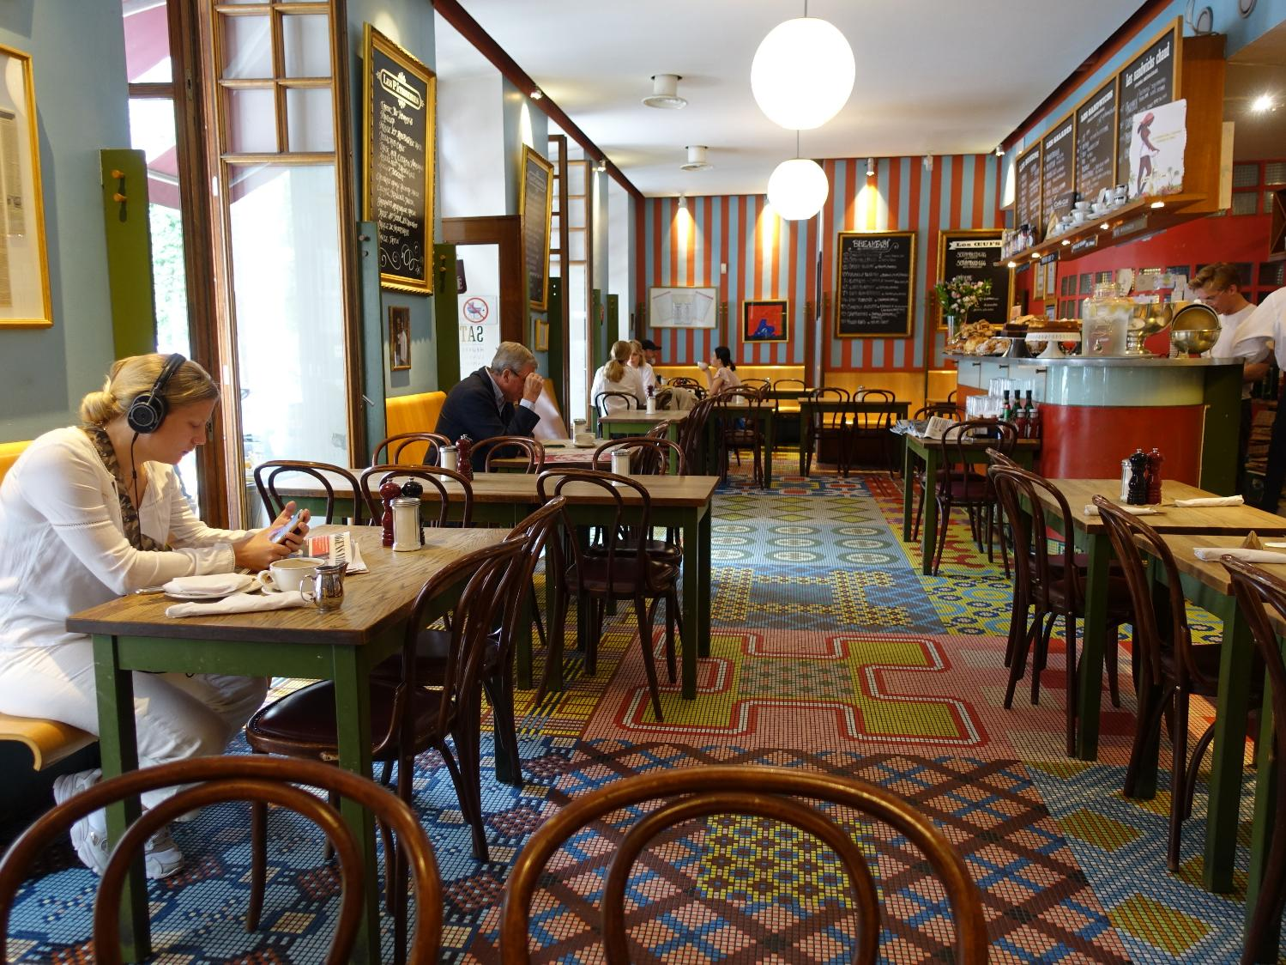
Stockholm | Café Saturnus

Slide 49
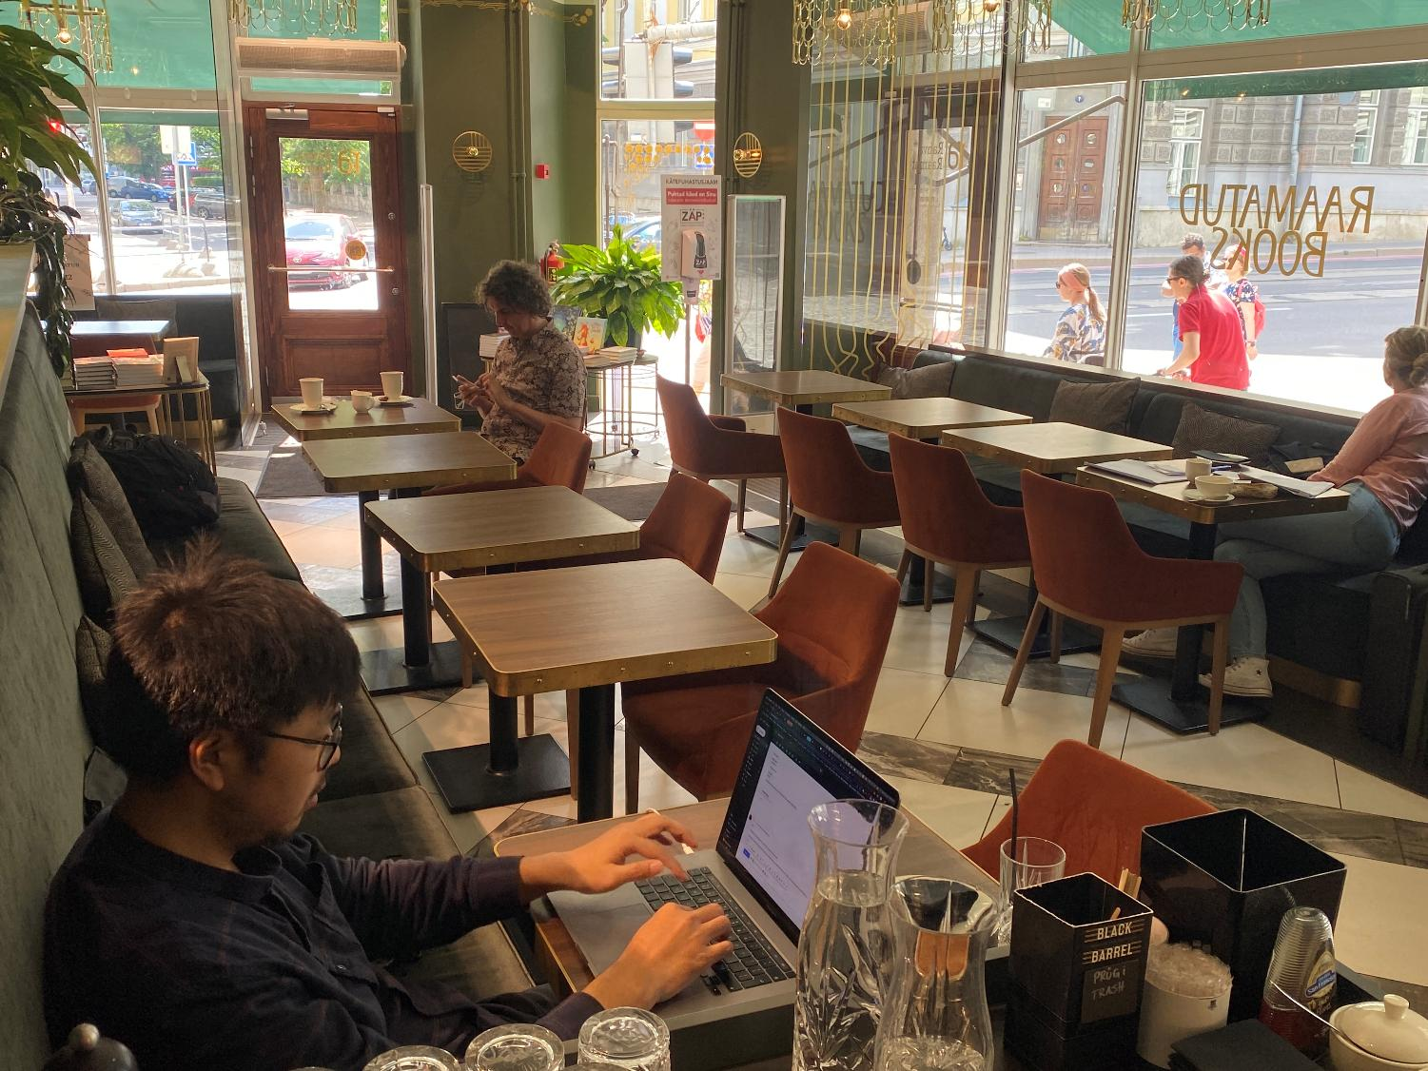
Tallinn | Vanalinna Rahva Raamat

Slide 50
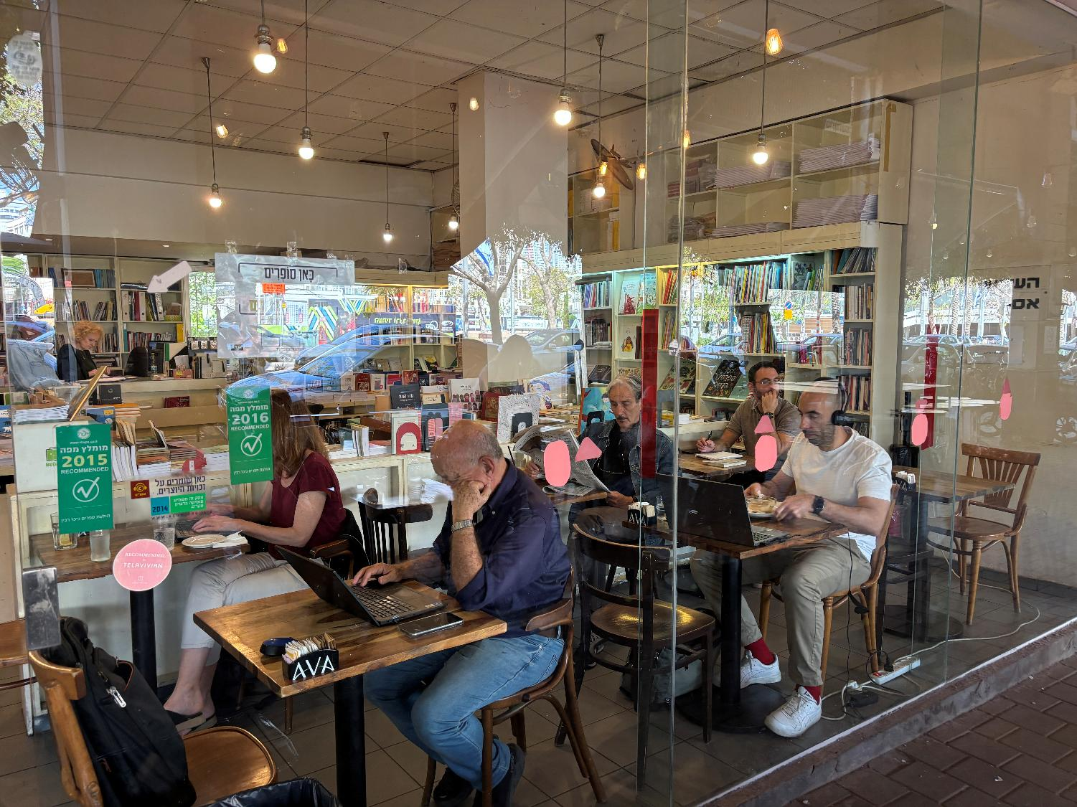
Tel Aviv | Tolaat Sfarim

Slide 51

Thessaloniki | Café Palermo

Slide 52

Tucson | Exo Roast Co

Slide 53

Venice | Sullaluna Libreria & Bistrot

Slide 54

Vienna | das café

Slide 55

Washington | Tryst

