Slide 1
Café Poster 2019
“Coffee places where you can think!”
Ariel Rubinstein

Slide 2
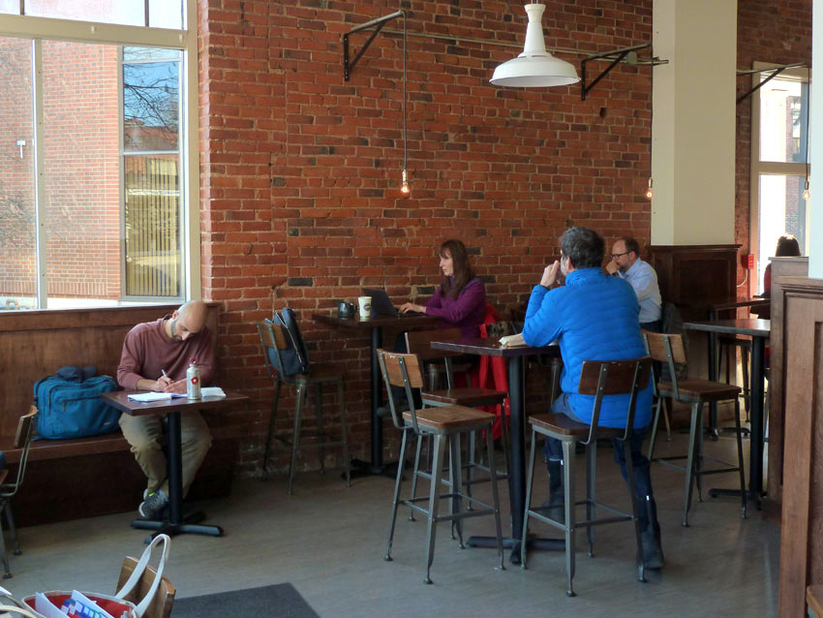
Amherst | Amherst Coffee

Slide 3
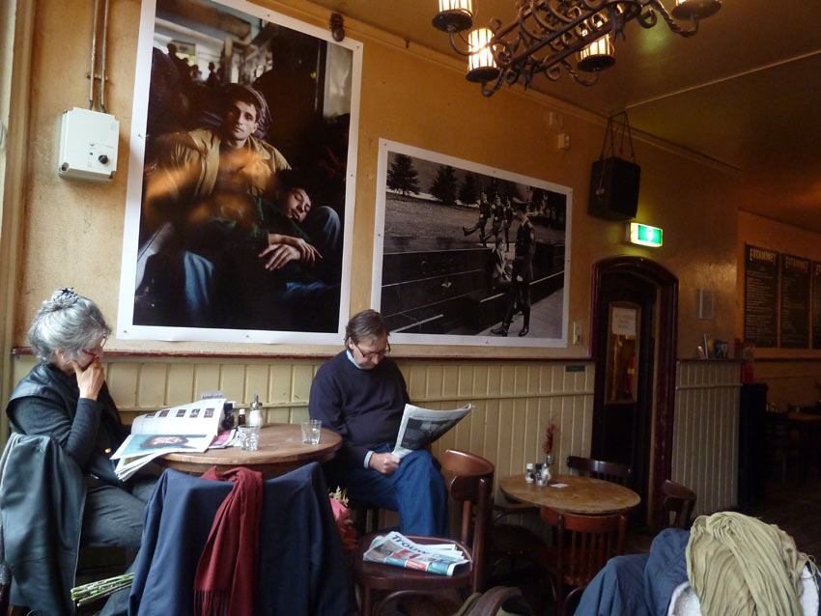
Amsterdam | Café De Engelbewaarder

Slide 4
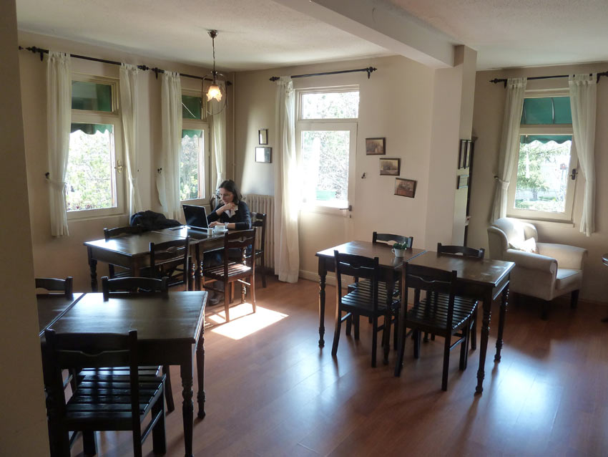
Ankara | Turta Home Cafe

Slide 5
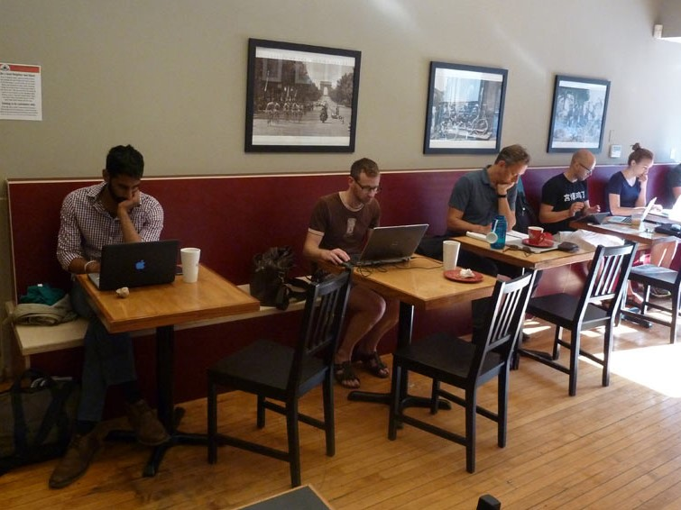
Ann Arbor | Mighty Good Coffee

Slide 6
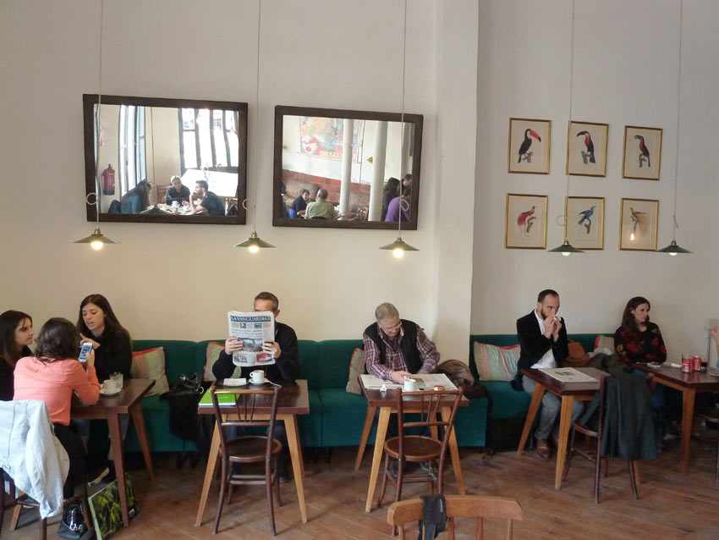
Barcelona | Granja Petitbo

Slide 7
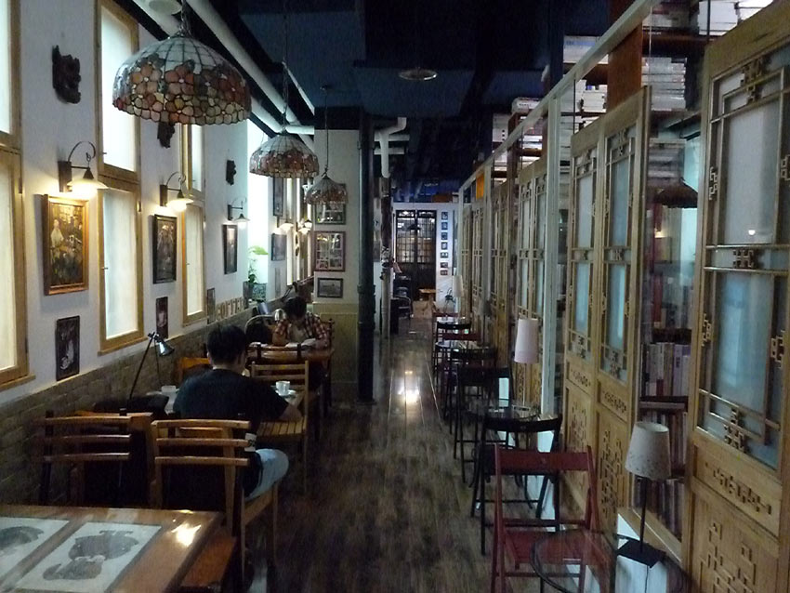
Beijing | Wansheng Bookstore

Slide 8
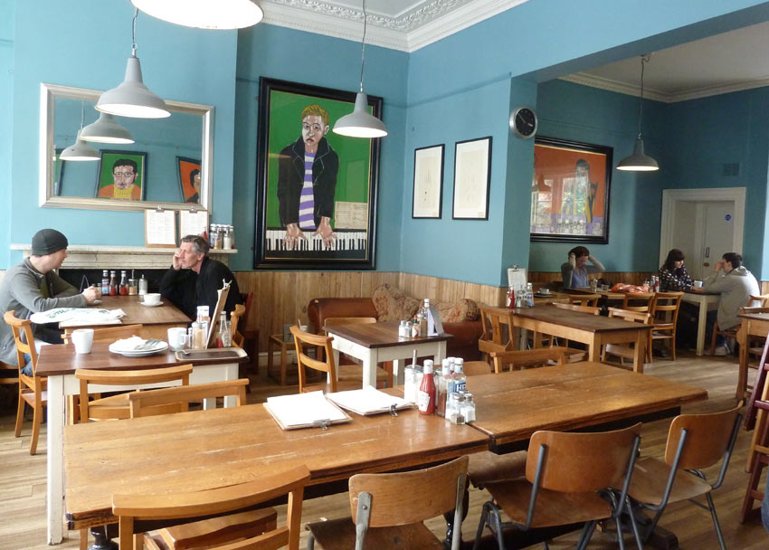
Bristol | Boston Tea Party

Slide 9
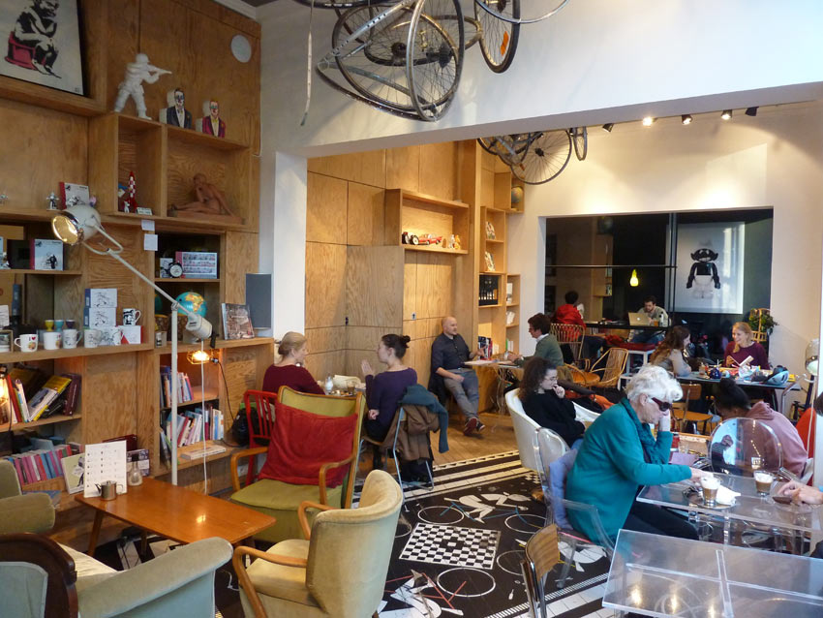
Brussels | Leopold Café Presse

Slide 10
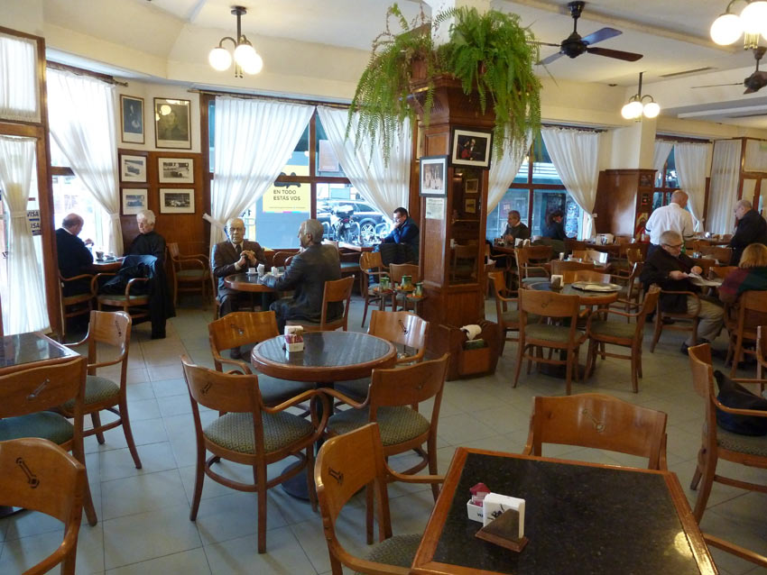
Buenos Aires | La Biela

Slide 11
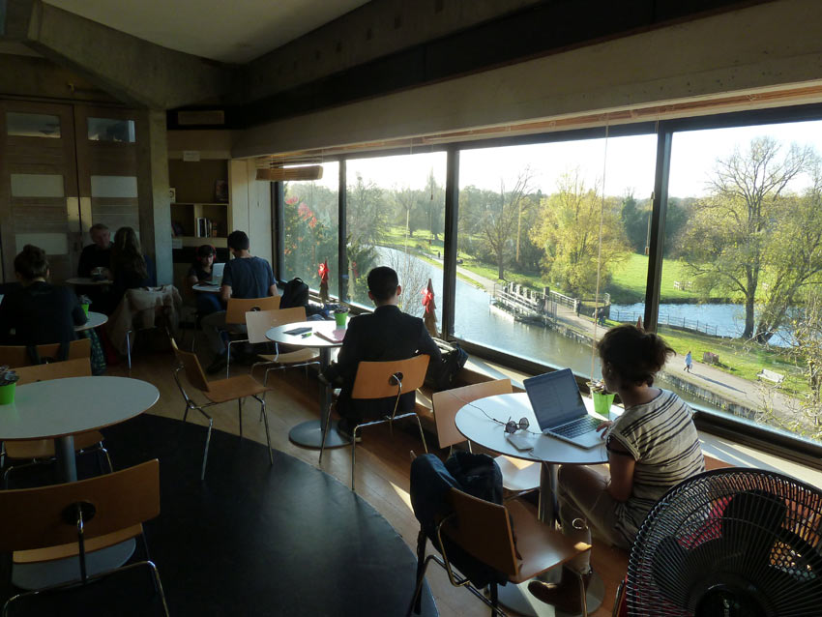
Cambridge (UK) | Grads cafe

Slide 12
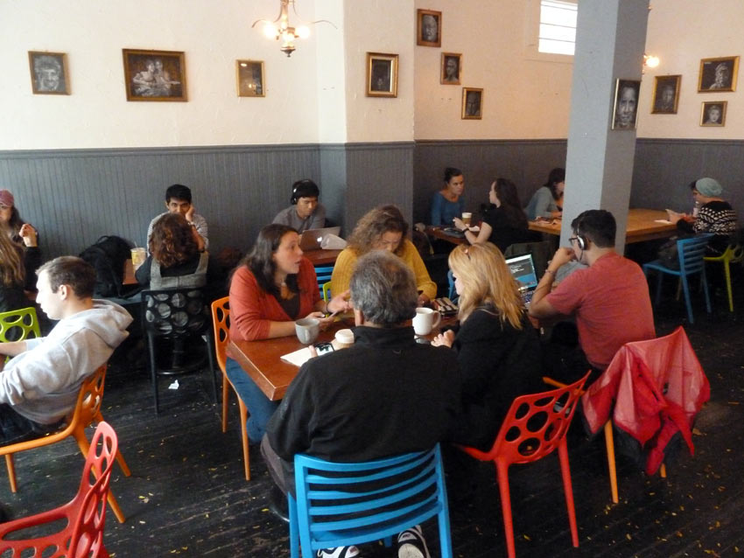
Cambridge (USA) | Petsi Pies

Slide 13
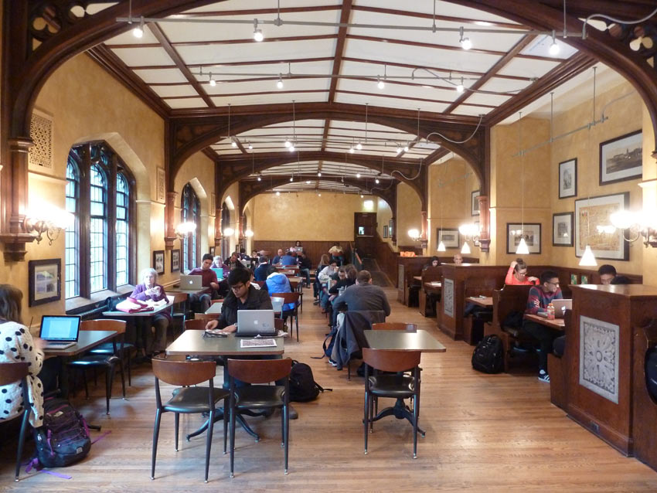
Chicago | The Reynolds Club

Slide 14
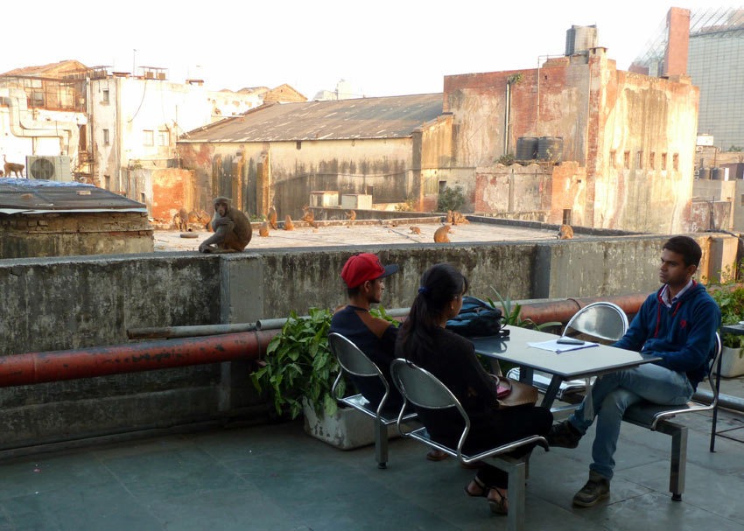
Delhi | Indian Coffee House

Slide 15
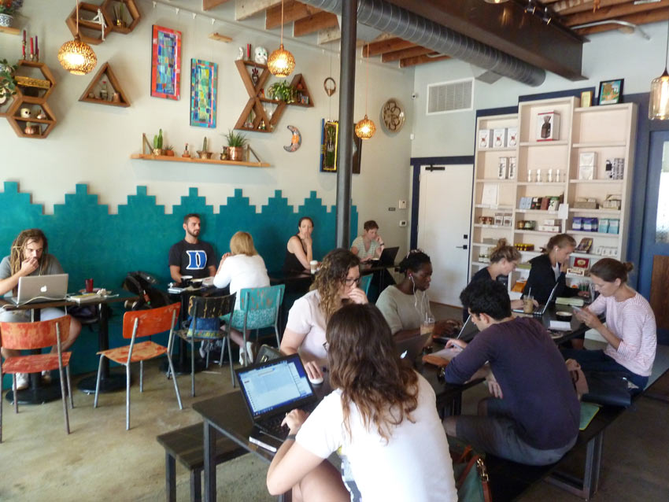
Durham | Cocoa Cinnamon

Slide 16
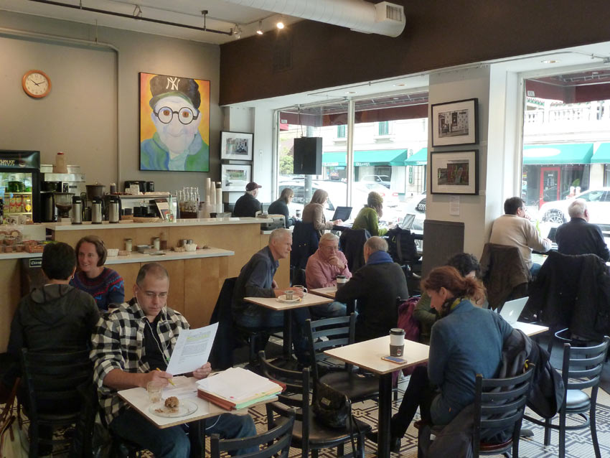
Evanston |Brothers K Coffeehouse

Slide 17
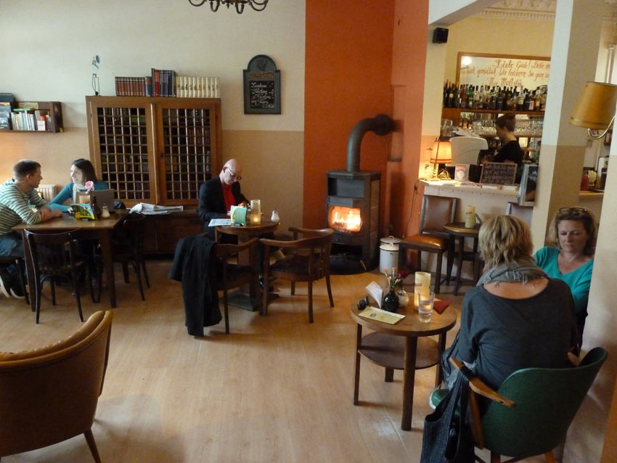
Hamburg | Mathilde

Slide 18
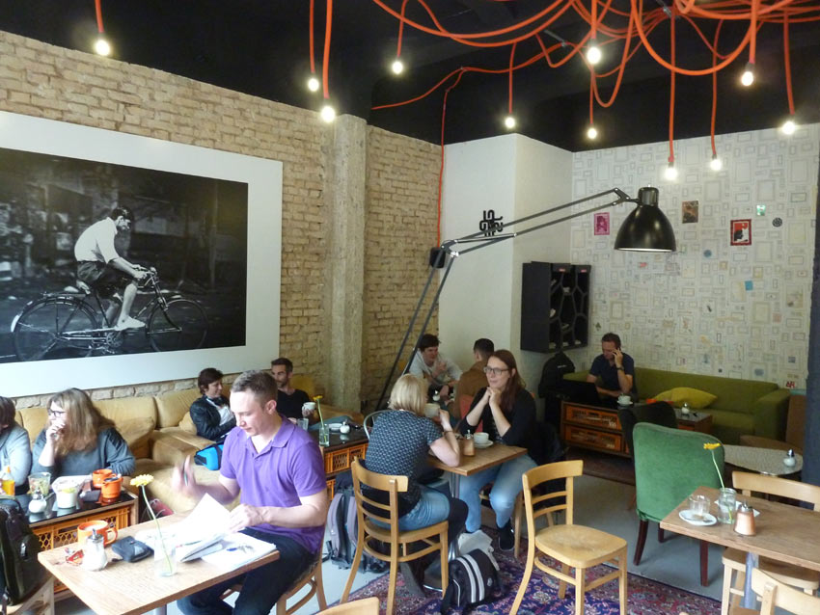
Heidelberg | Mildner's

Slide 19
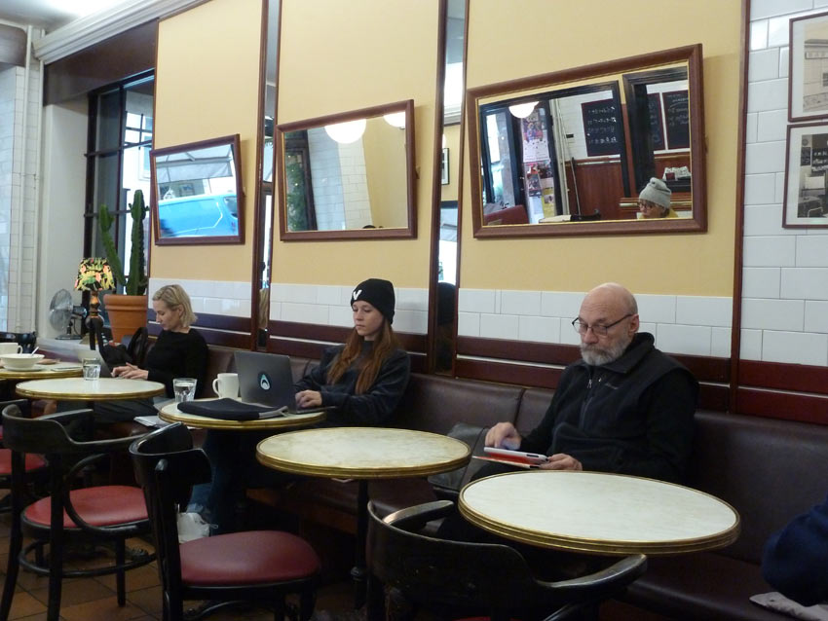
Helsinki | Café Succès

Slide 20
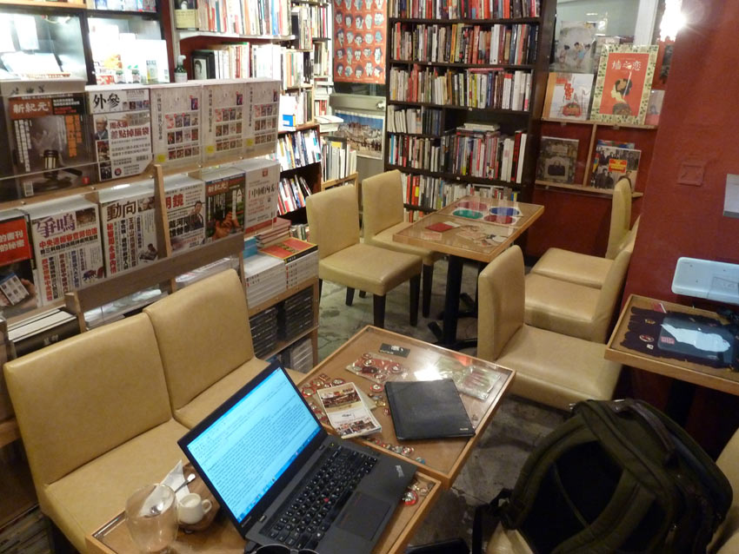
Hong Kong | People Book Cafe

Slide 21
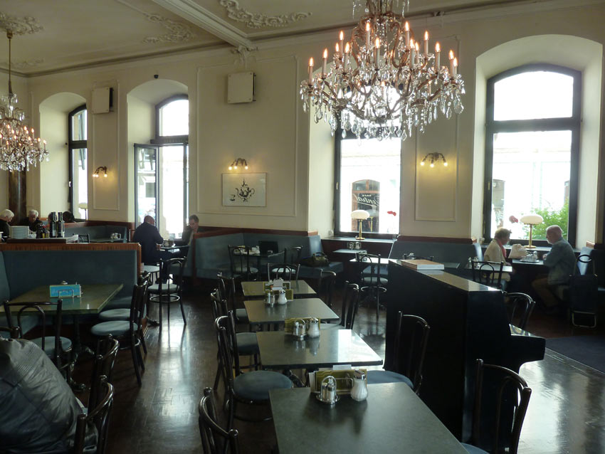
Innsbruck | Cafe Central

Slide 22
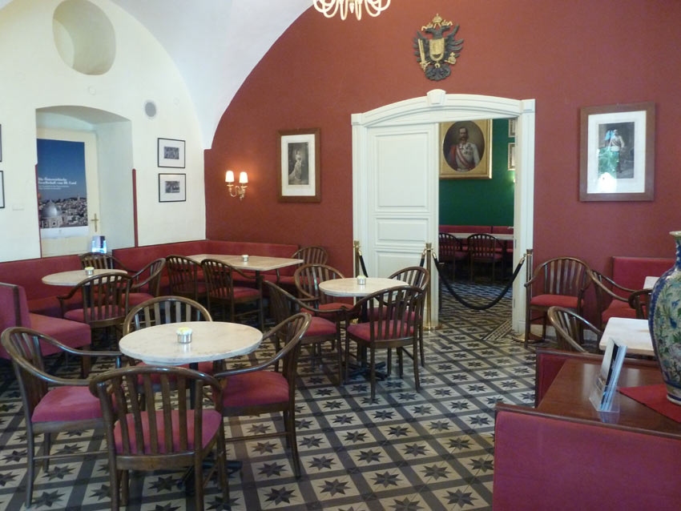
Jerusalem | Austrian Hospice

Slide 23
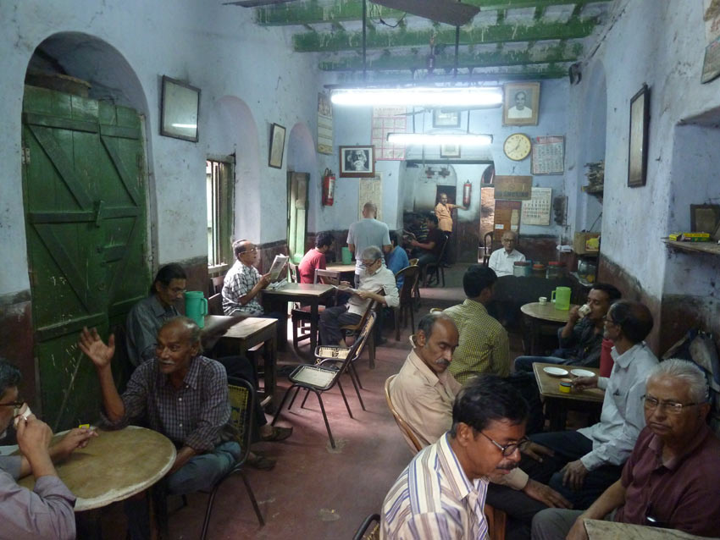
Kolkata | Favourite Cabin

Slide 24
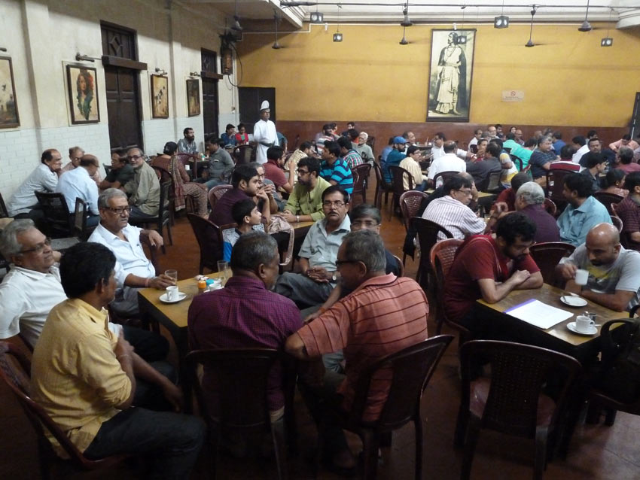
Kolkata | Indian Coffee House

Slide 25
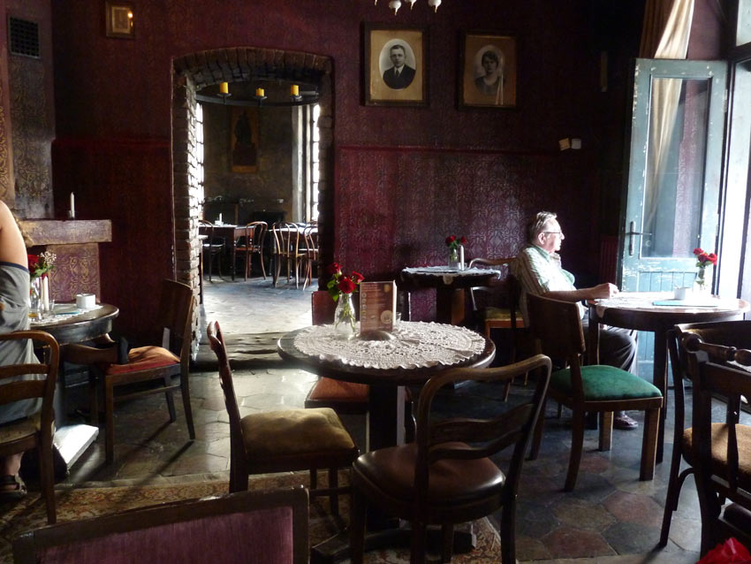
Krakow | Alchemia

Slide 26
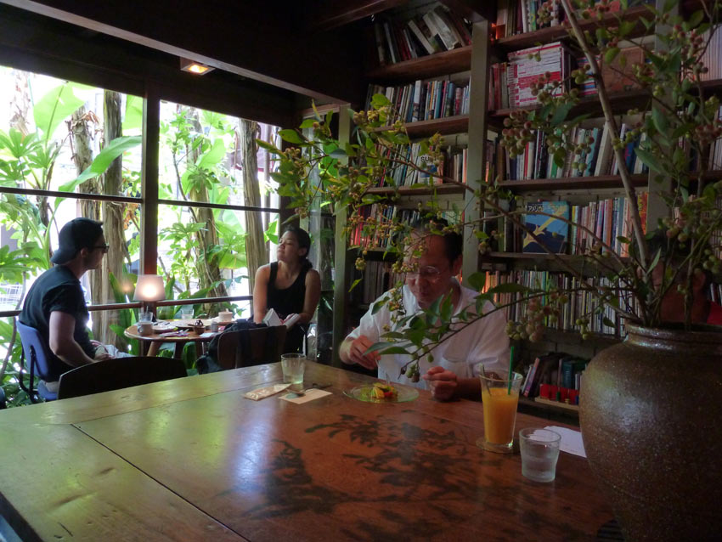
Kyoto | Cafe Bibliotec Hello!

Slide 27
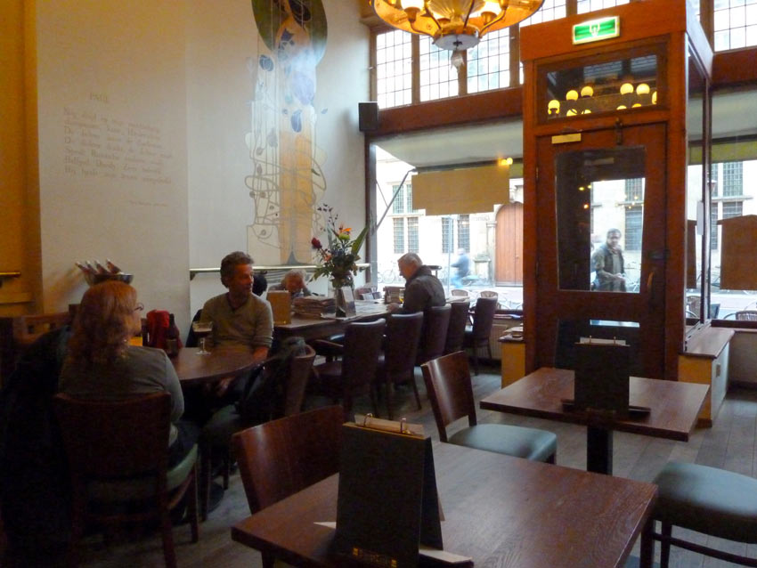
Leiden | BurgerZaken

Slide 28
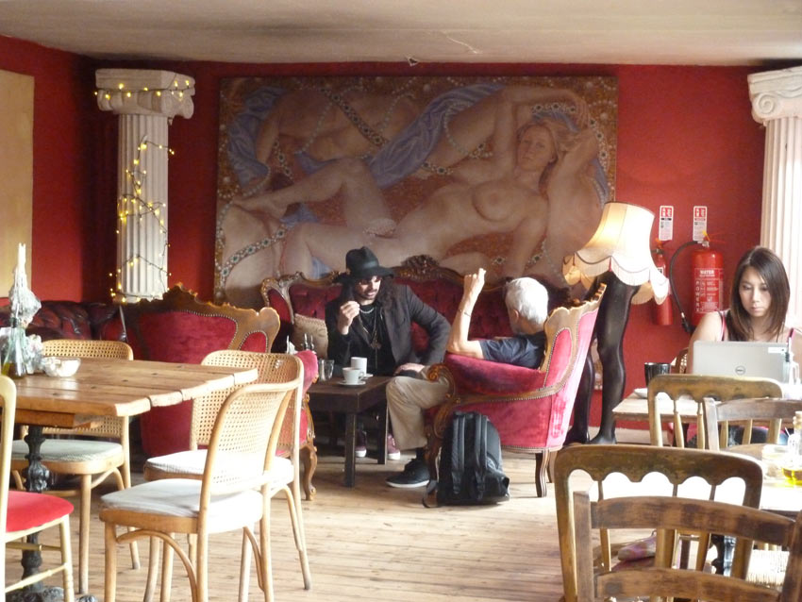
London | Candid Cafe

Slide 29
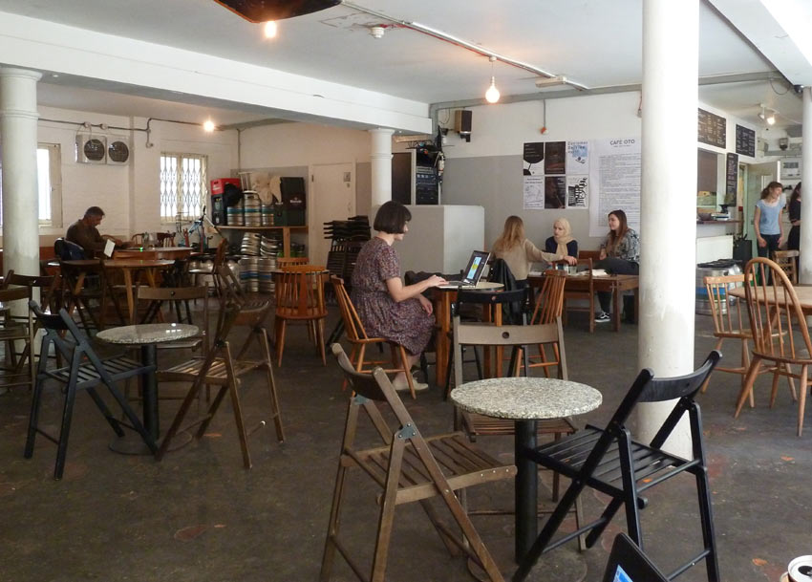
London | Café OTO

Slide 30
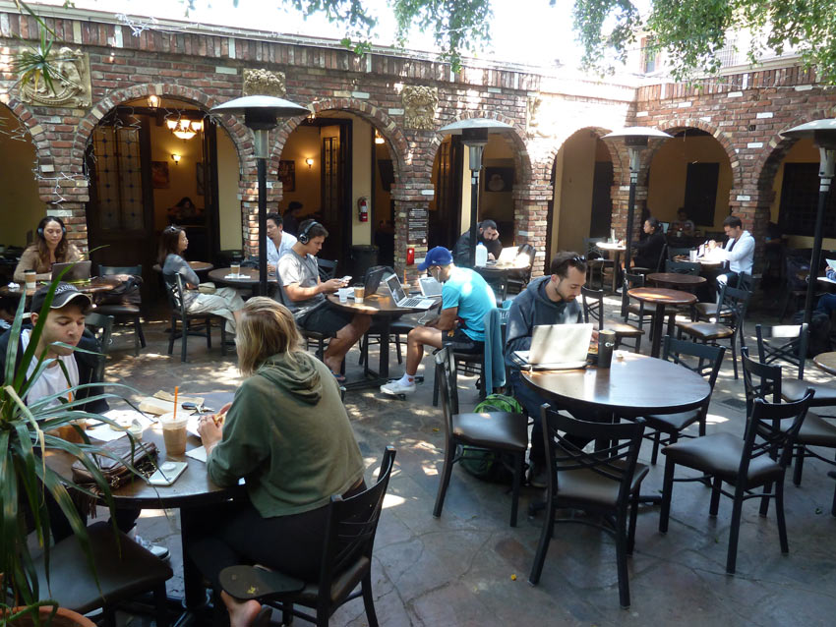
Los Angeles | Coffee Connection

Slide 31
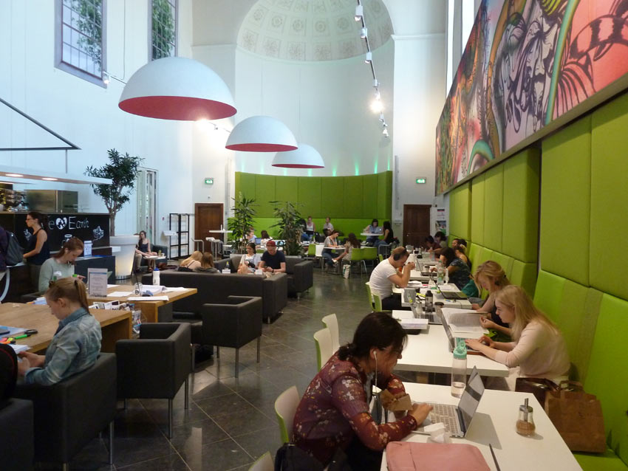
Maastricht | Coffeelovers Universiteit Maastricht

Slide 32
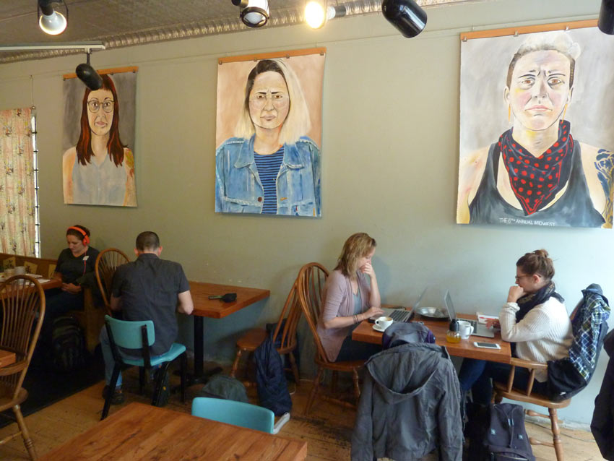
Madison | Johnson

Slide 33
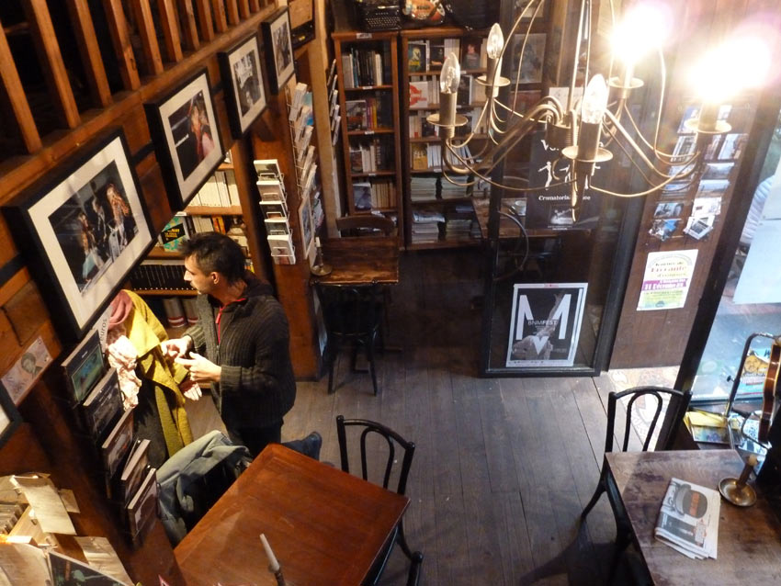
Marseille | Cup of Tea

Slide 34
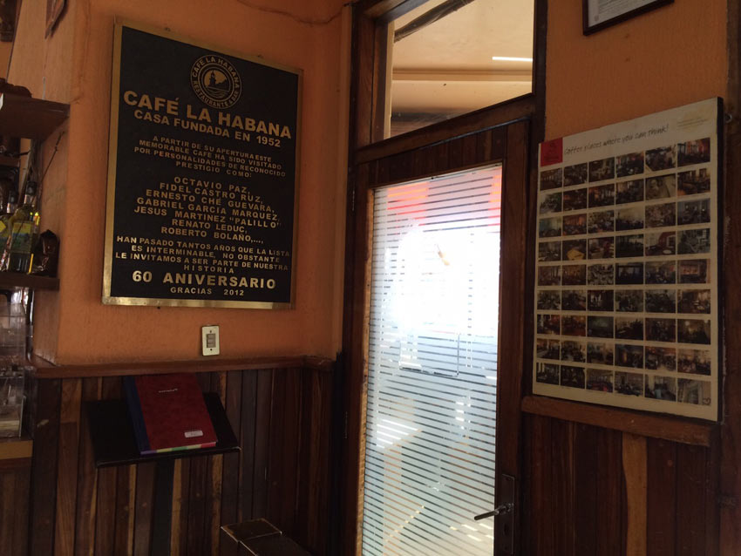
Mexico | Café La Habana

Slide 35
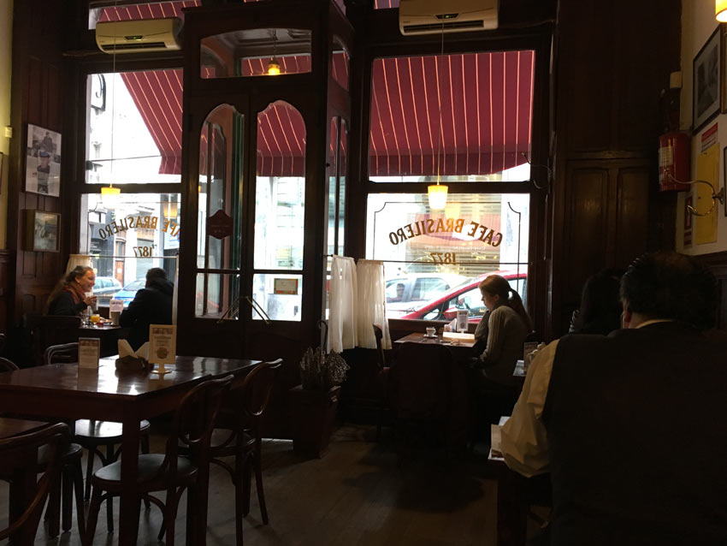
Montevideo | Café Brasilero

Slide 36
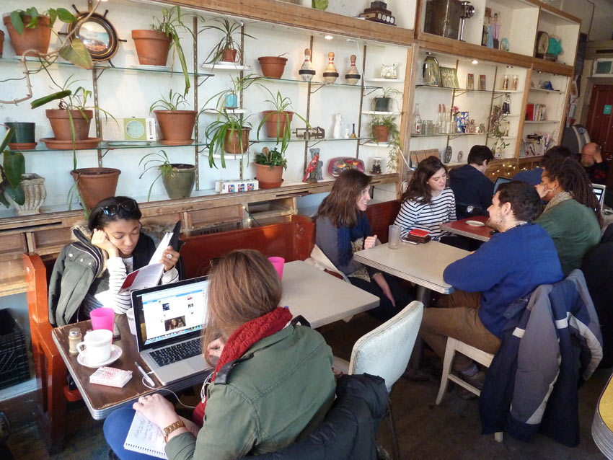
Montréal | Le Cagibi

Slide 37
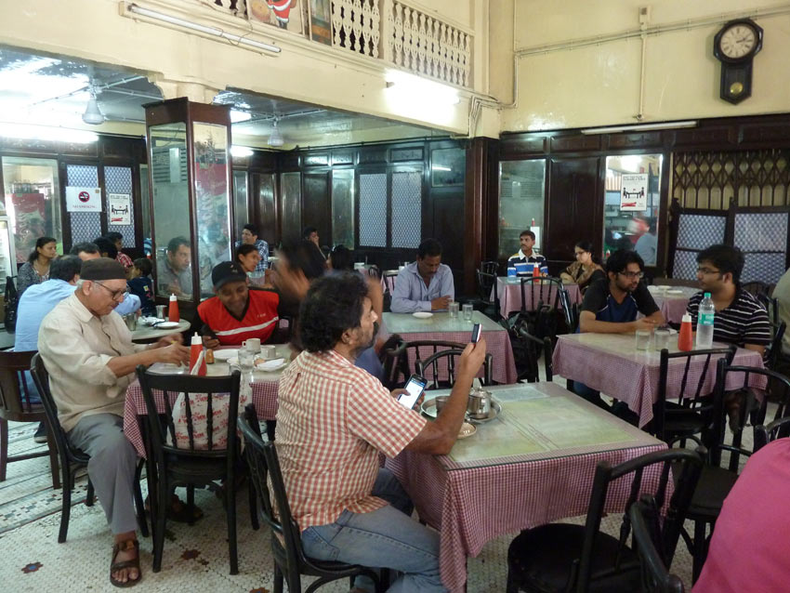
Mumbai | Kyani & Co.

Slide 38
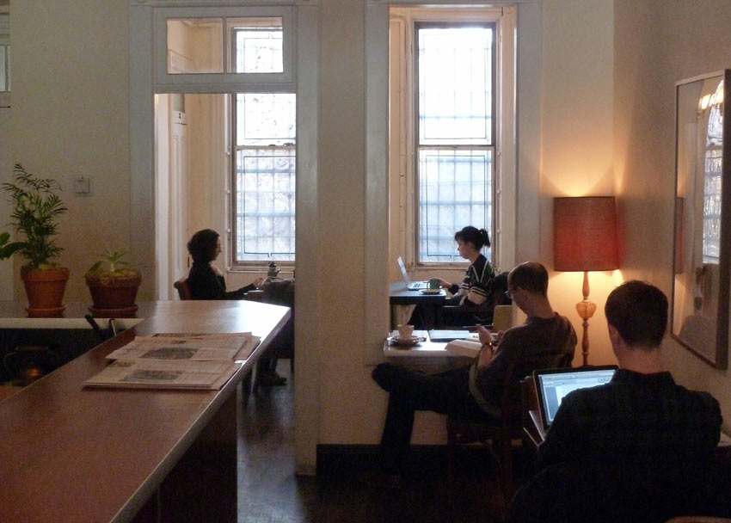
New York | Odd Fox Coffee

Slide 39
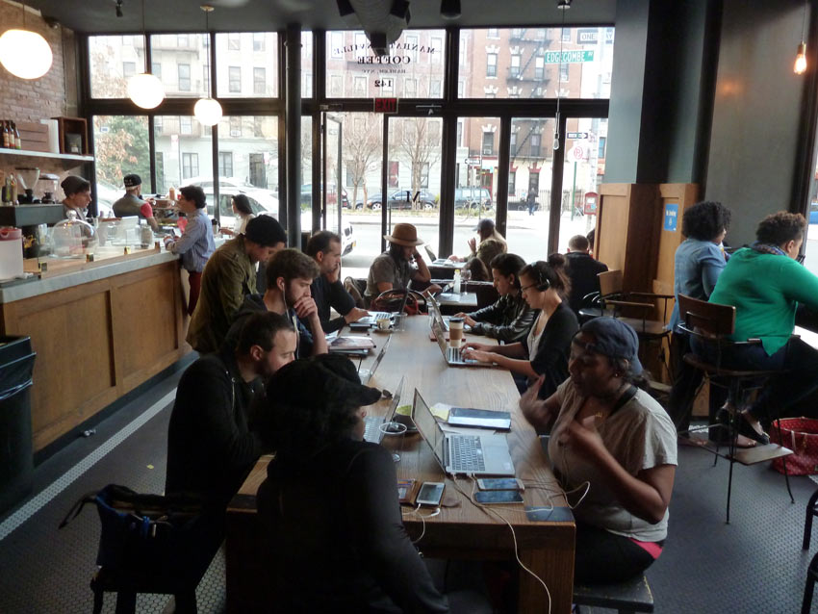
New York | Manhattanville Coffee

Slide 40
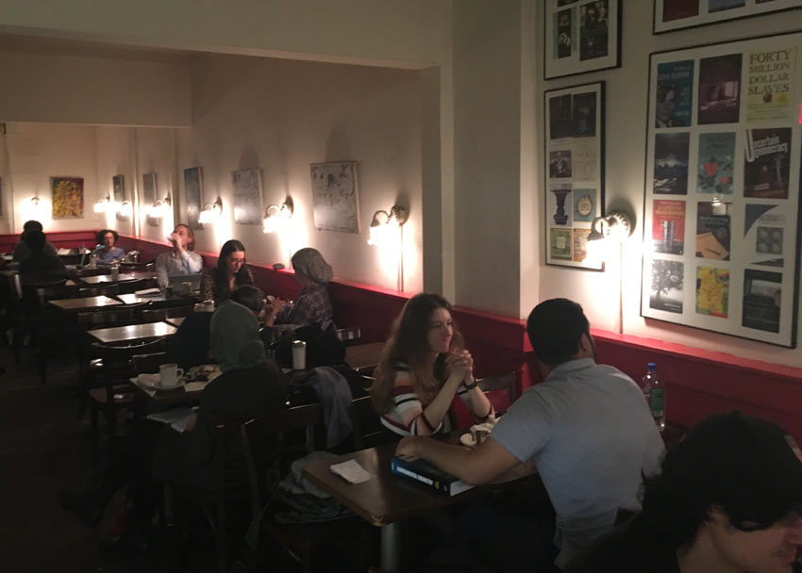
New York | The Hungarian Pastry Shop

Slide 41
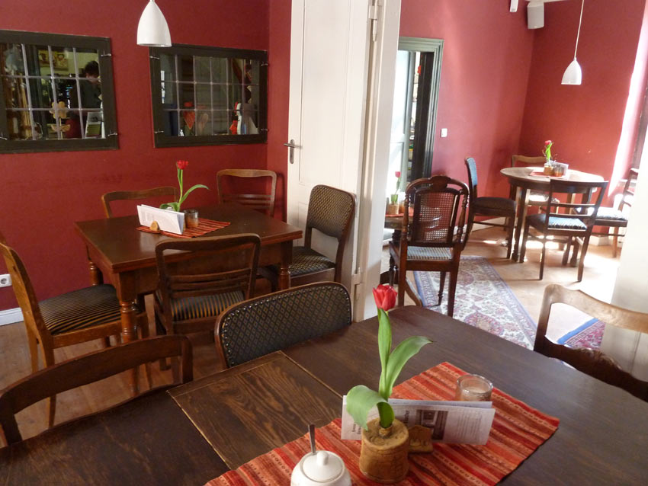
Rostock | Café Kloster

Slide 42
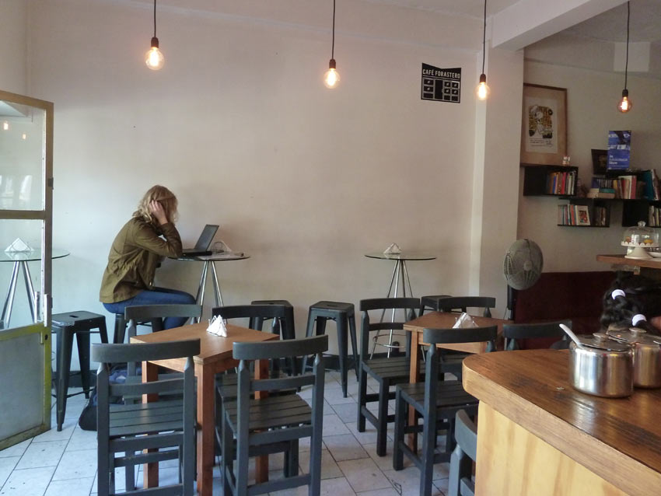
Santiago (Chile) | Café Forastero

Slide 43
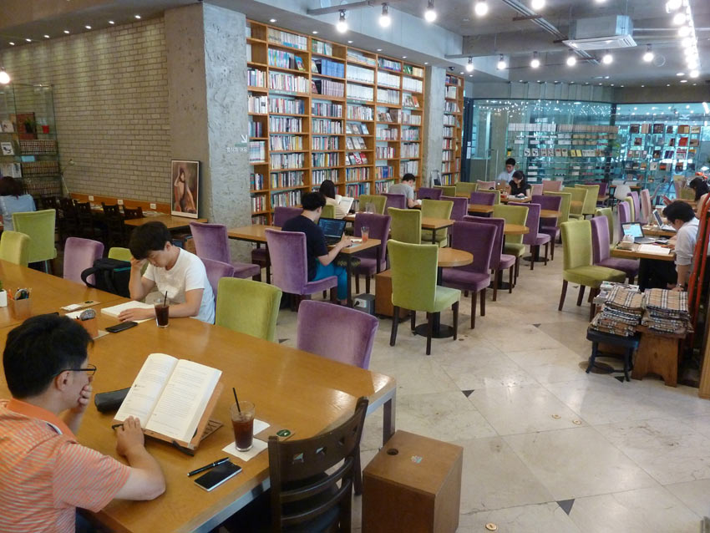
Seoul | Wisdom of the Rabbit

Slide 44
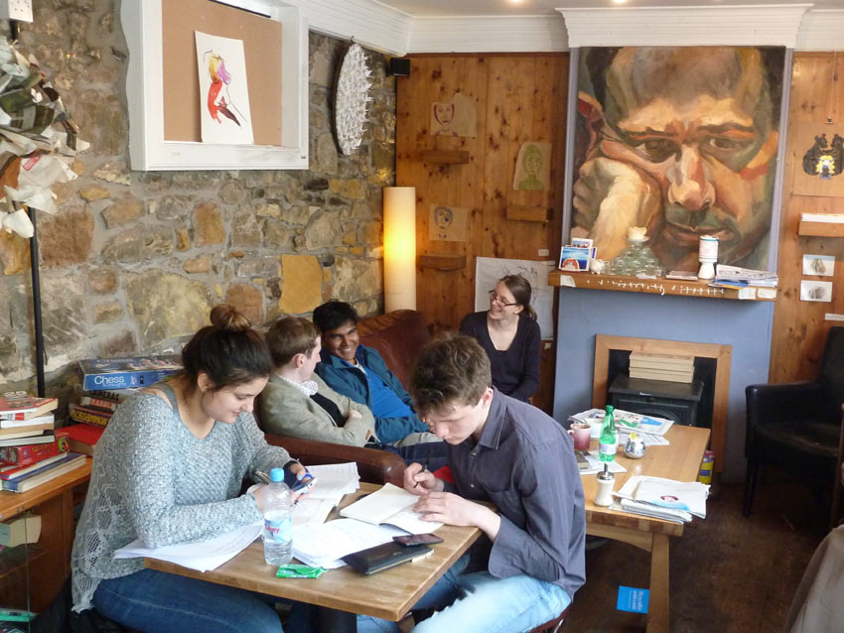
St. Andrews | Taste

Slide 45
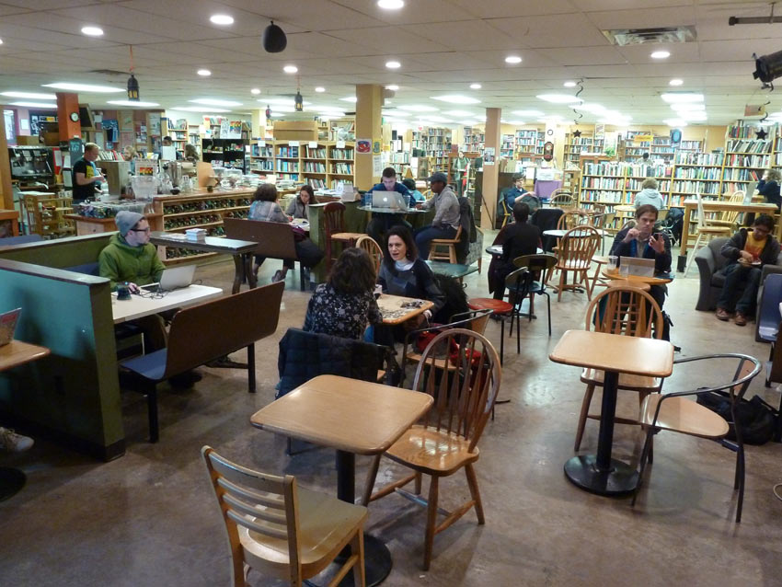
State College | Webster’s Bookstore Café

Slide 46
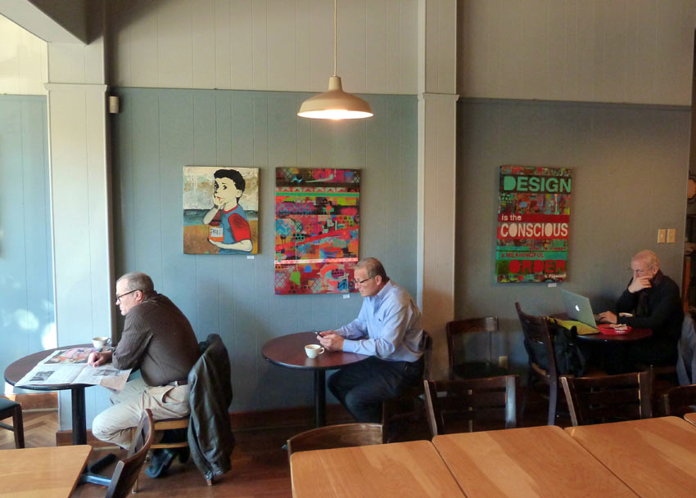
St. Louis | Meshuggah Cafe

Slide 47
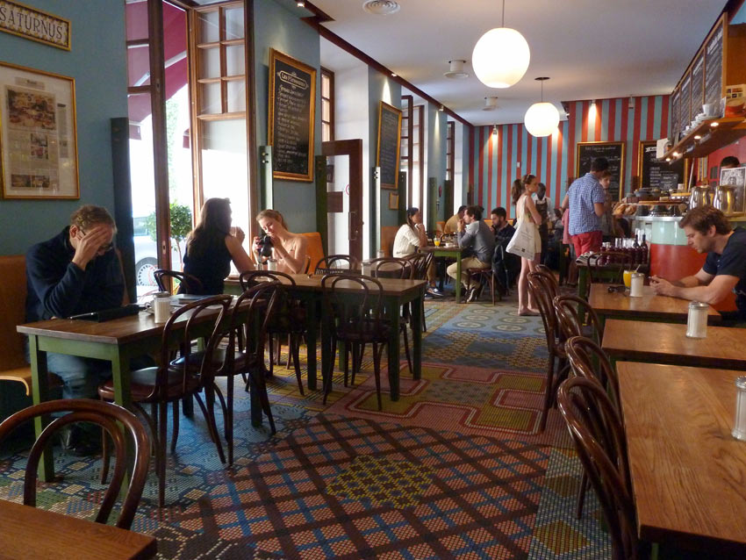
Stockholm | Café Saturnus

Slide 48
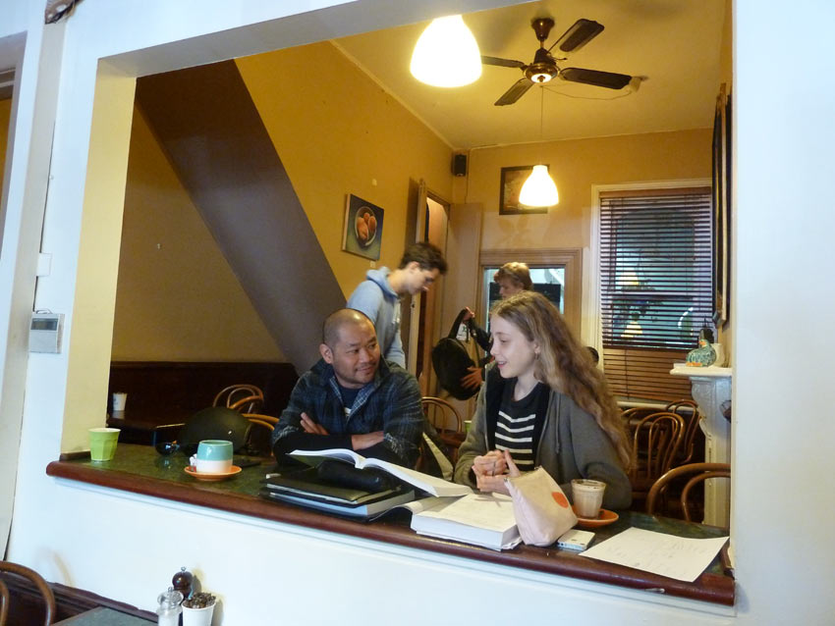
Sydney | Le Petit Cafe

Slide 49
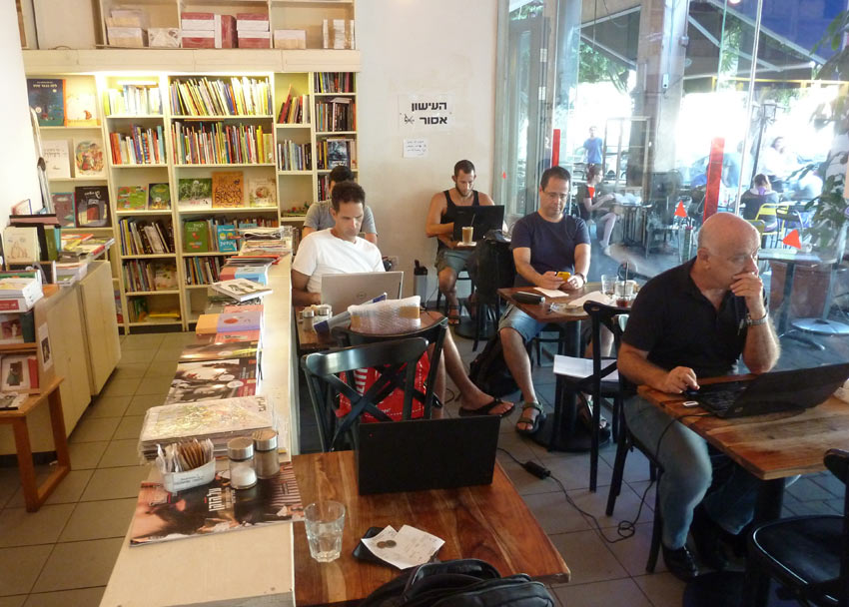
Tel Aviv | Tola'at Sfarim

Slide 50
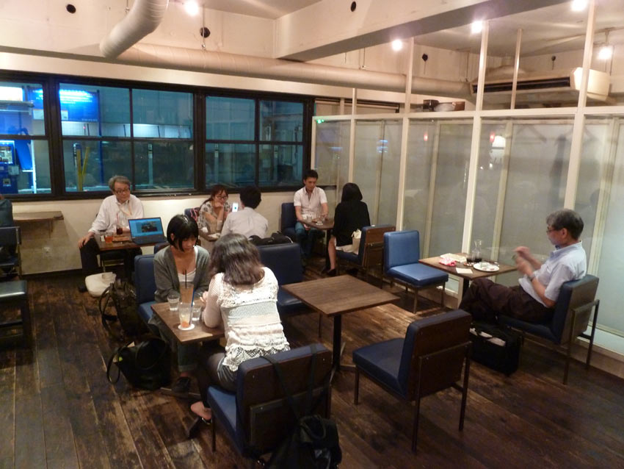
Tokyo | Pause Cafe

Slide 51
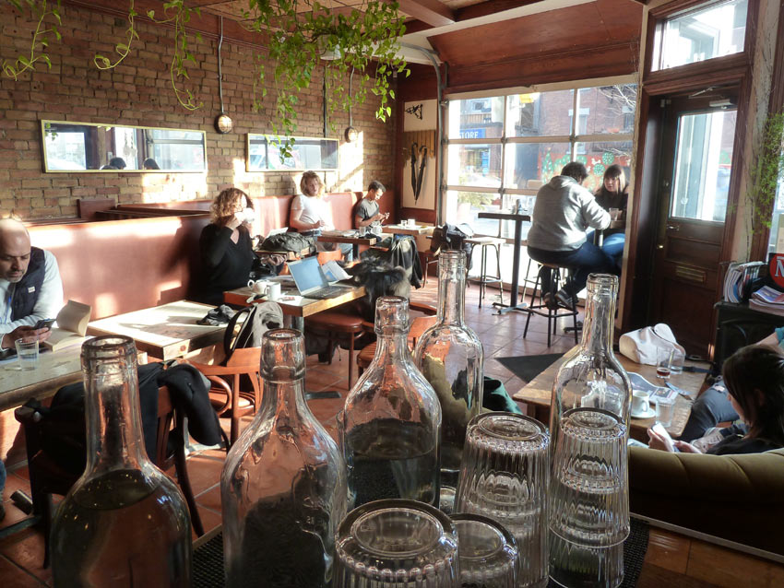
Toronto | The Loveless Café

Slide 52

Toulouse | Ras La Tasse

Slide 53

Vienna | Café Prückel

Slide 54

Warsaw | Kawiarnia Kafka

Slide 55

Zurich | KafiSchnaps

