Slide 1
Café Poster 2013
by Ariel Rubinstein

Slide 2
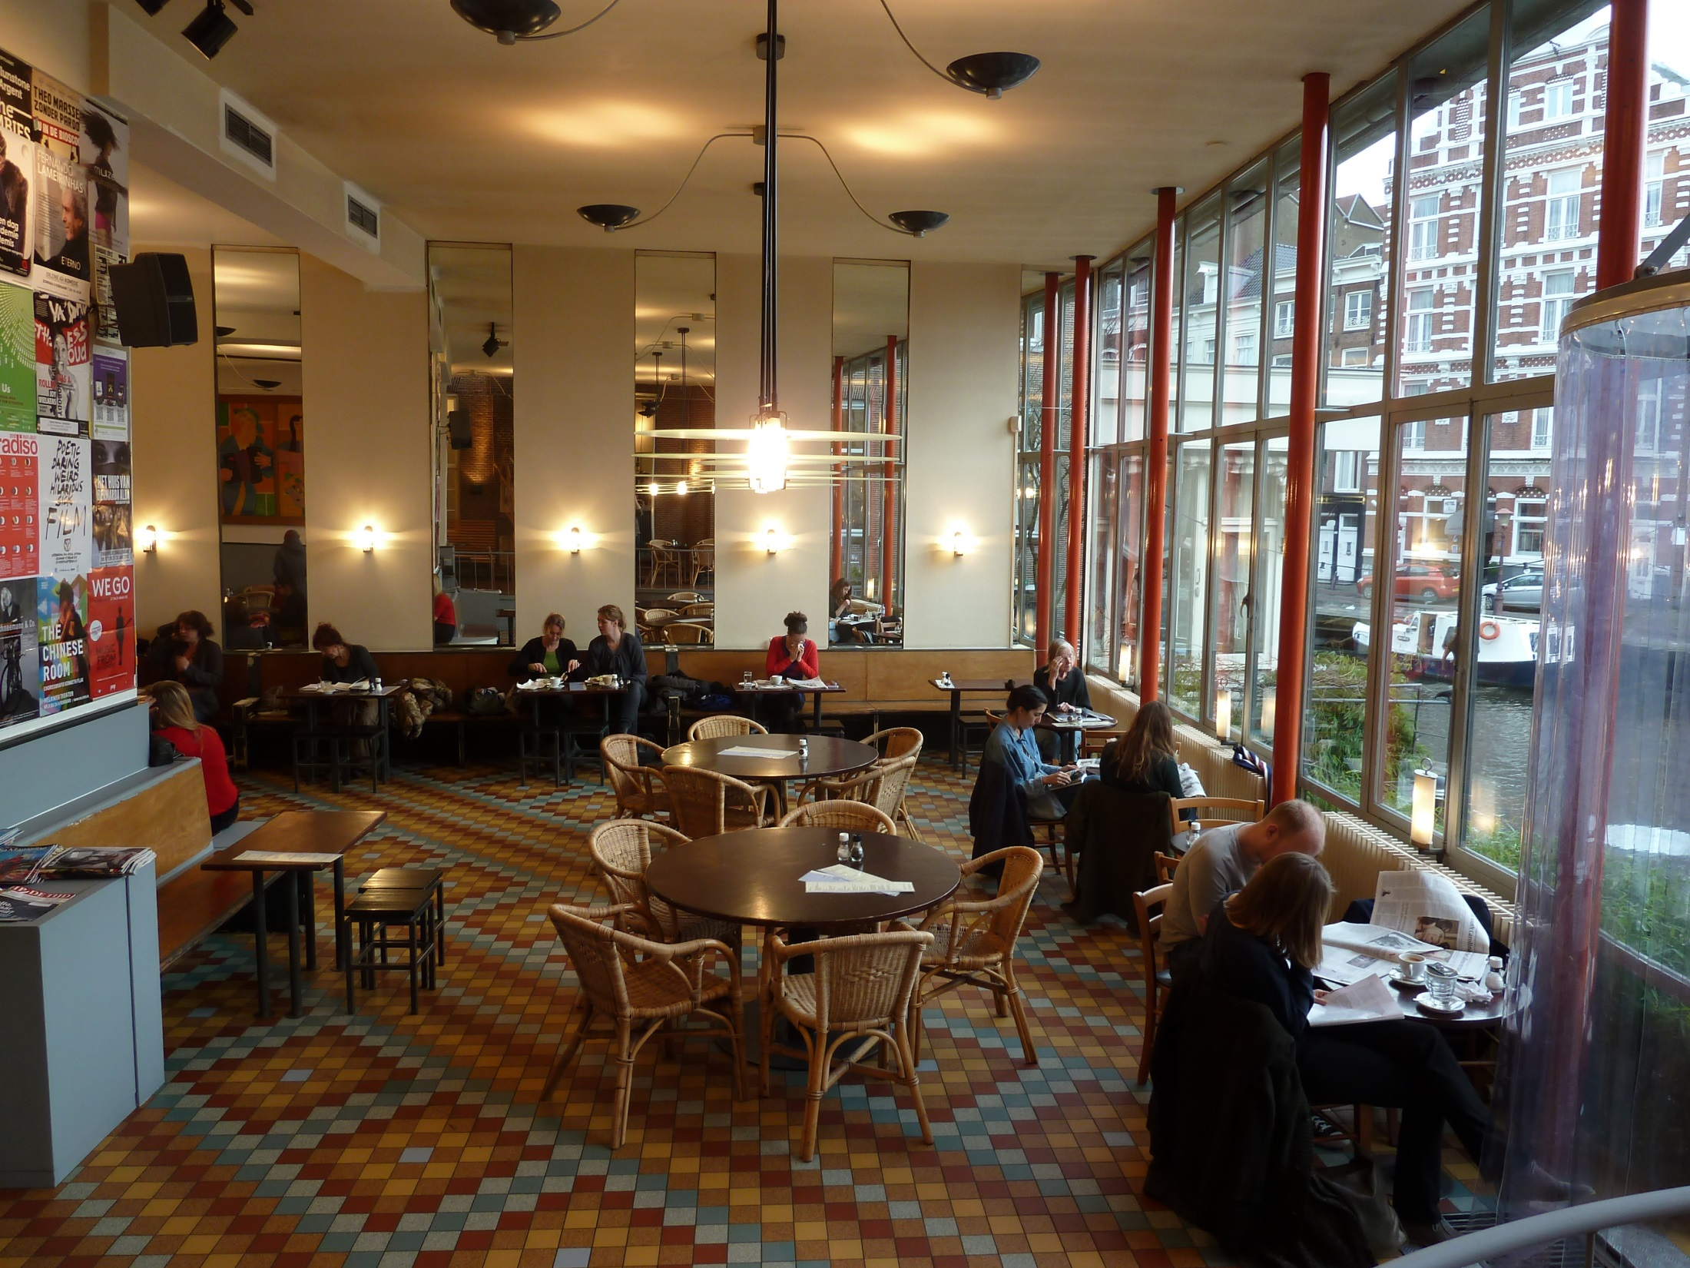
Amsterdam | Café de Jaren
Notes:
Amsterdam | Café de Jaren

Slide 3
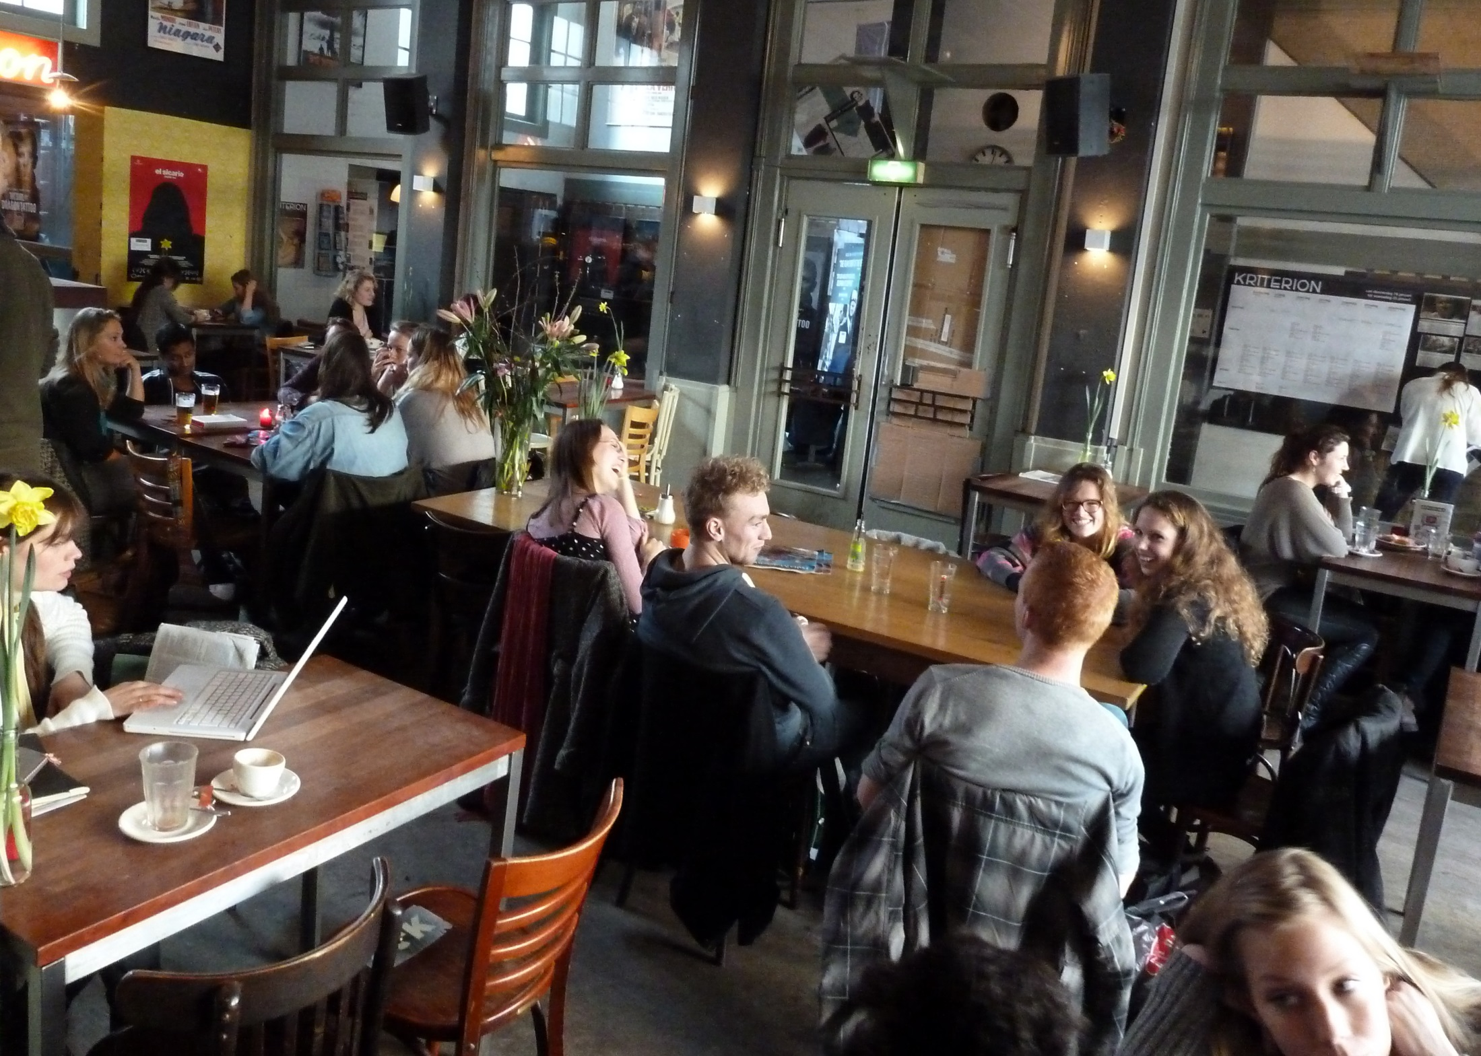
Amsterdam | Kriterion

Slide 4
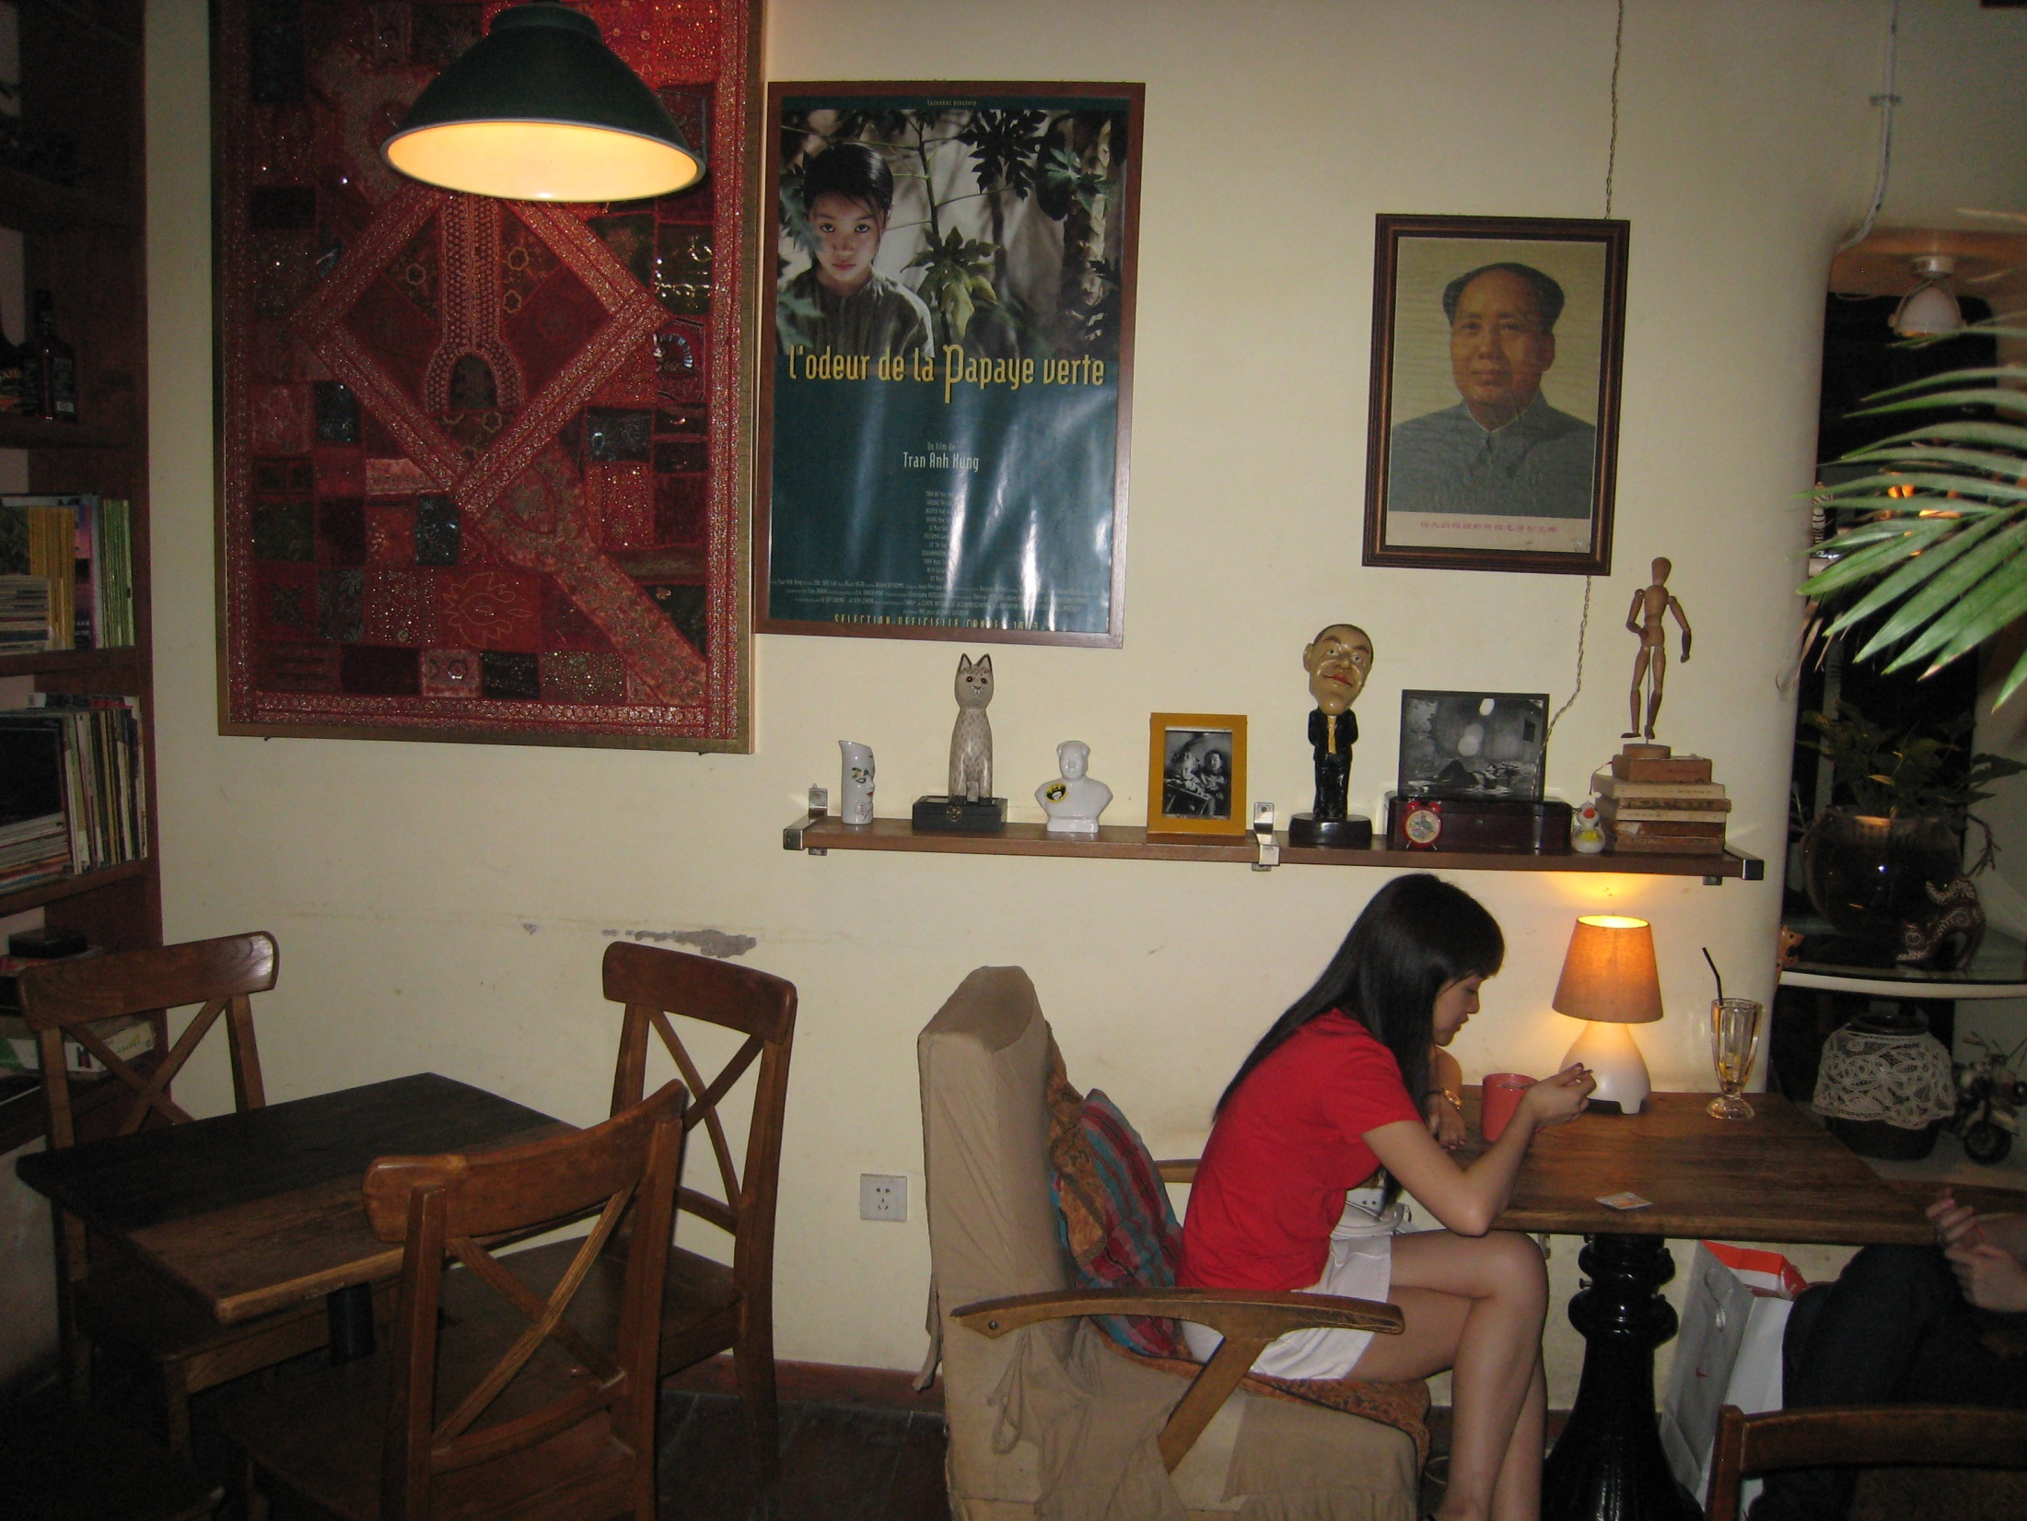
Beijing| Xiao Xin's Café

Slide 5
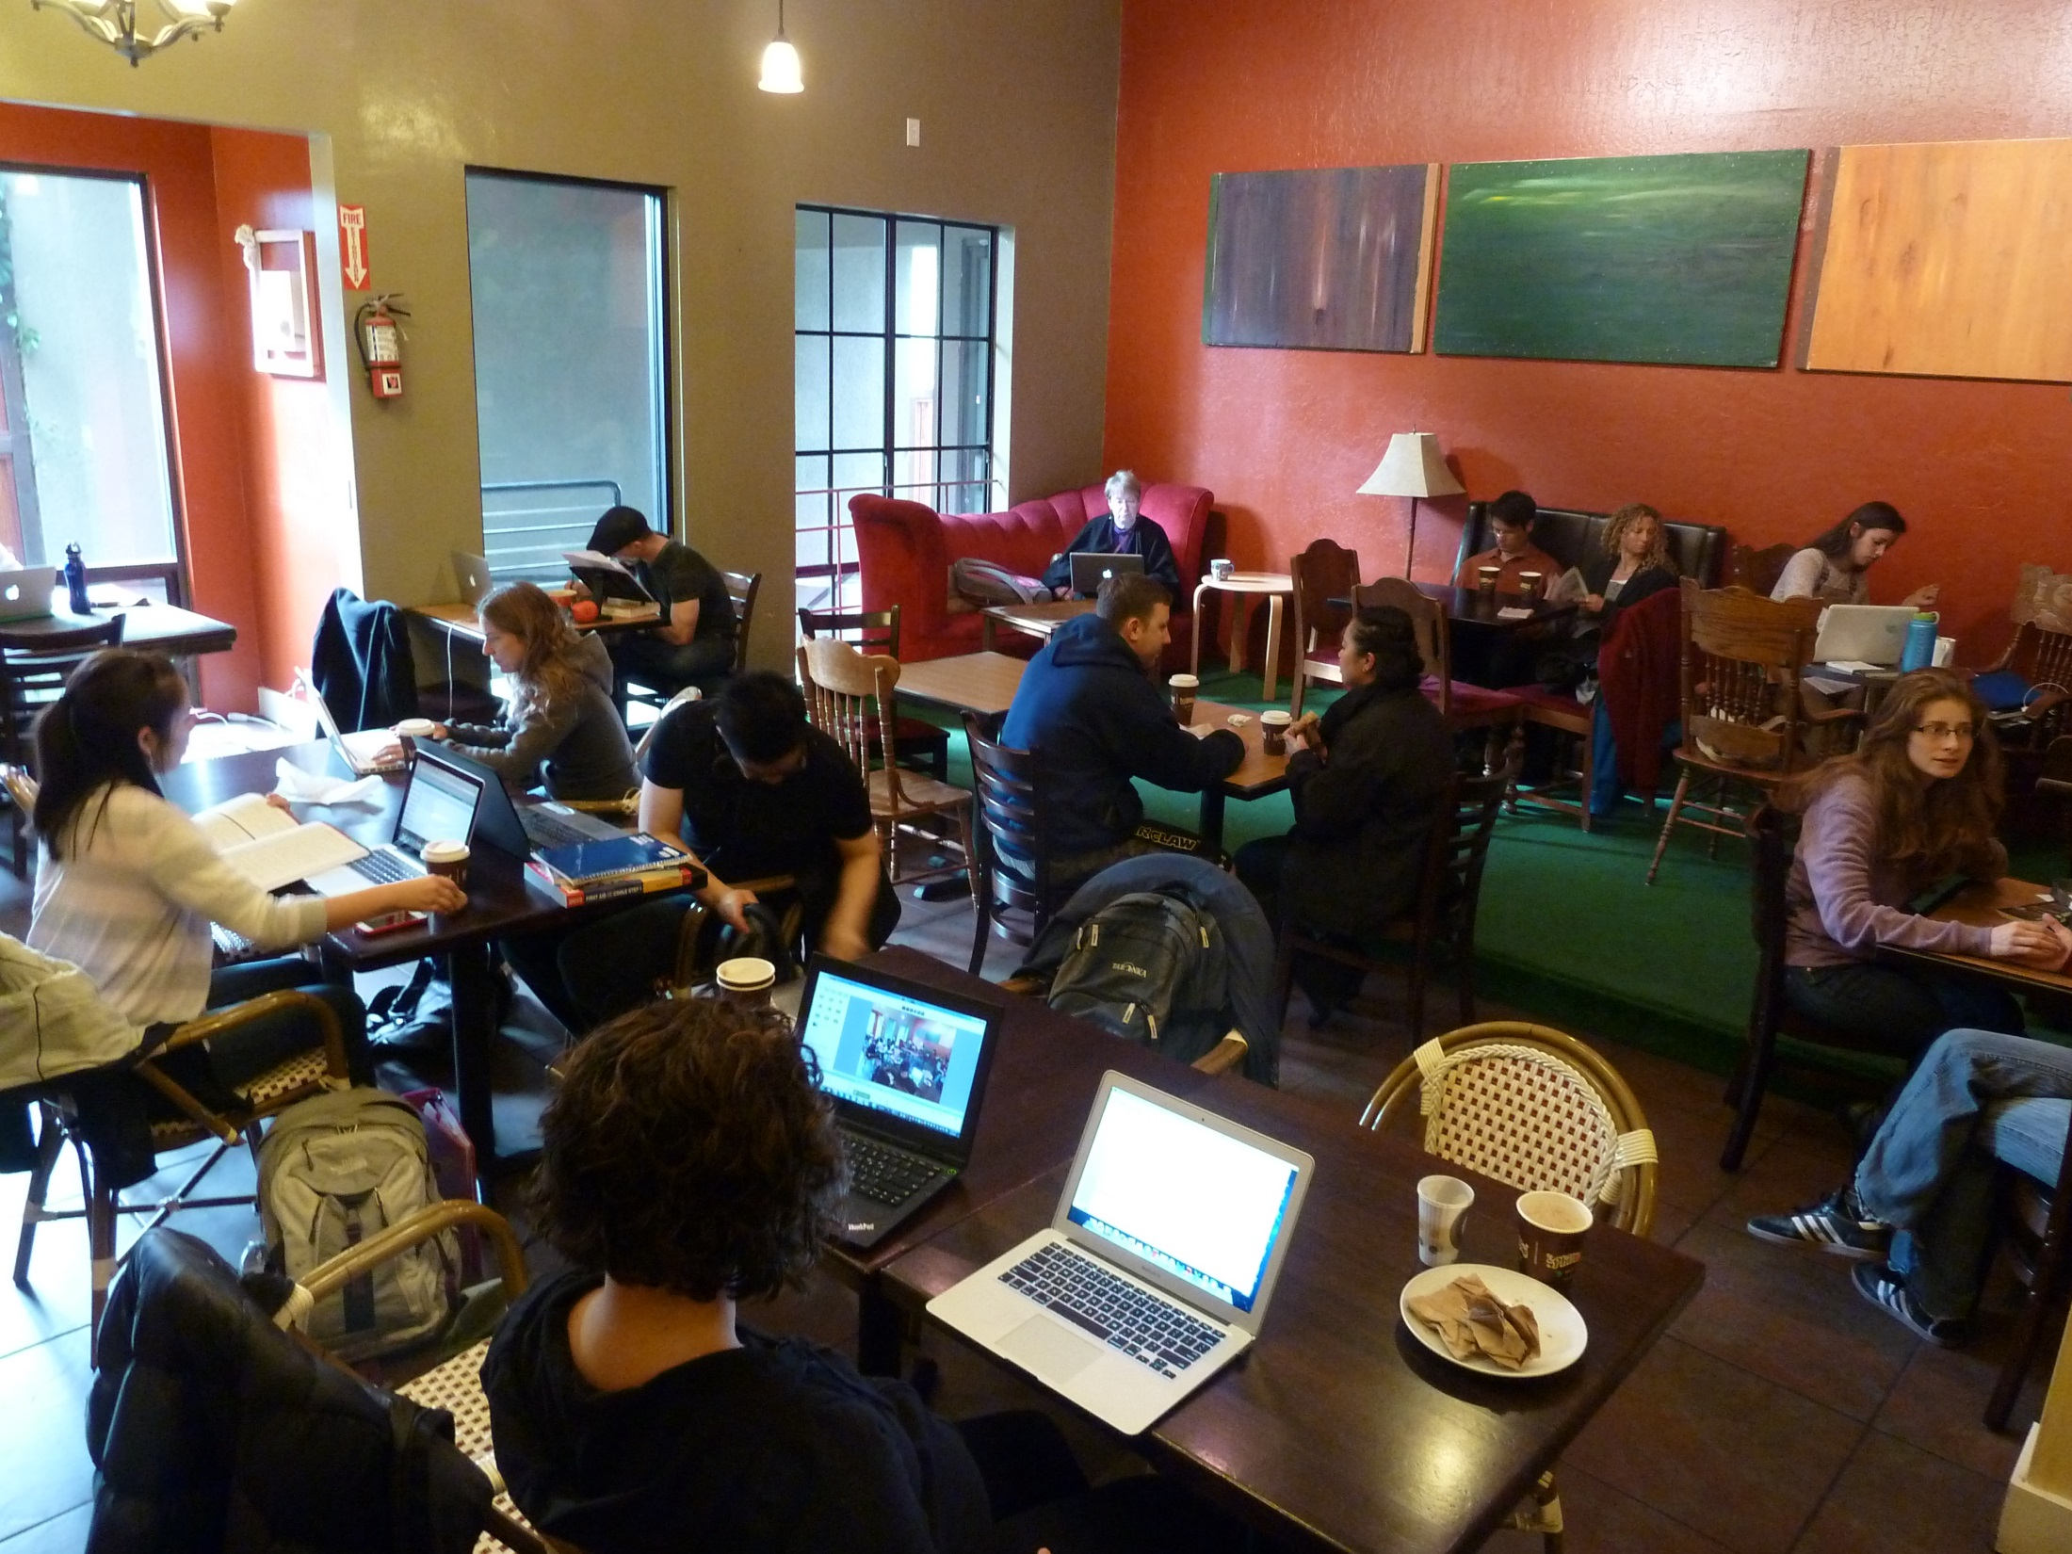
Berkeley | Philz

Slide 6
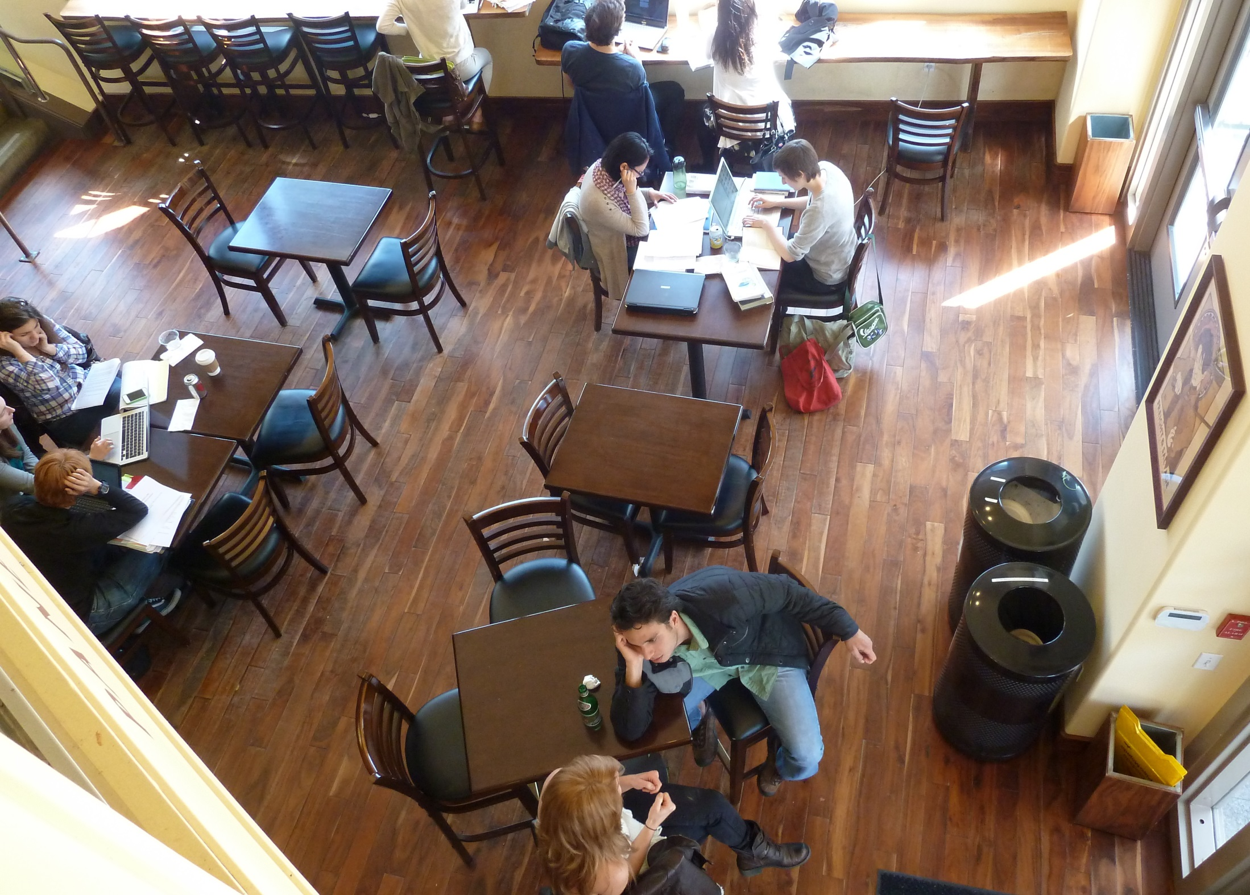
Berkeley| PiQ

Slide 7
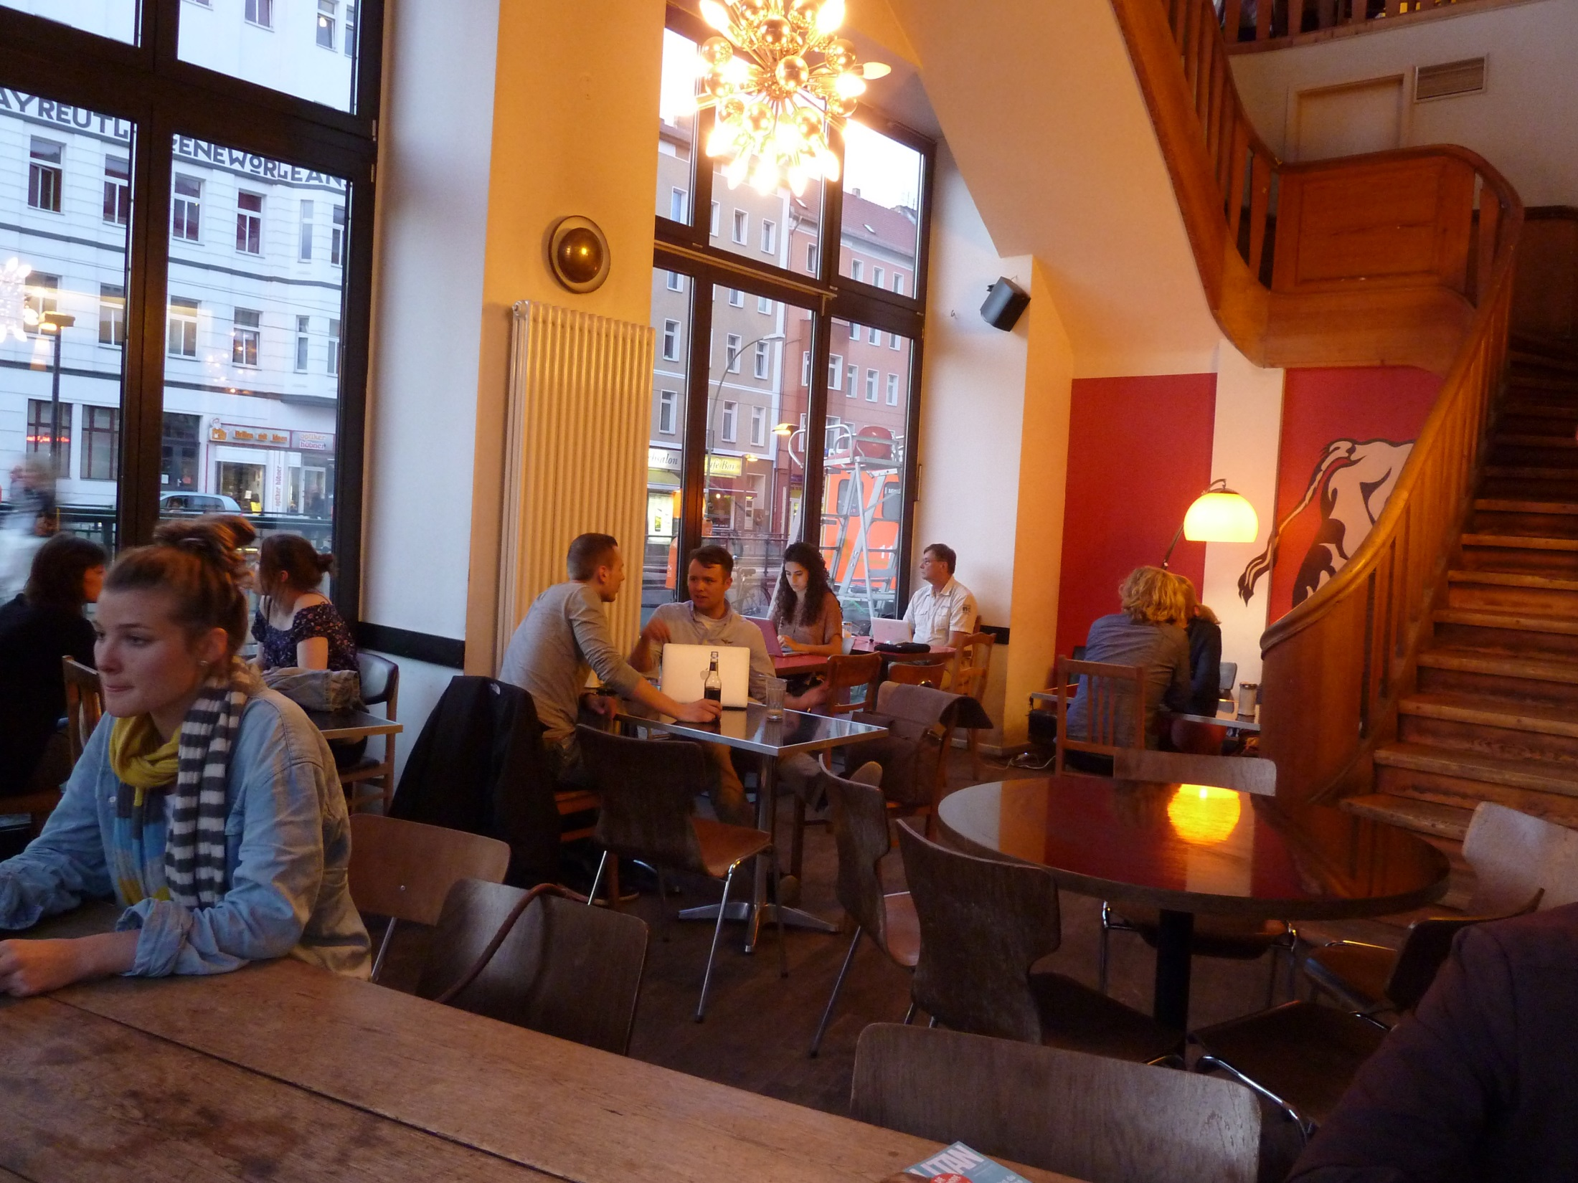
Berlin | St. Oberholz

Slide 8
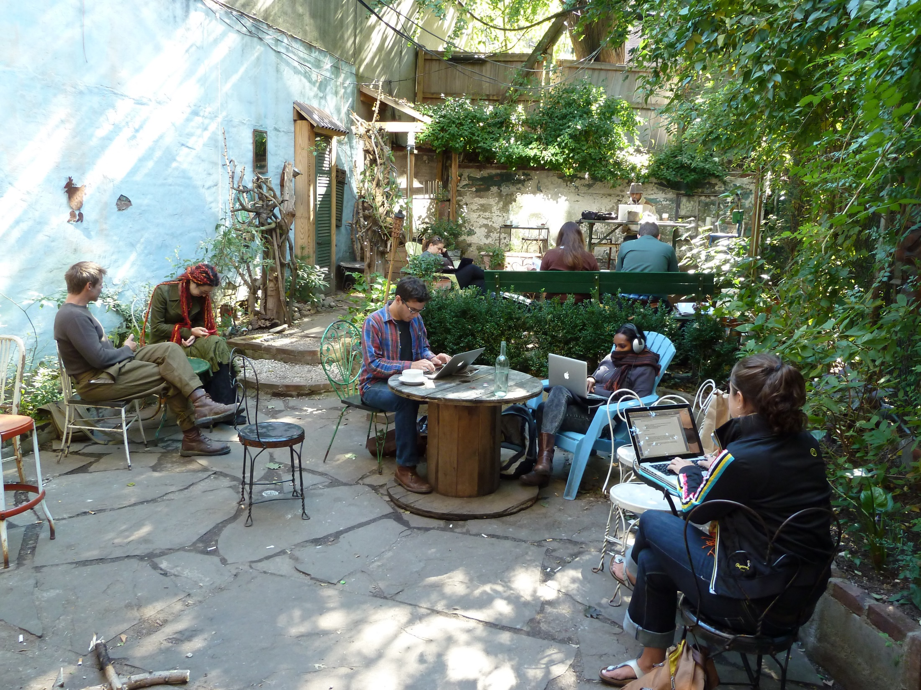
Brooklyn | Outpost

Slide 9
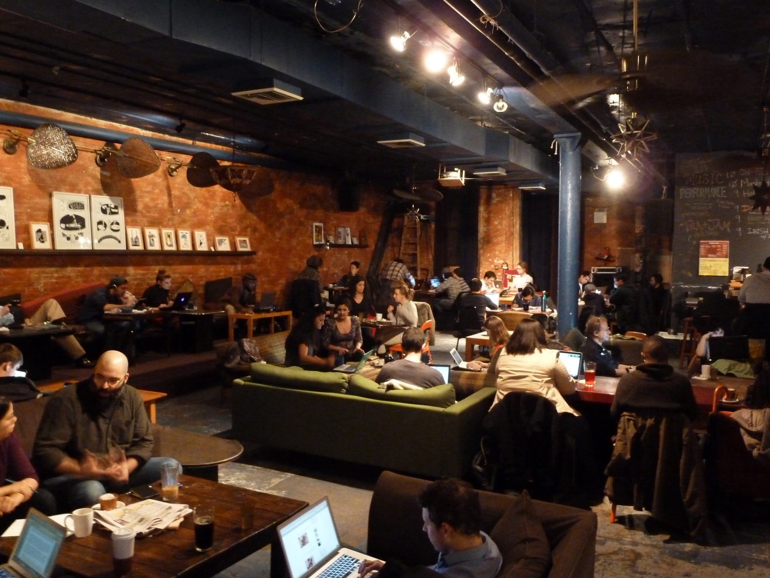
Brooklyn | Tea Lounge

Slide 10
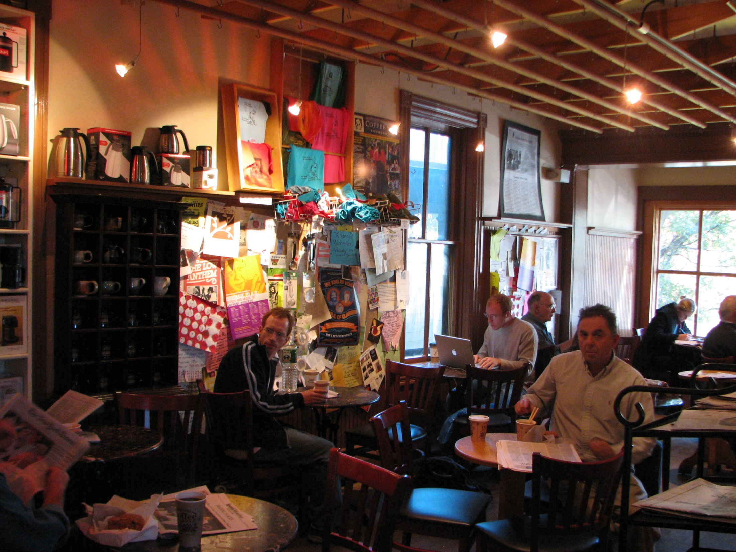
Brown U. | Coffee Exchange

Slide 11
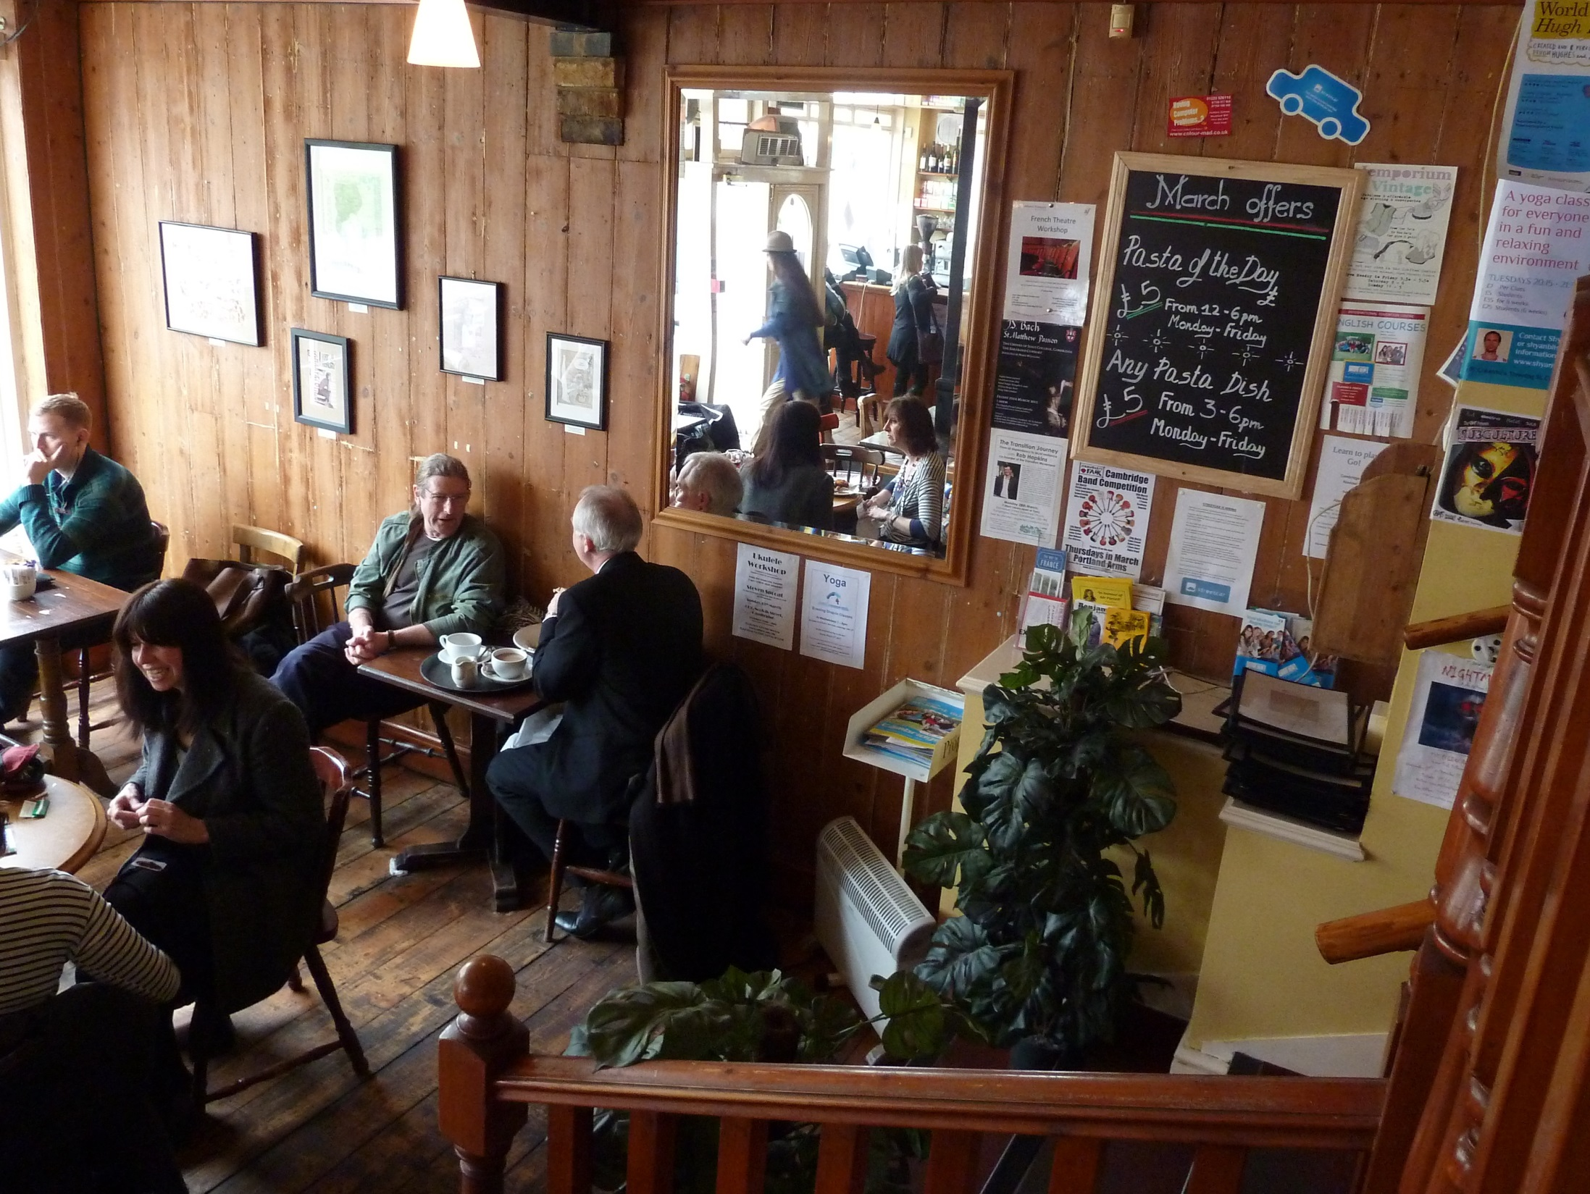
Cambridge | CB2

Slide 12
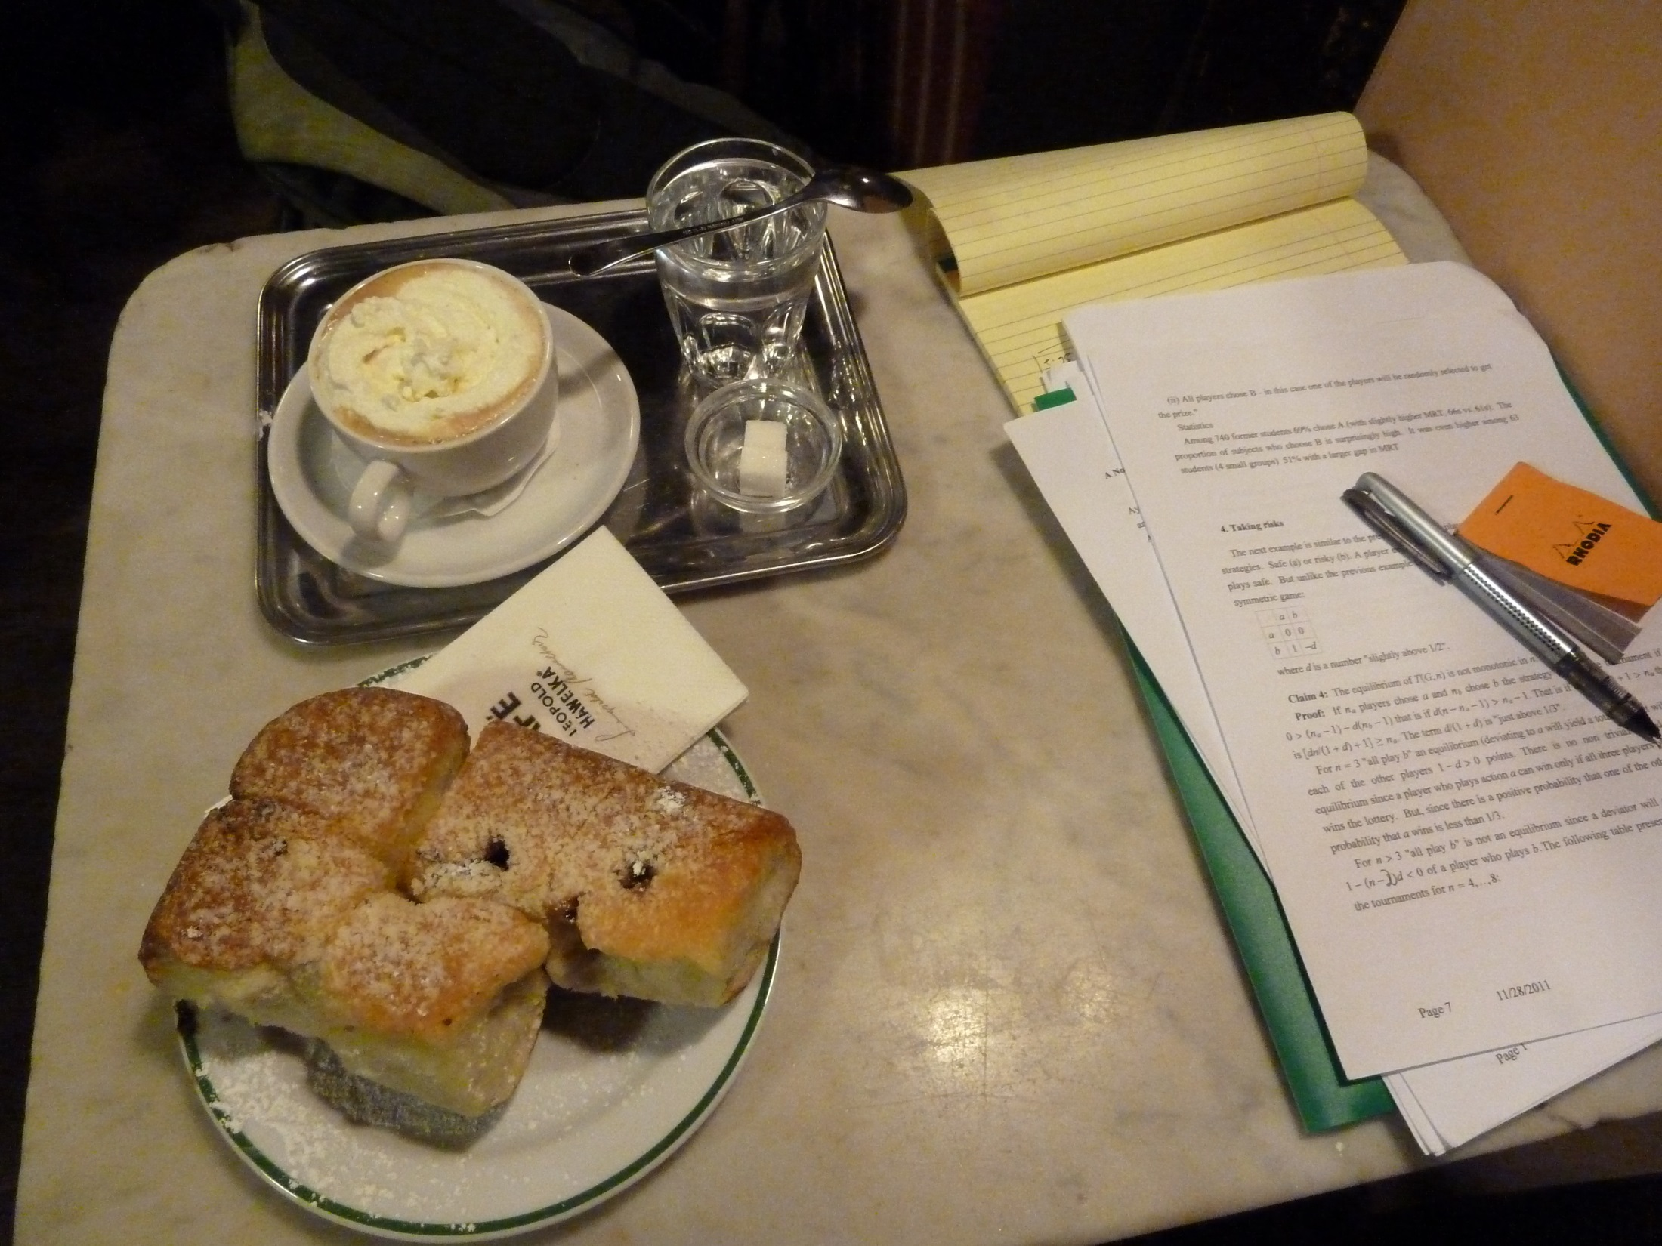
University of Vienna Cafes

Slide 13
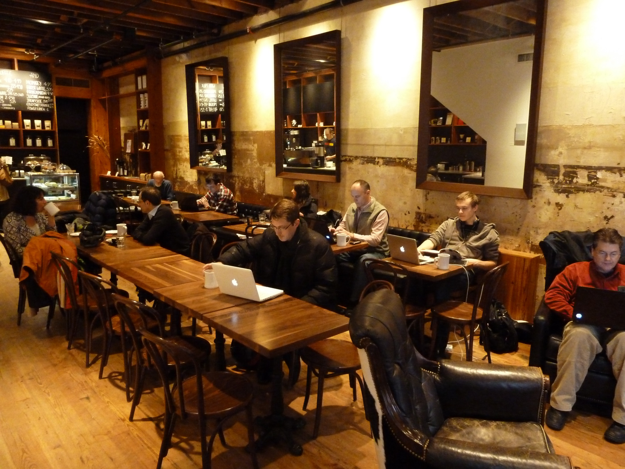
Charlottesville | Mudhouse Coffee

Slide 14
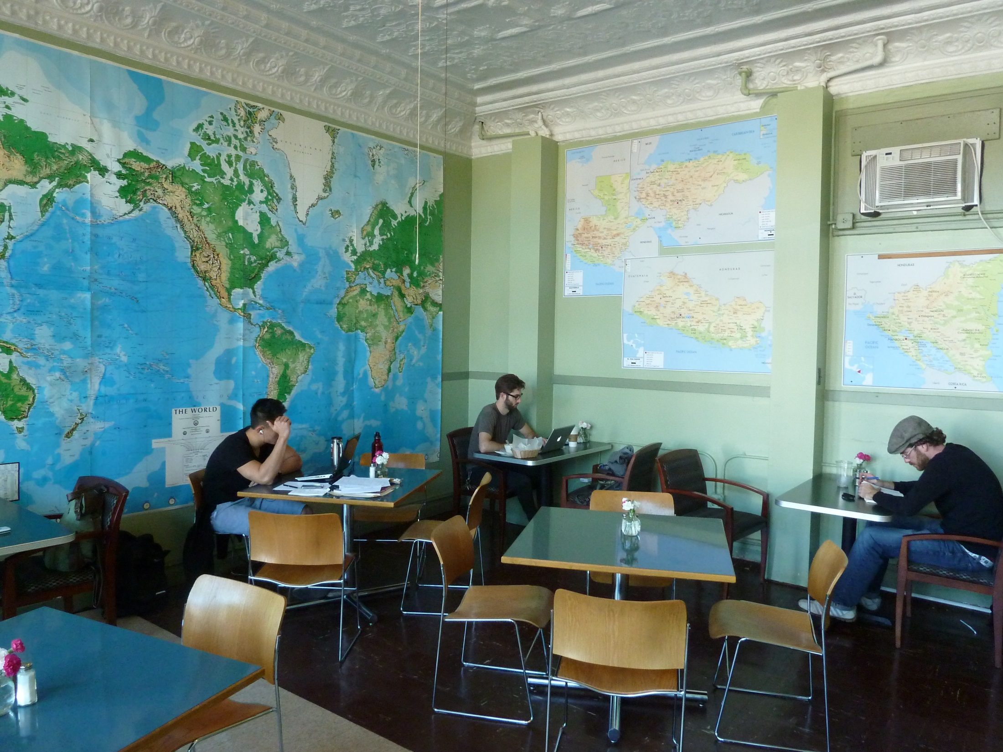
Chicago | Bridgeport Coffee

Slide 15
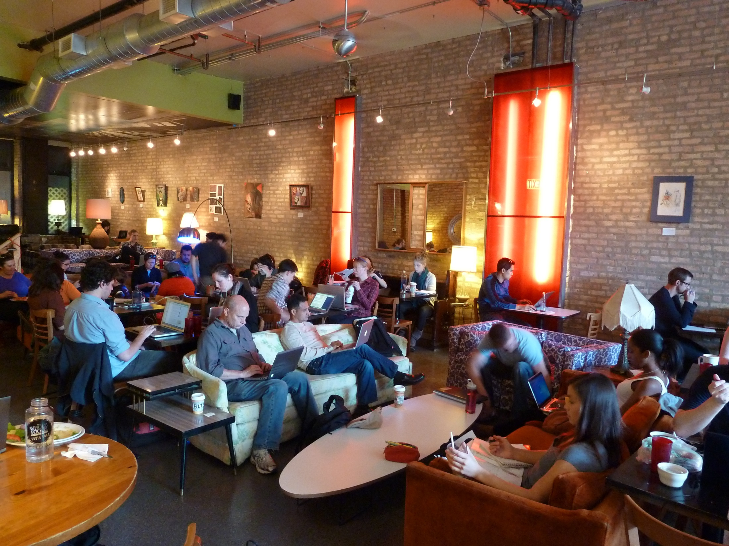
Chicago | Filter Café

Slide 16
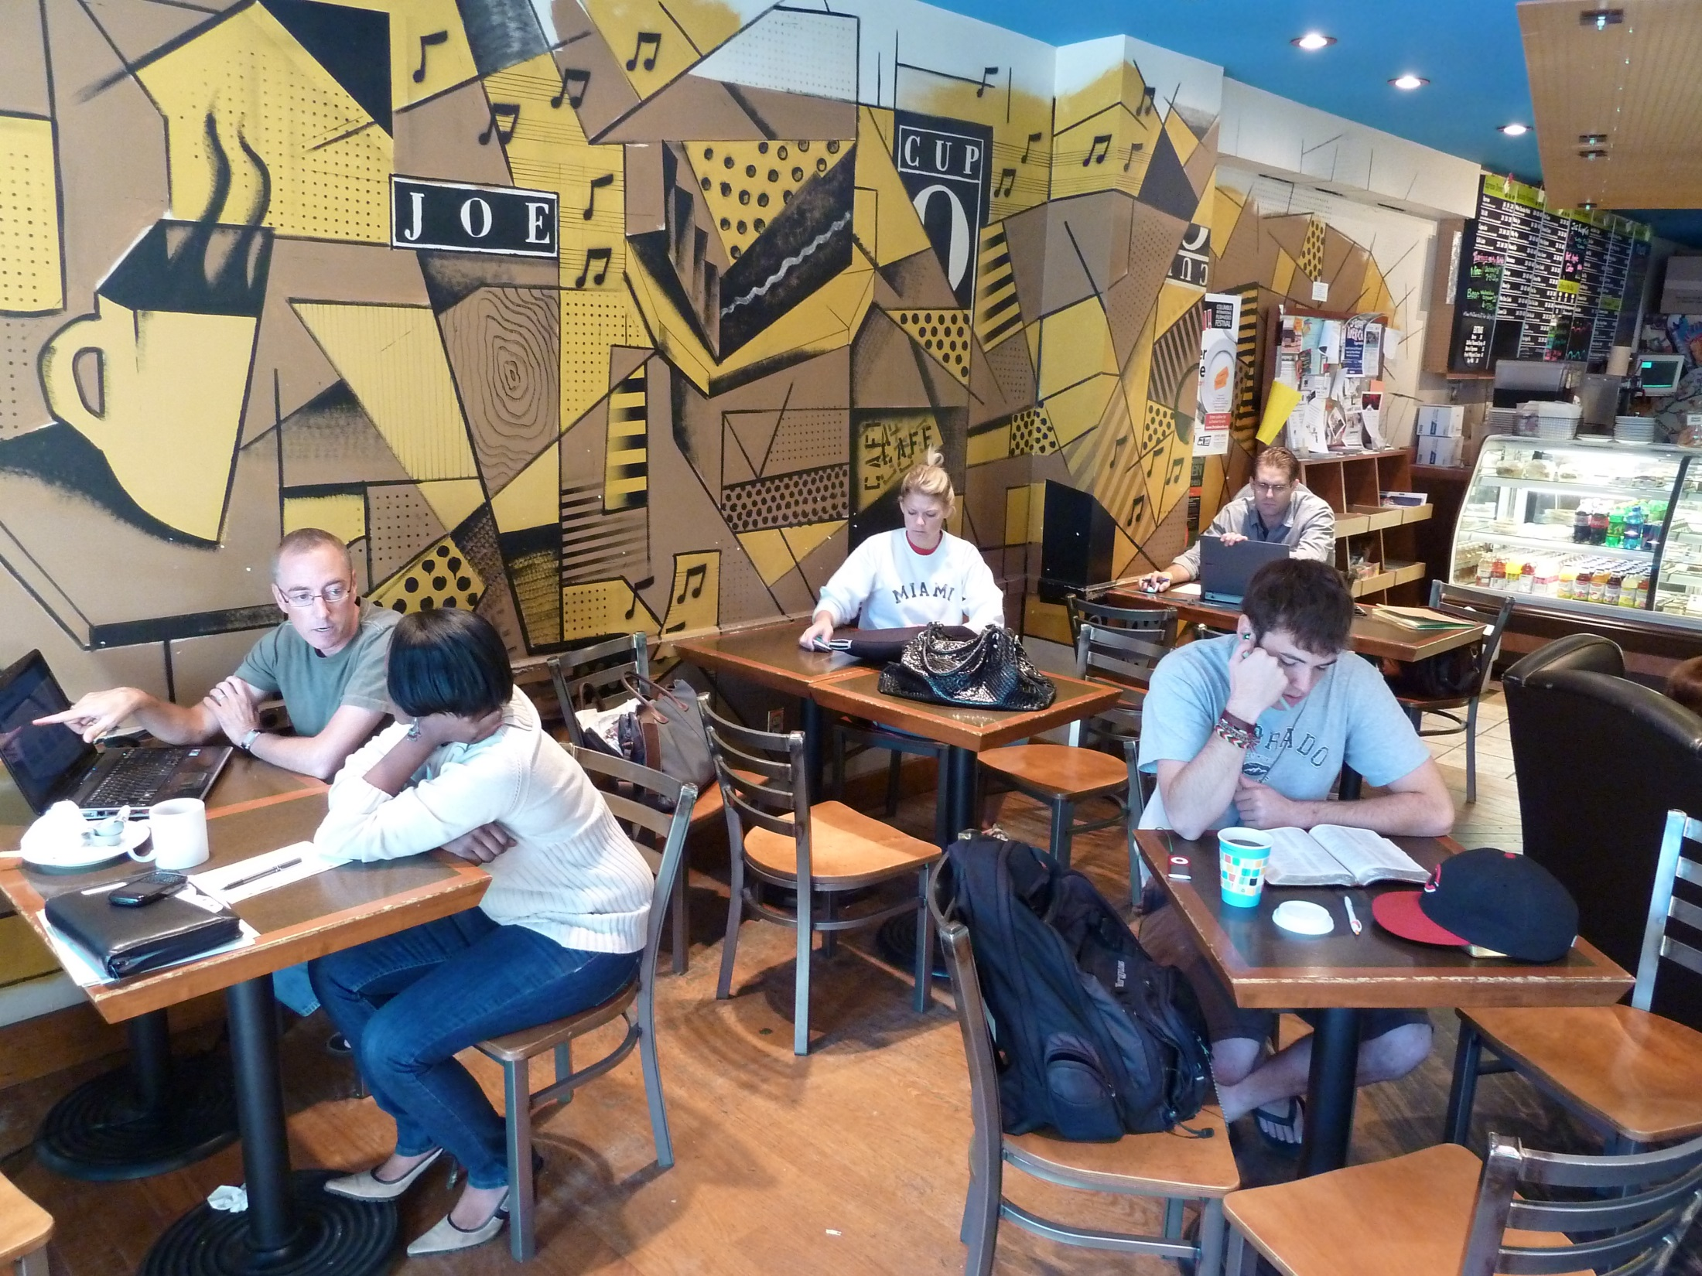
Columbus | Cup O'Joe

Slide 17
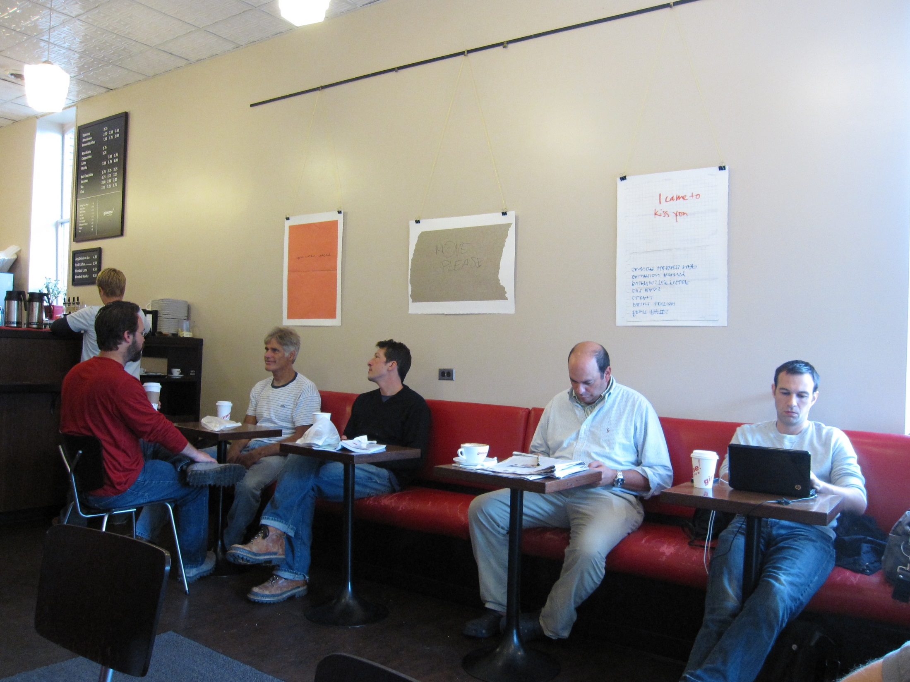
Cornell | Gimme! Coffee

Slide 18
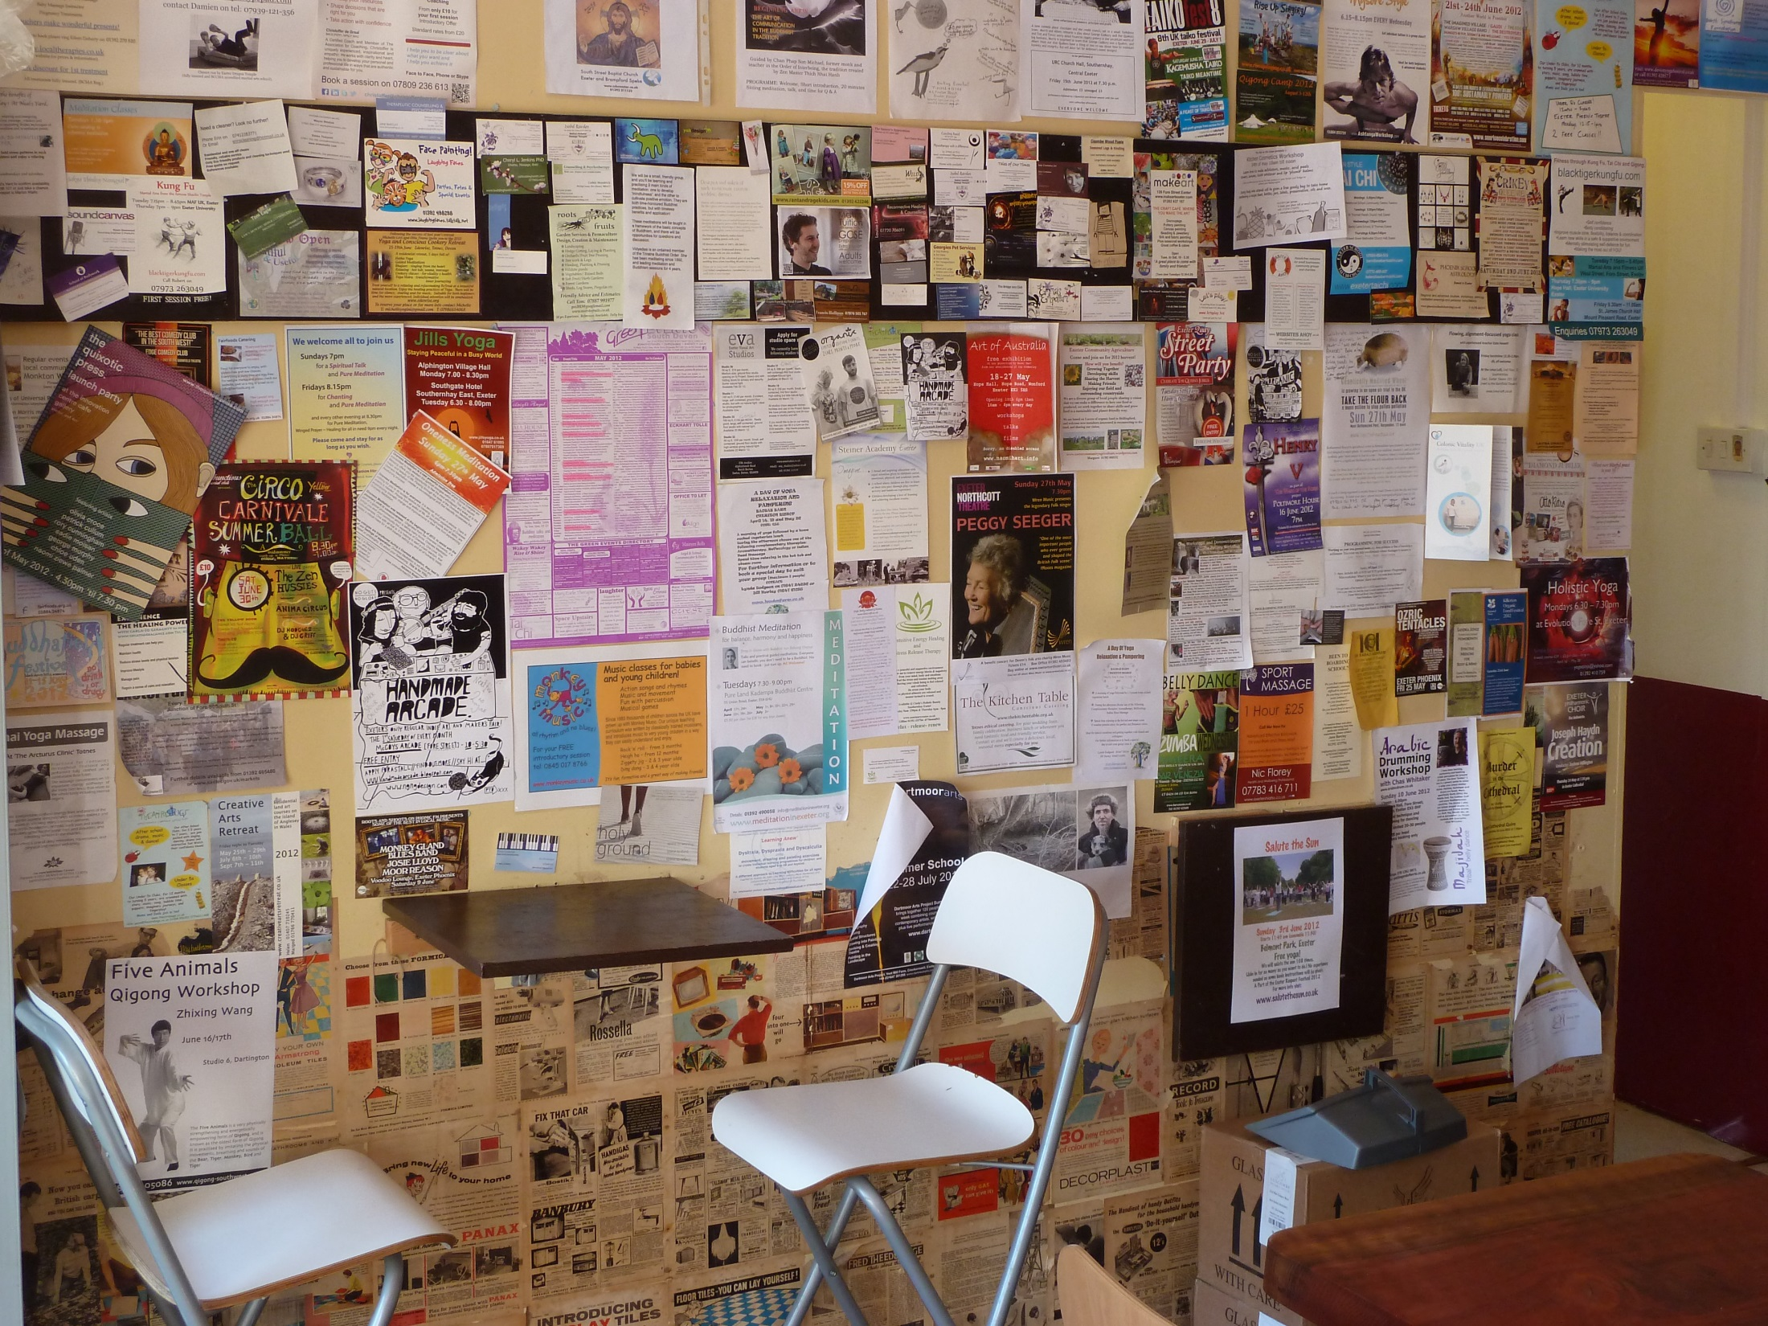
Exeter | The Plant Café

Slide 19
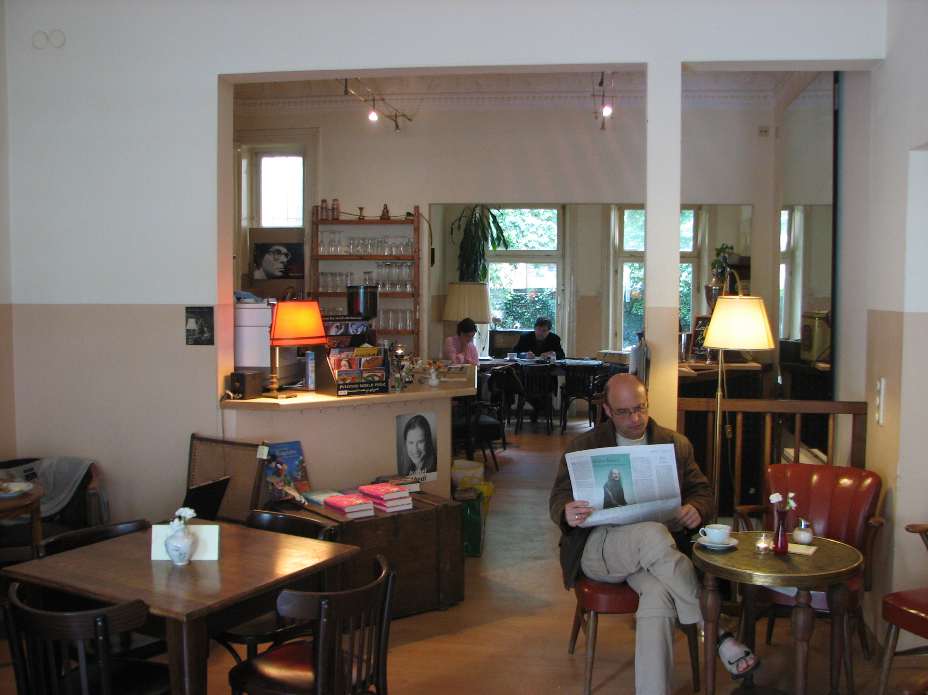
Hamburg | Mathilde Literatur & Café

Slide 20
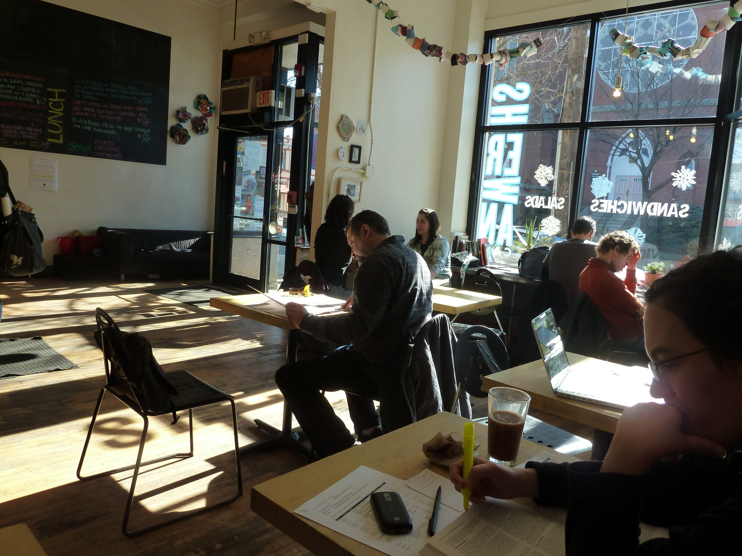
Harvard | Sherman

Slide 21
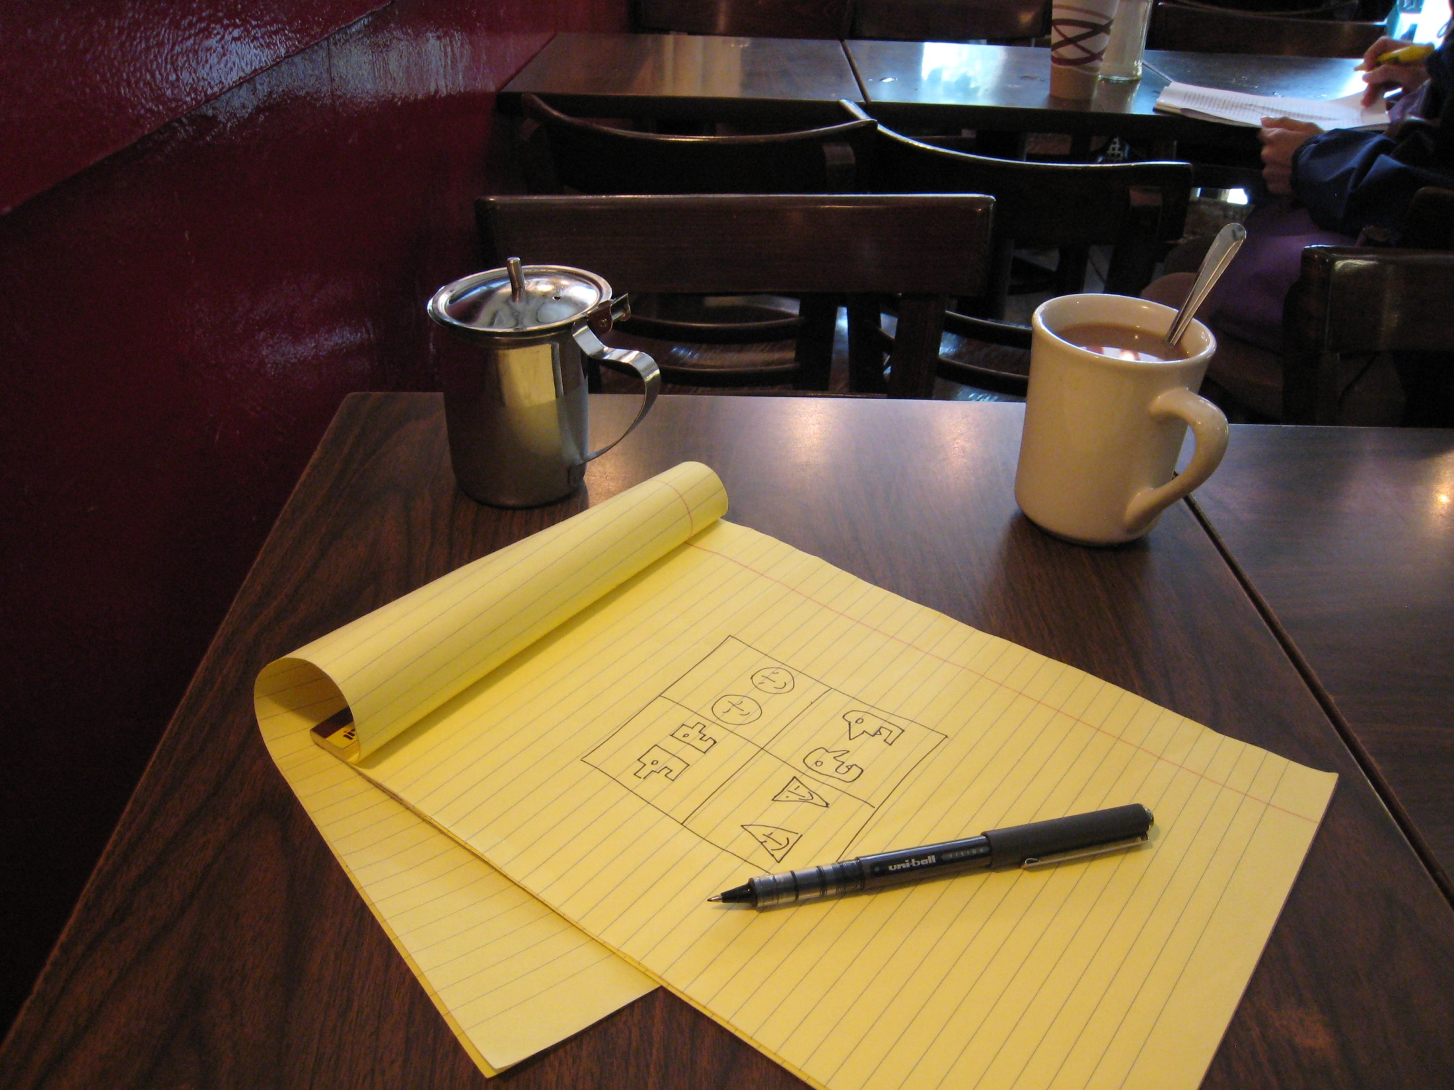
University of New York Cafes

Slide 22
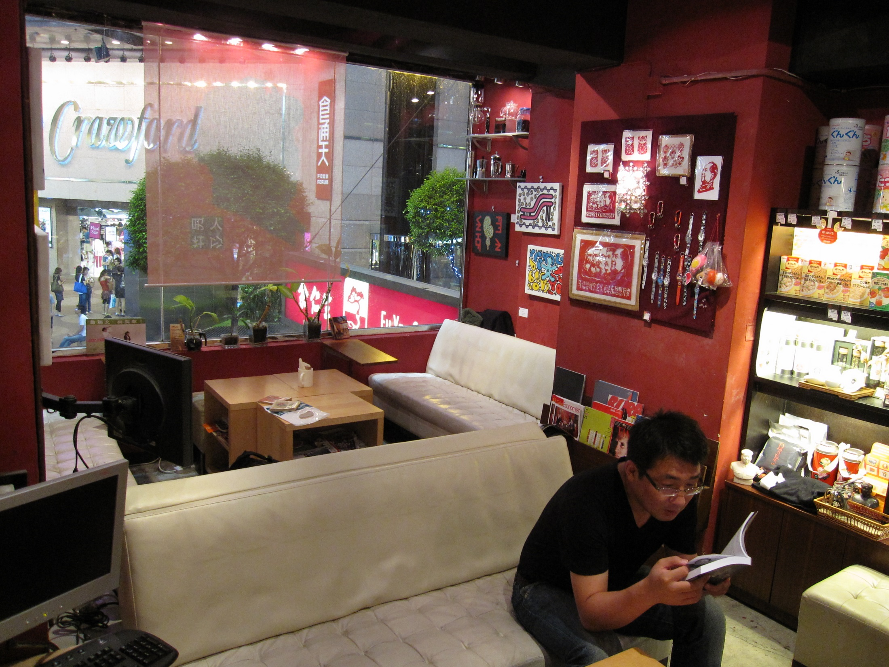
Hong Kong | The People's Bookstore

Slide 23
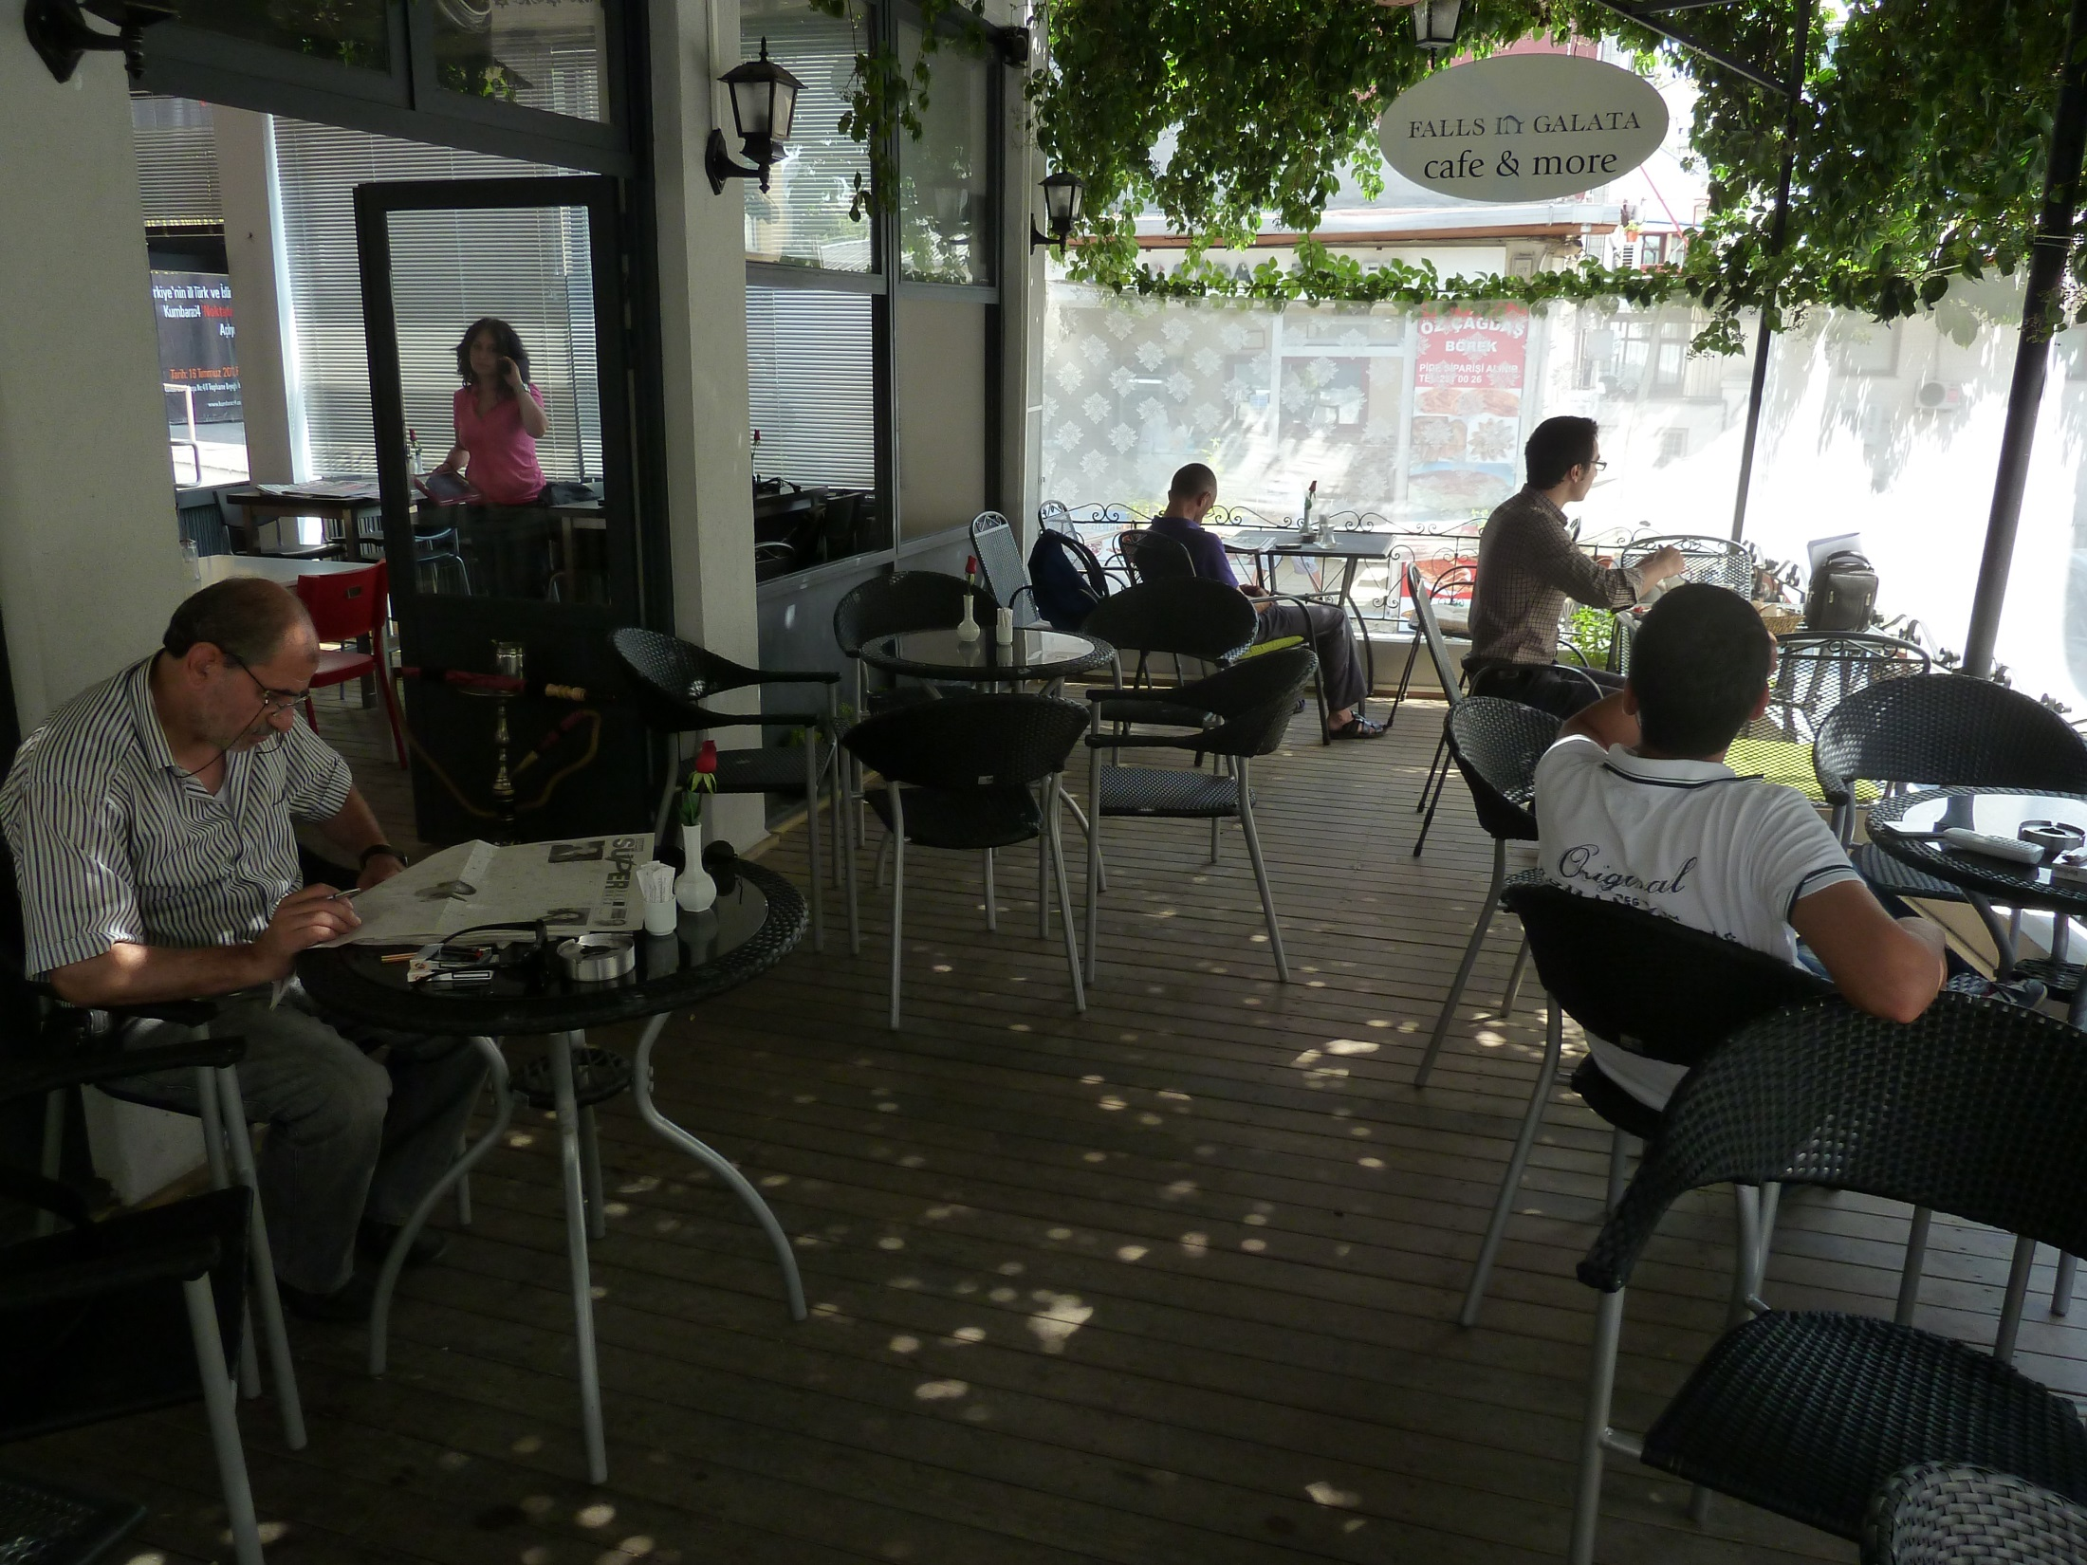
Istanbul | Falls in Galata

Slide 24
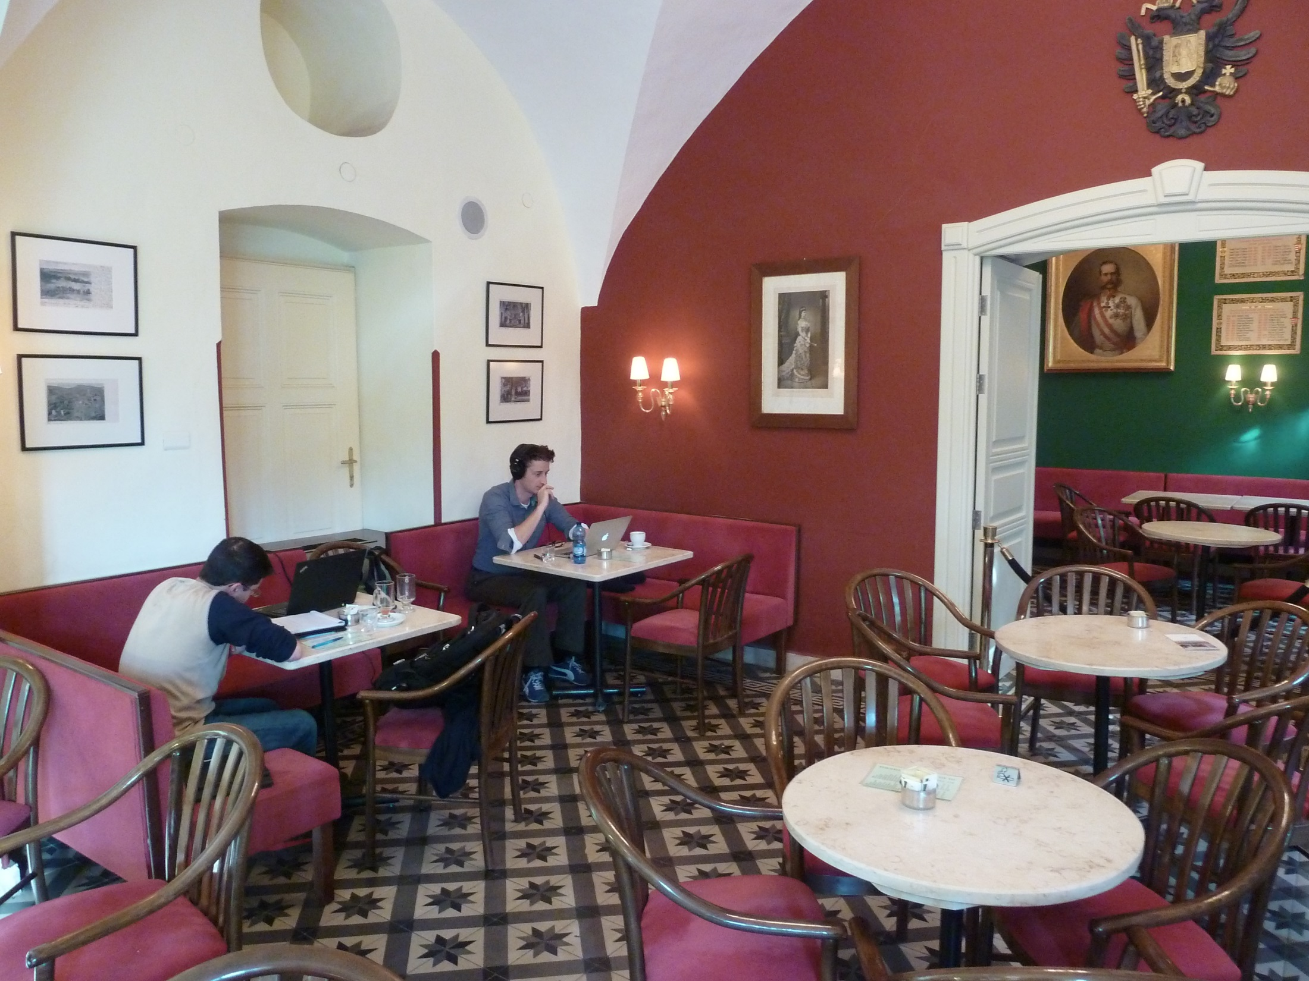
Jerusalem | Austrian Hospice

Slide 25
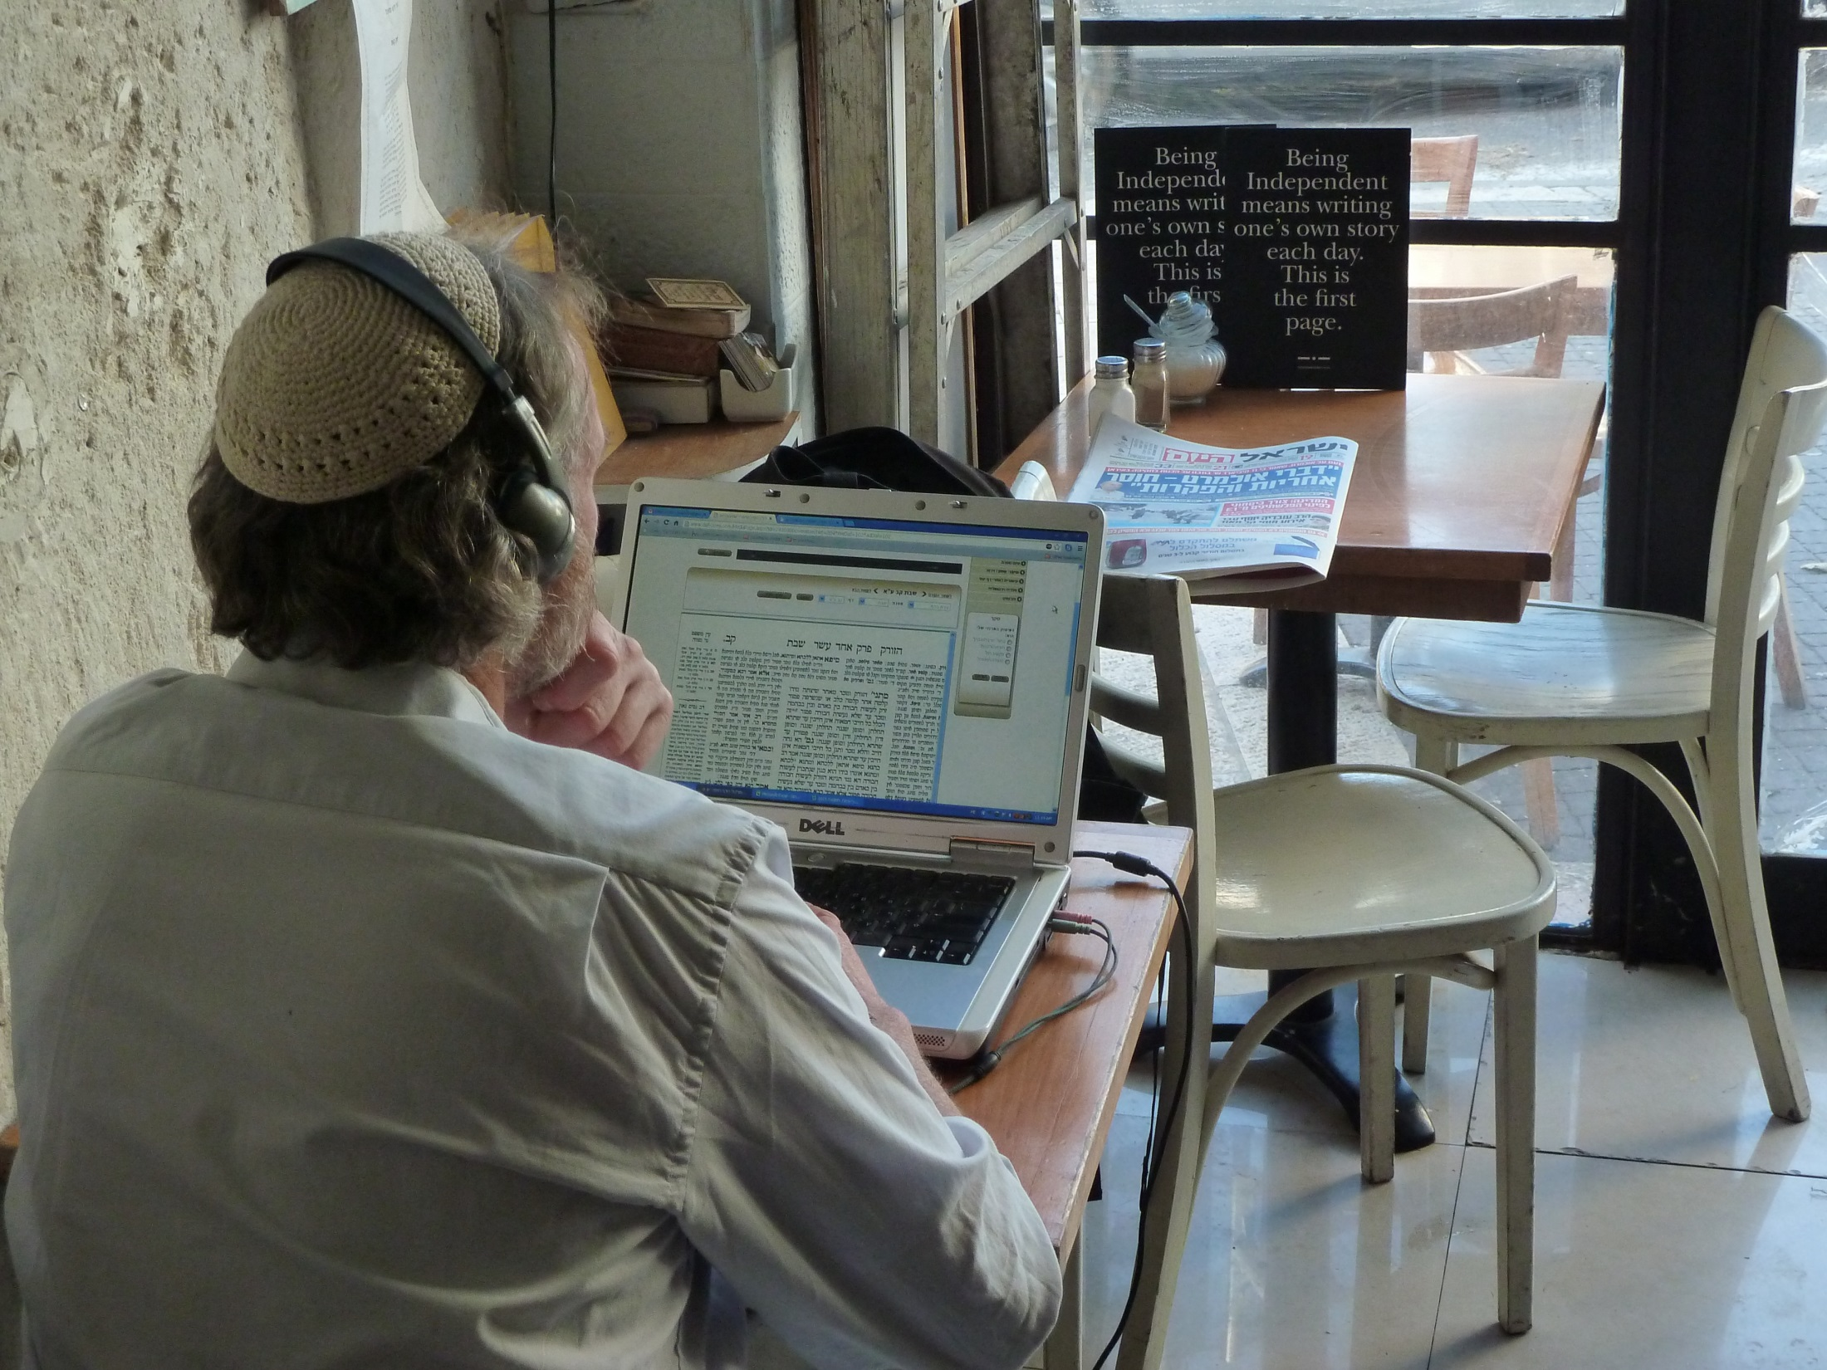
Jerusalem | Taamon

Slide 26
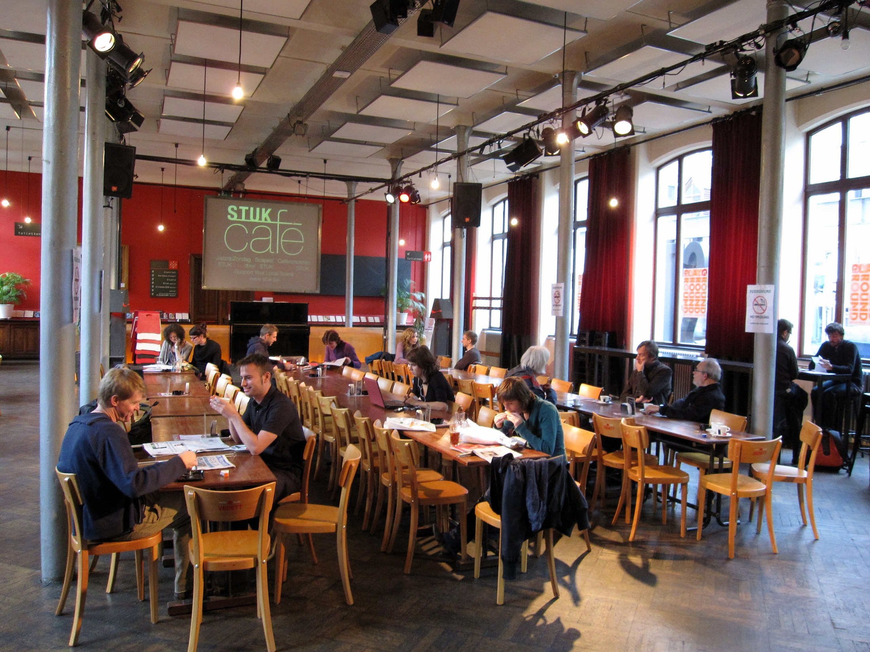
Leuven | Stuk

Slide 27
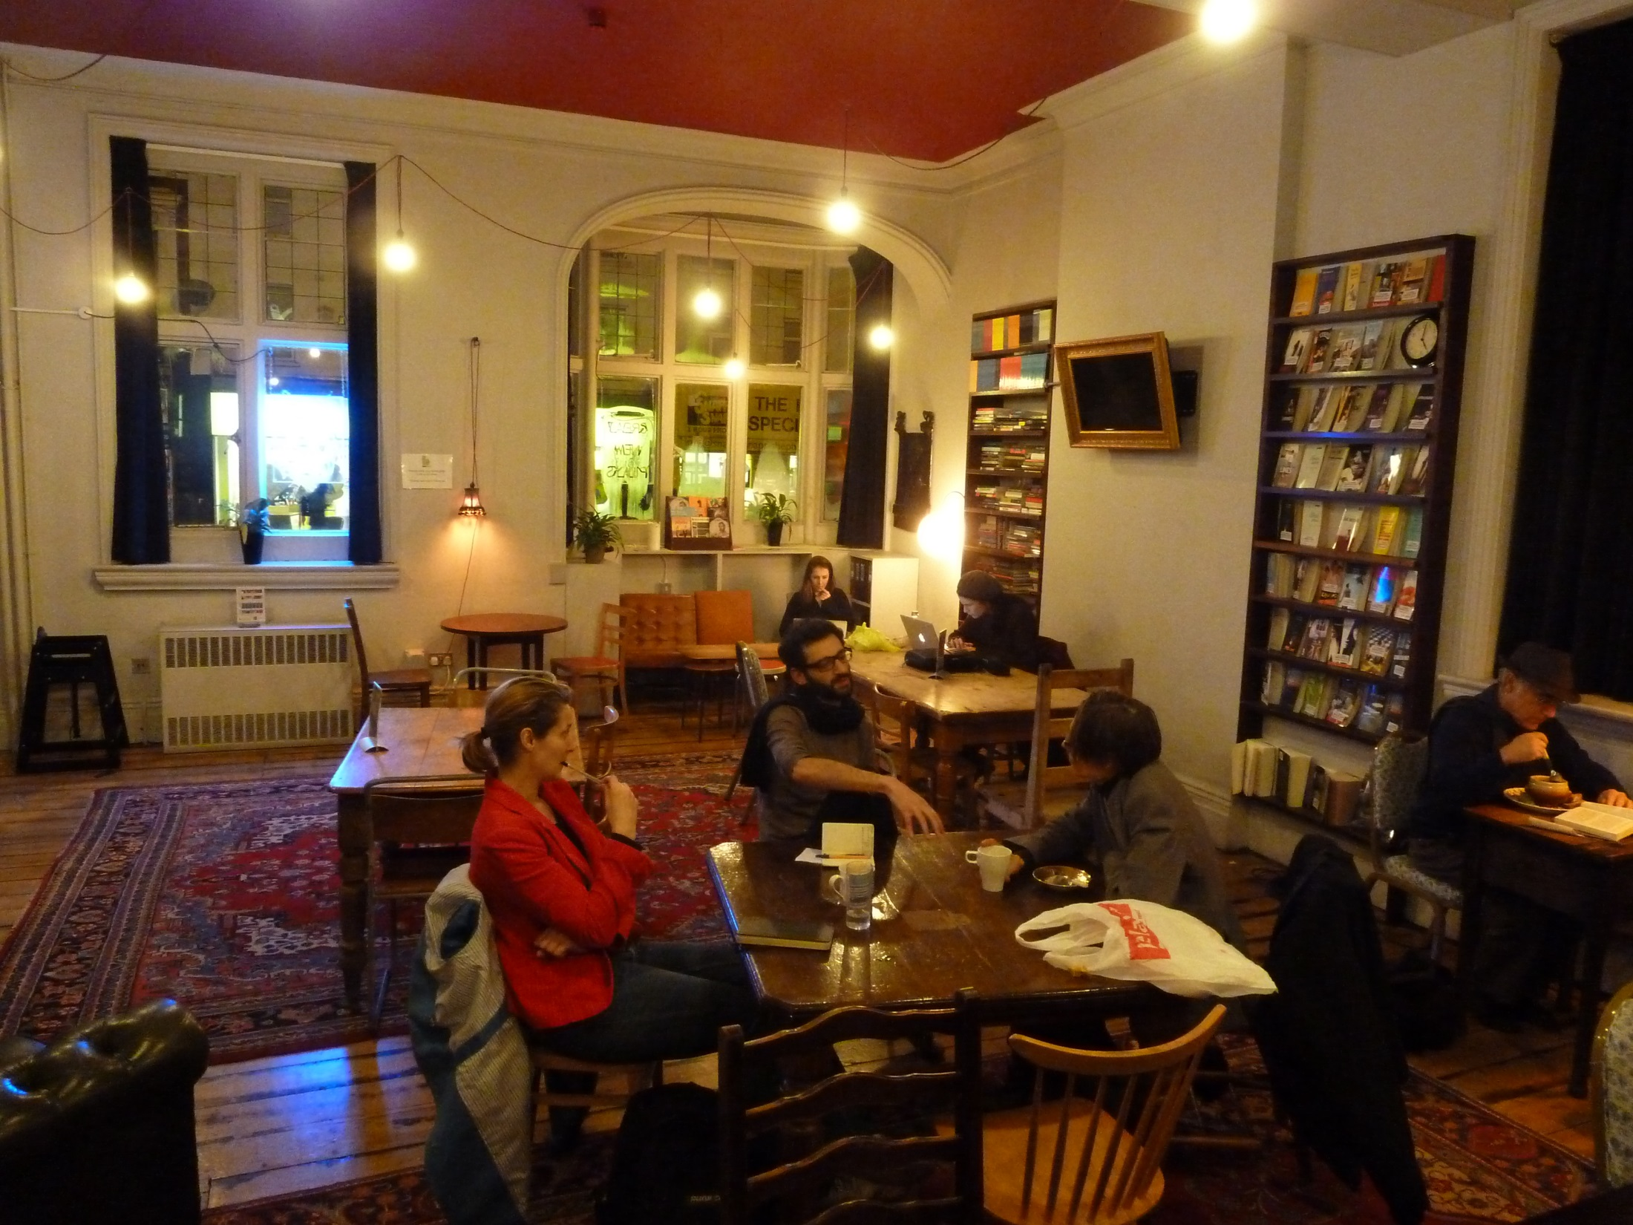
London | Bush Theatre

Slide 28
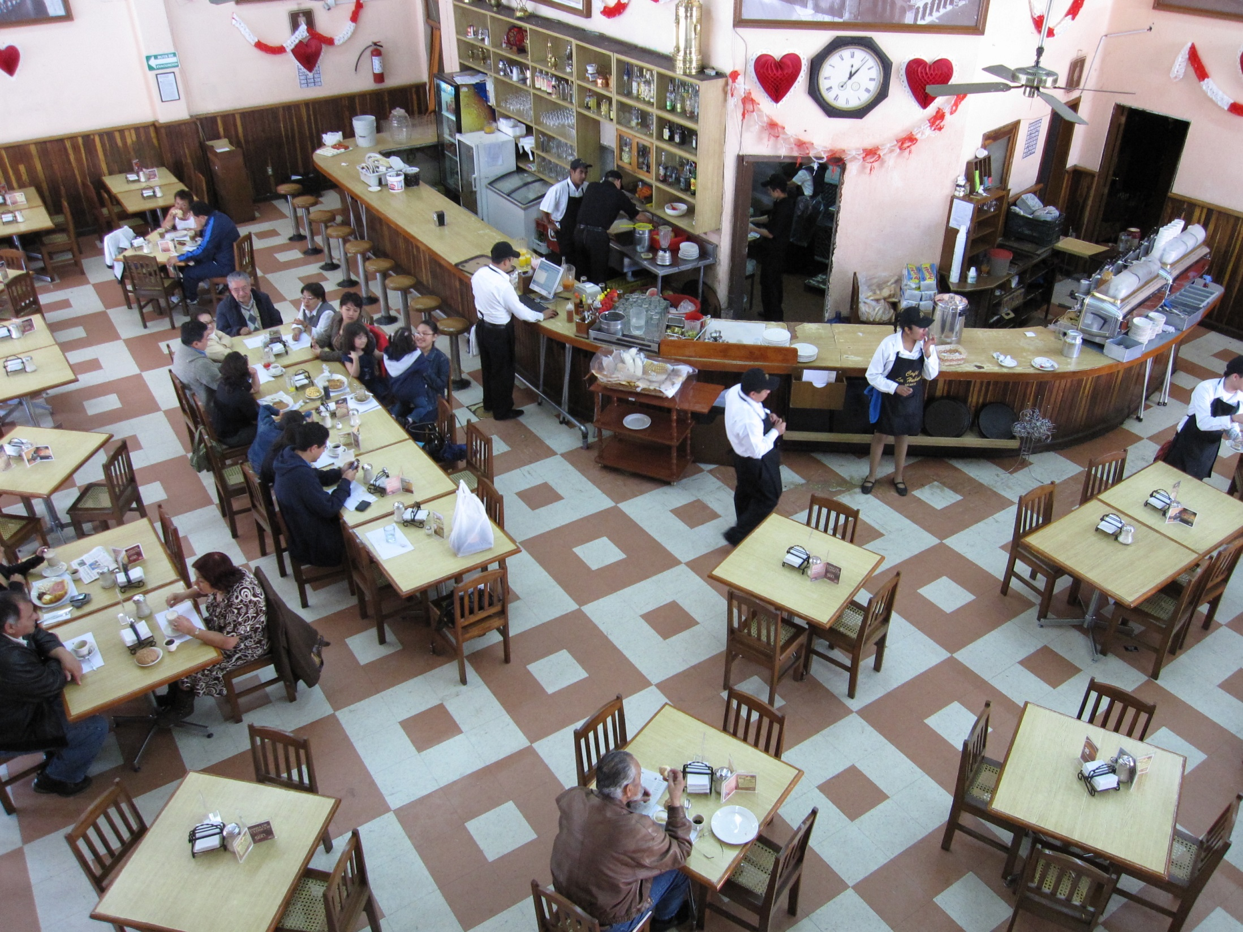
Mexico City | Café La Habana

Slide 29
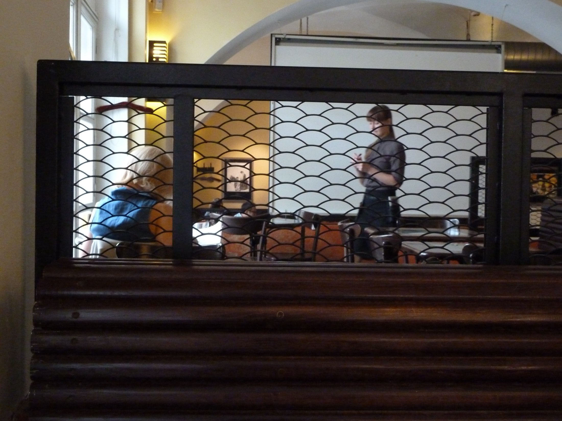
Moscow | Coffee Mania

Slide 30
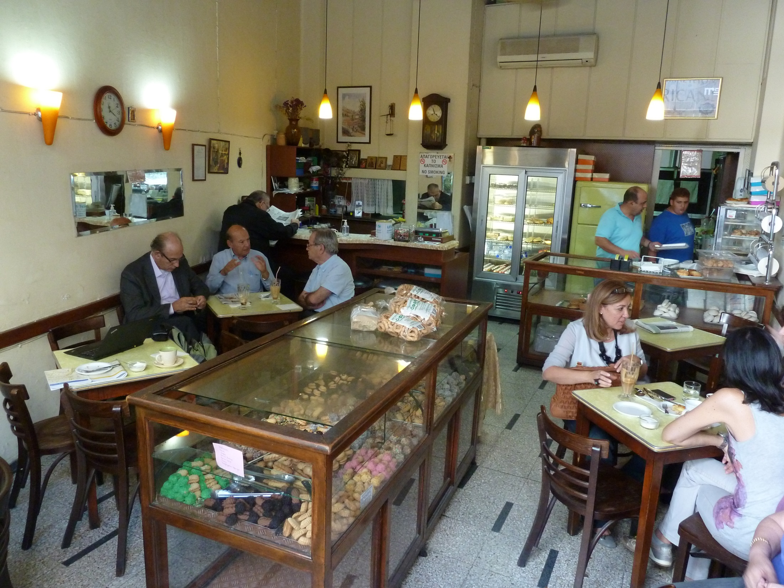
Nicosia | Hurricane

Slide 31
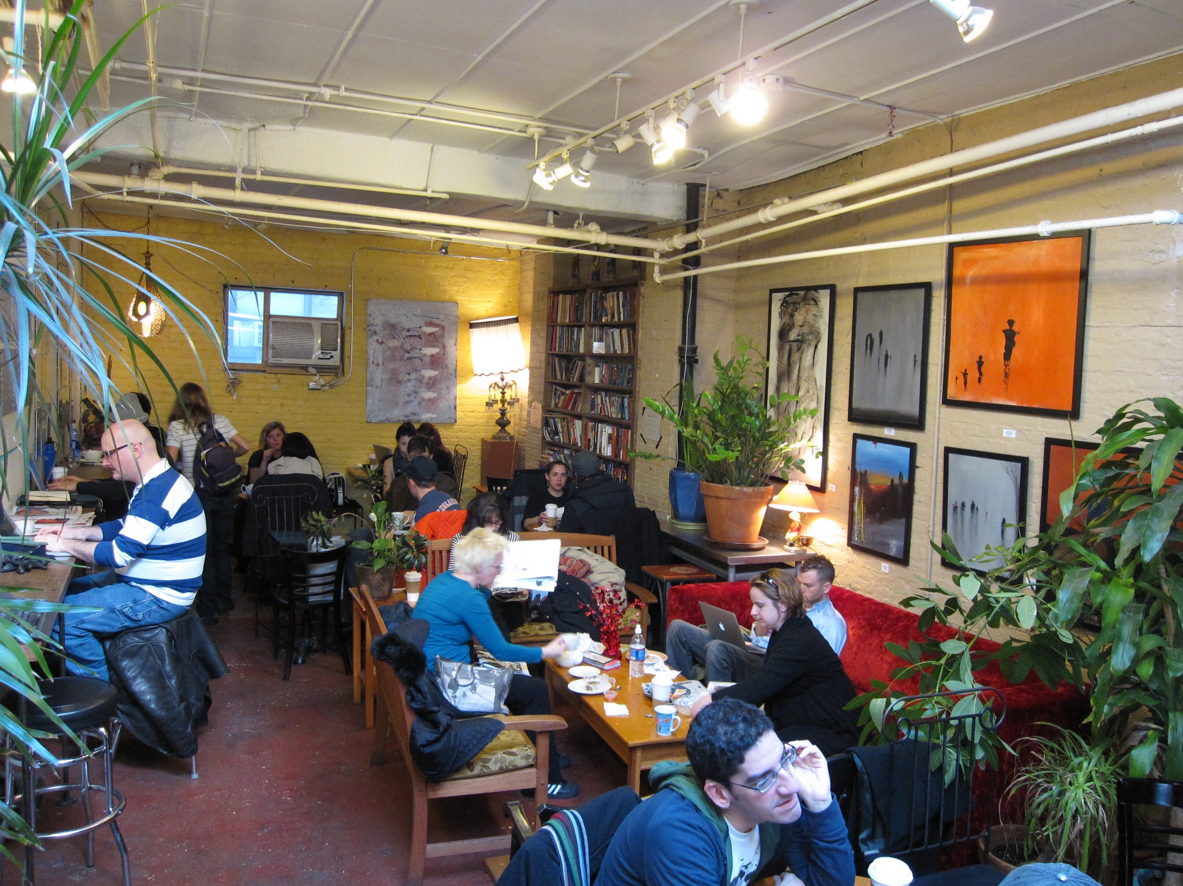
New York | Grounded

Slide 32
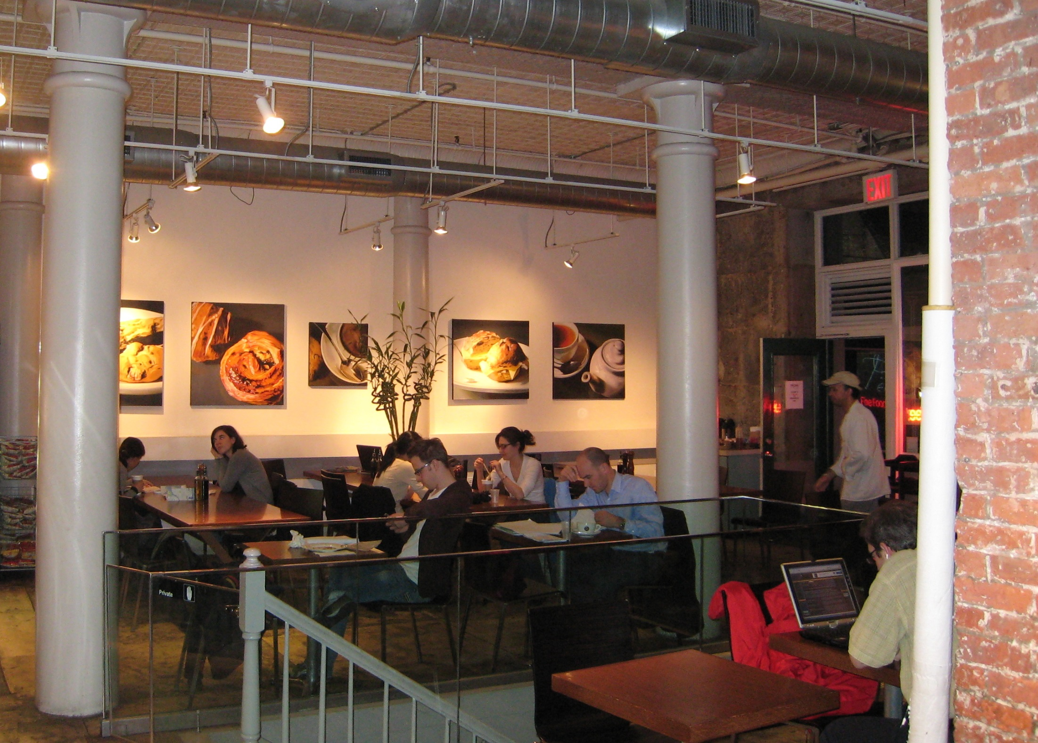
New York | Pecan

Slide 33
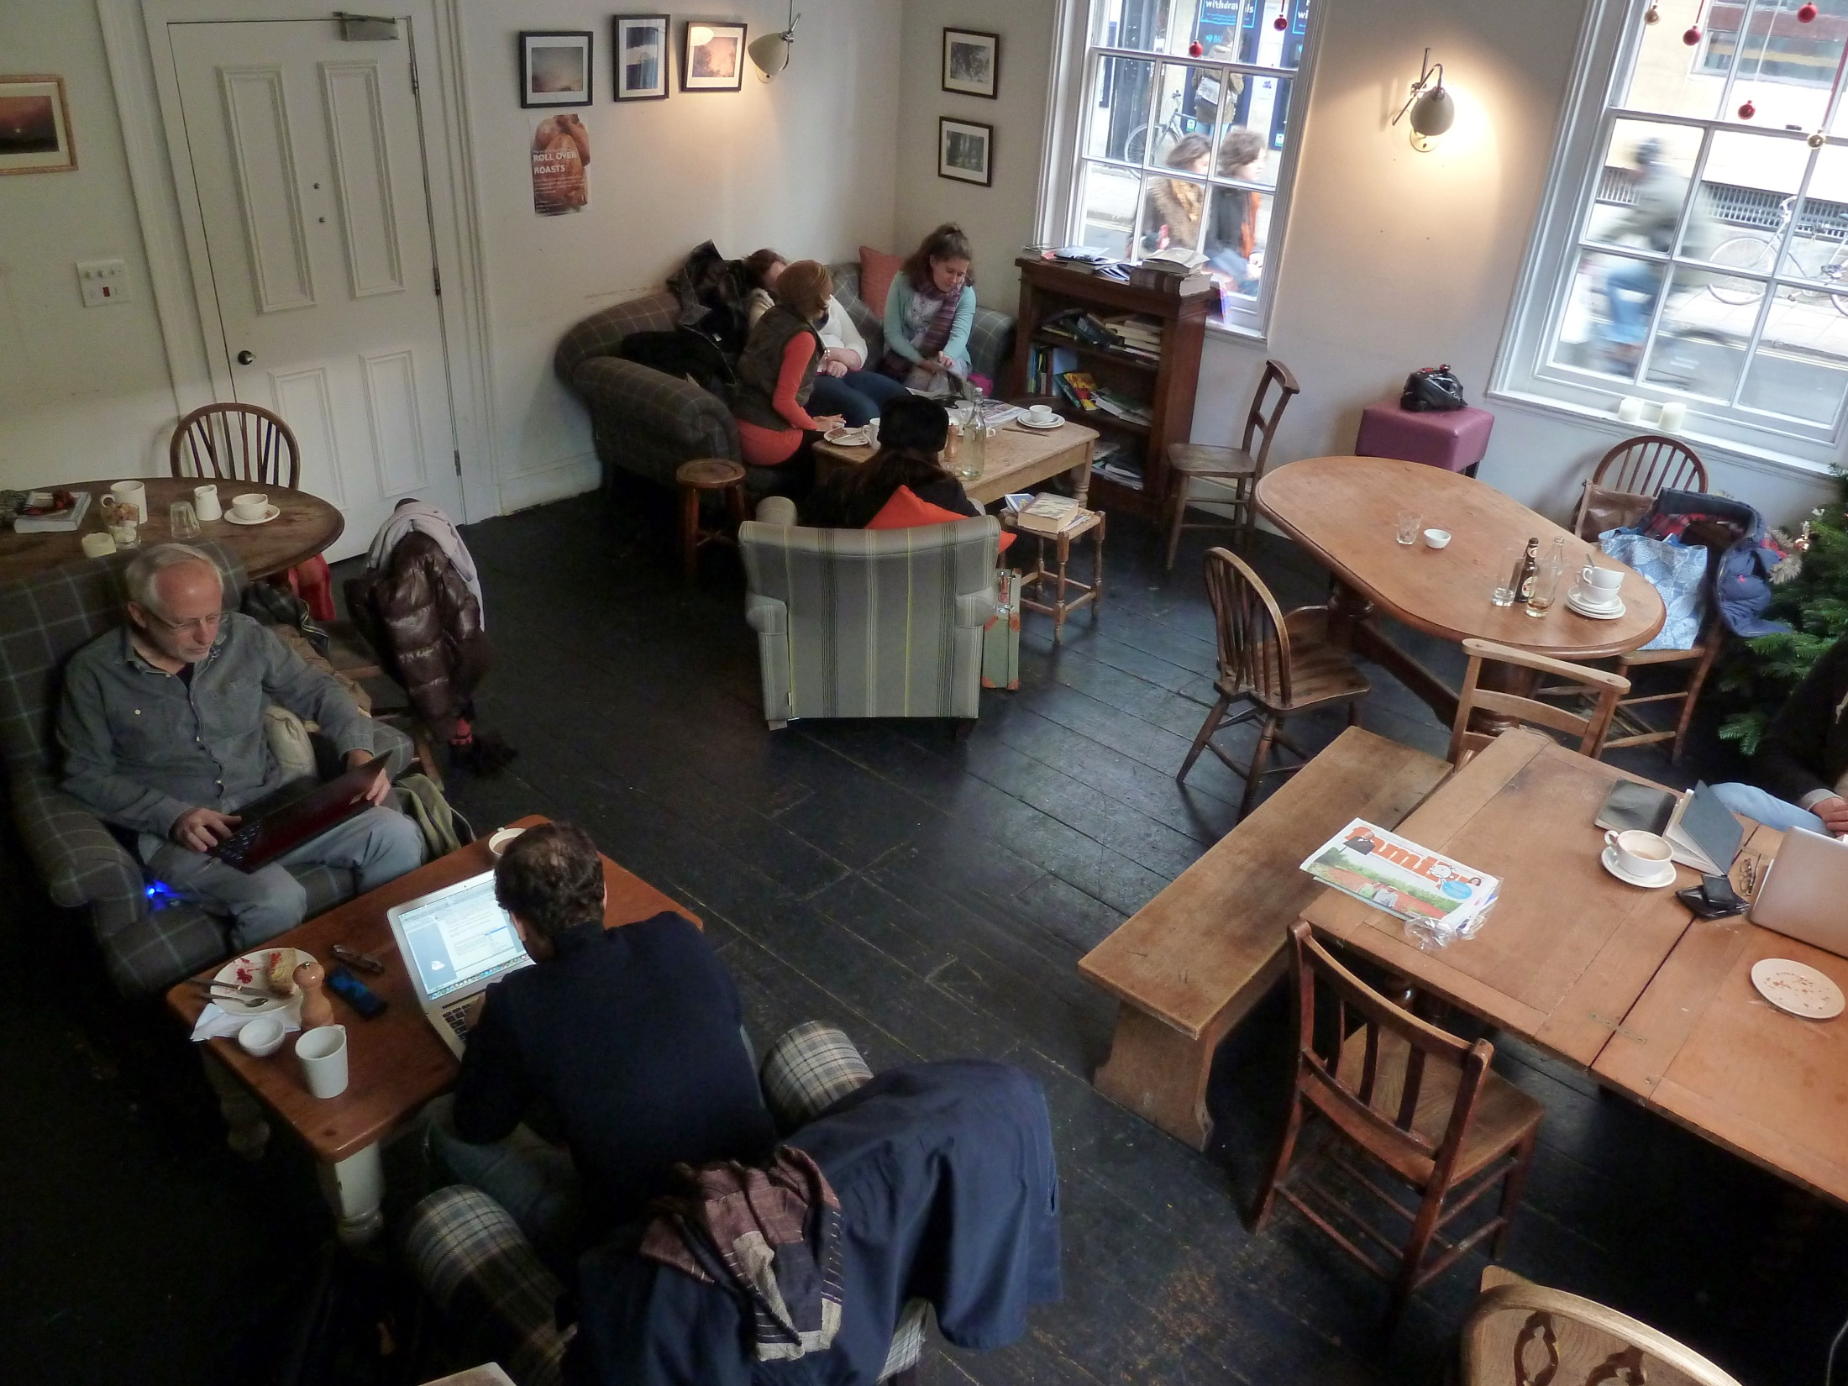
Oxford | Turl Street Kitchen

Slide 34
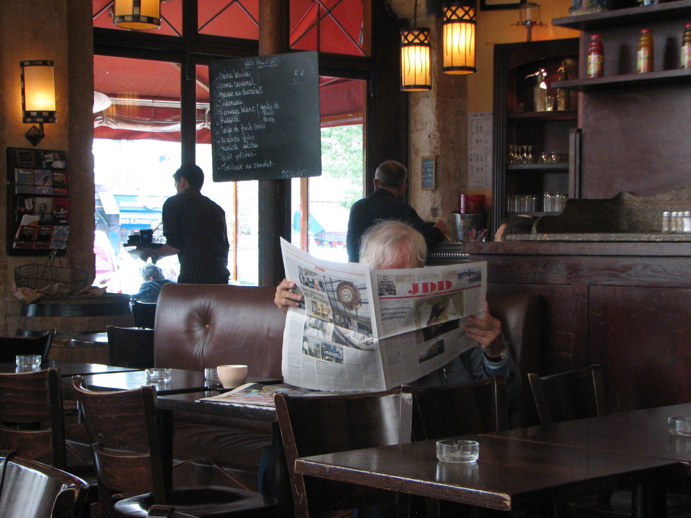
Paris | Cave La Bourgogne

Slide 35
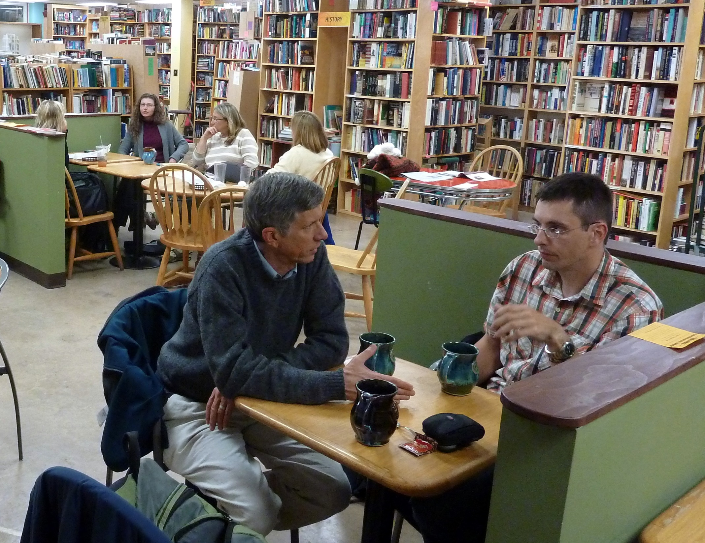
Penn State | Webster's Café

Slide 36
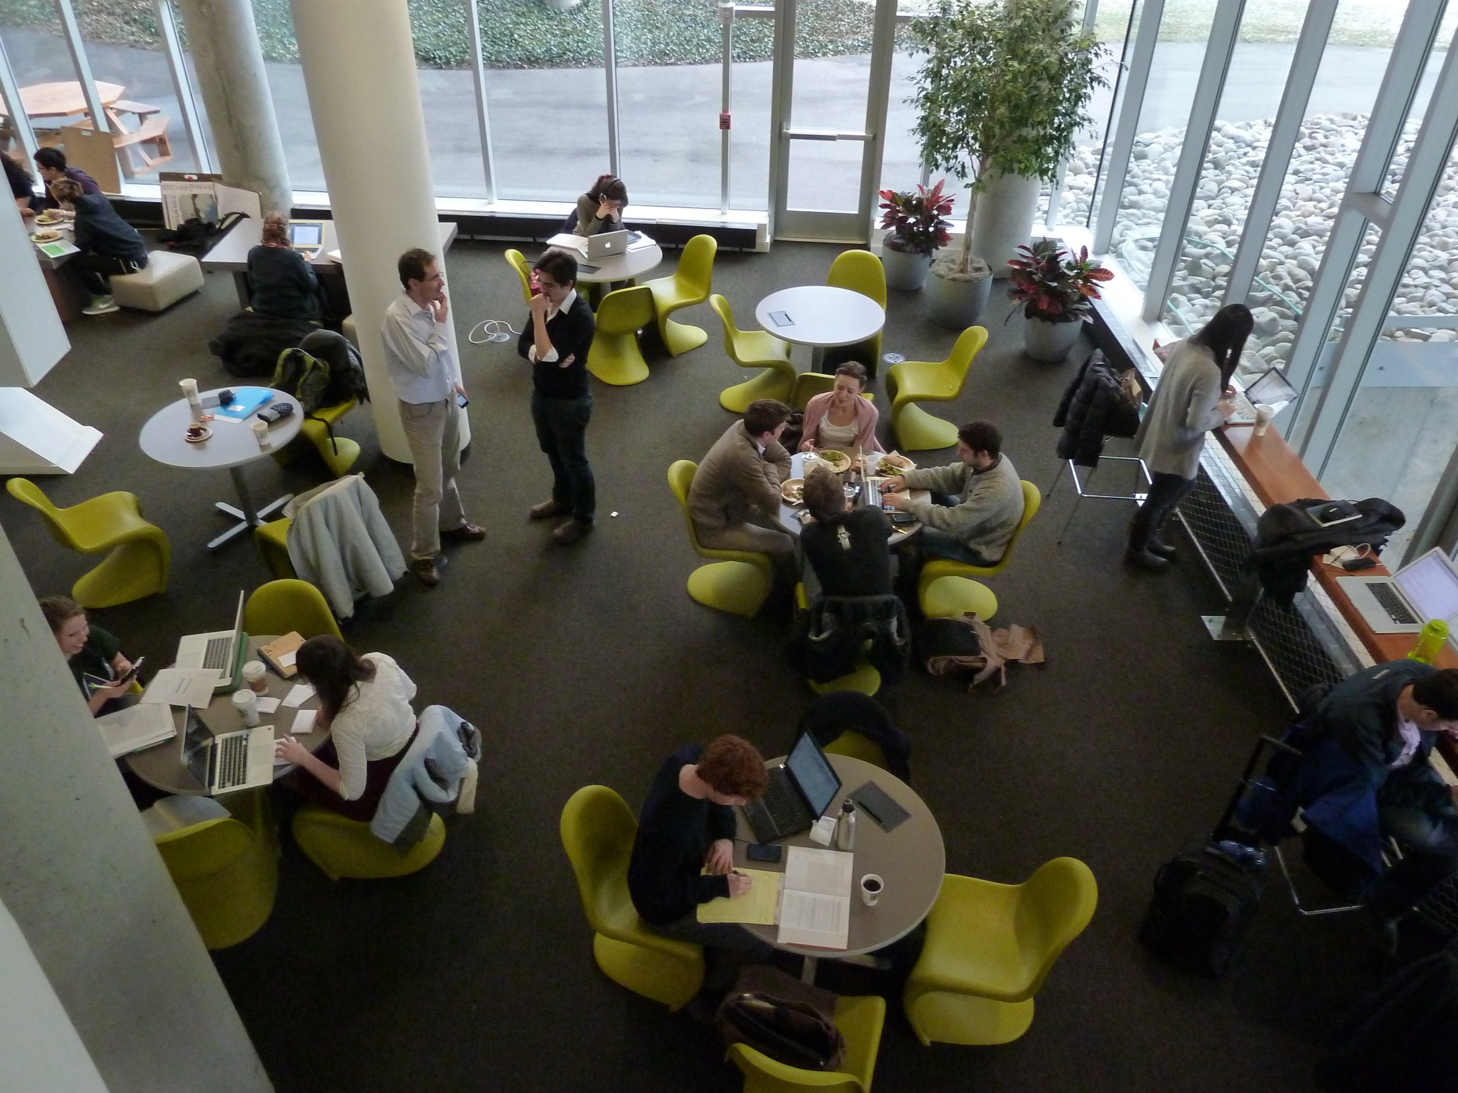
Pittsburgh | Tazza D'Oro

Slide 37
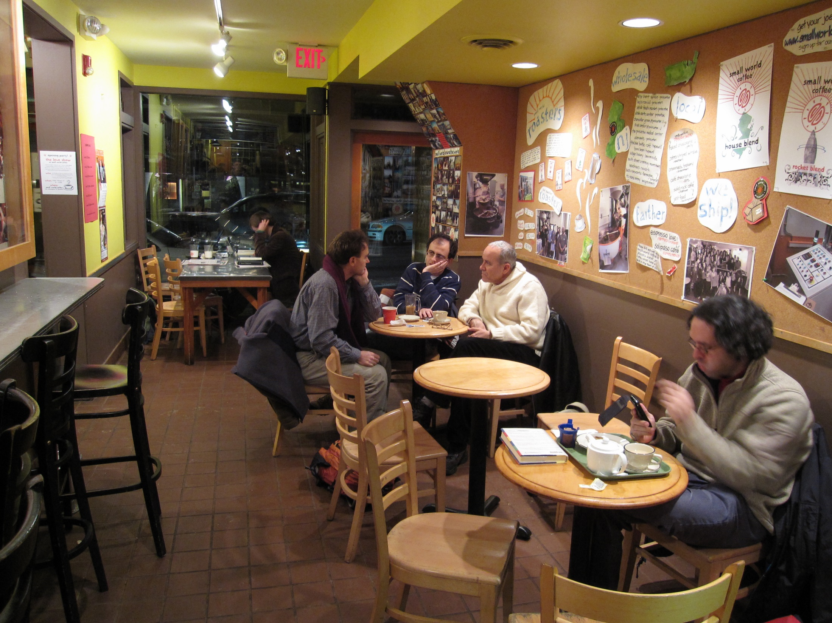
Princeton | Small World Coffee

Slide 38
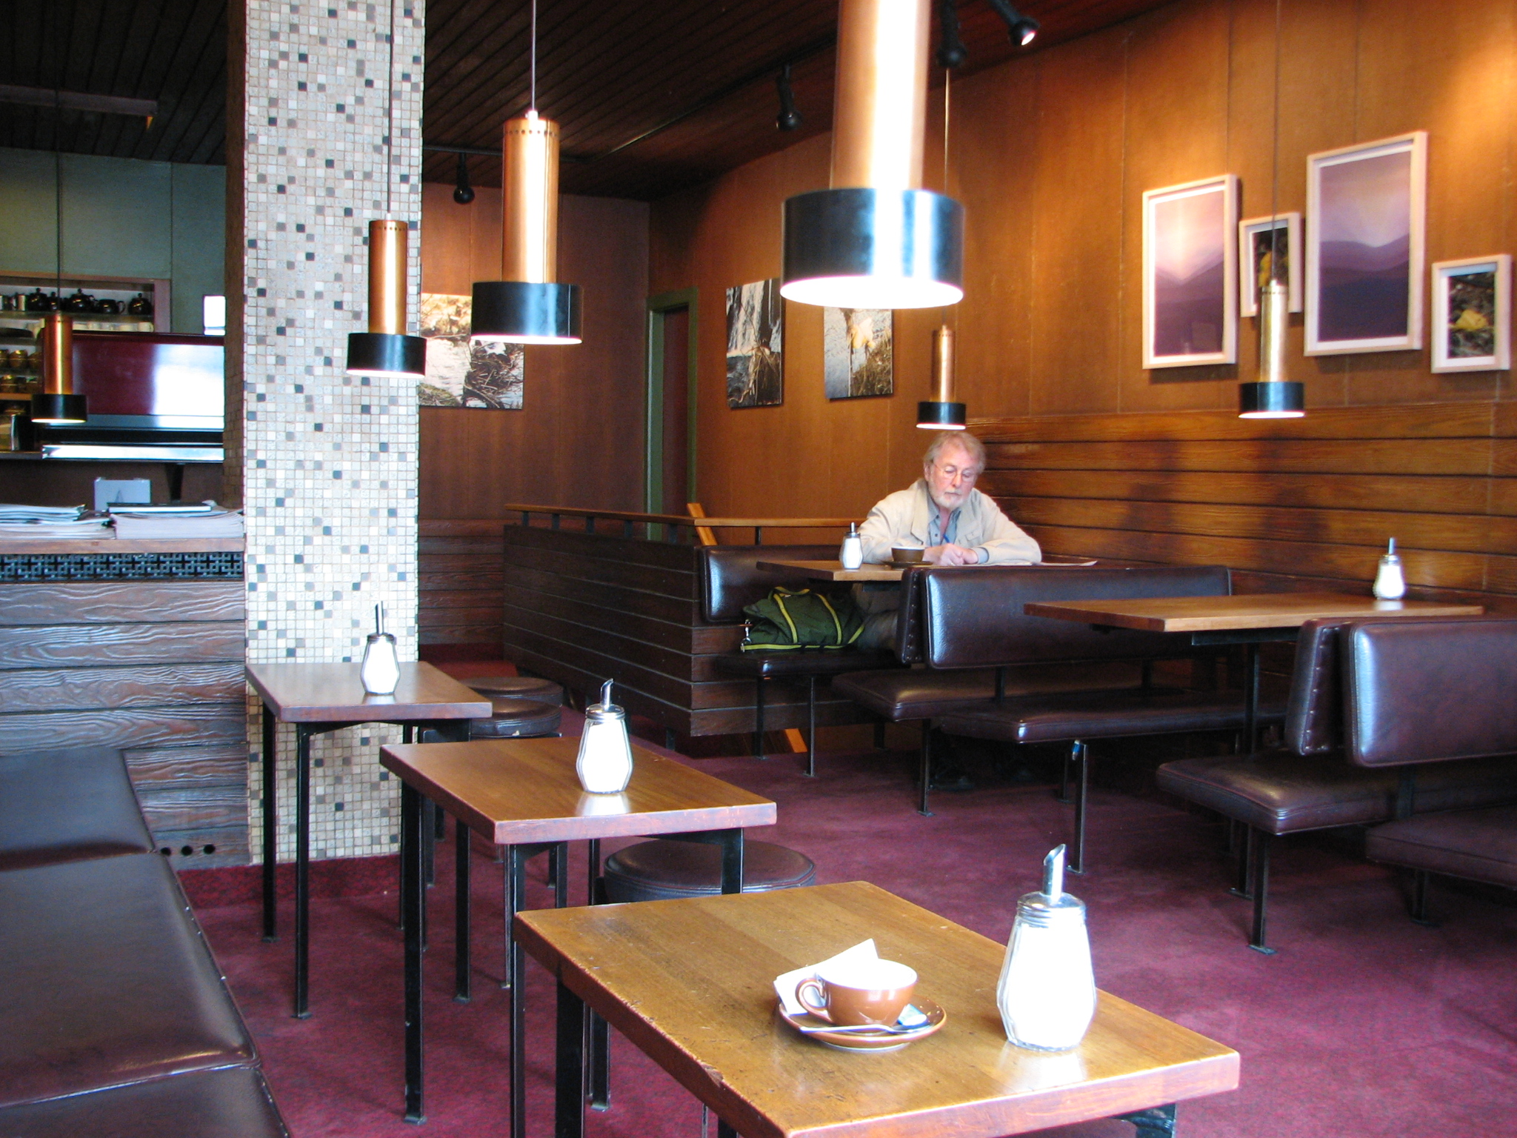
Reykjavík | Mokka Kaffi

Slide 39
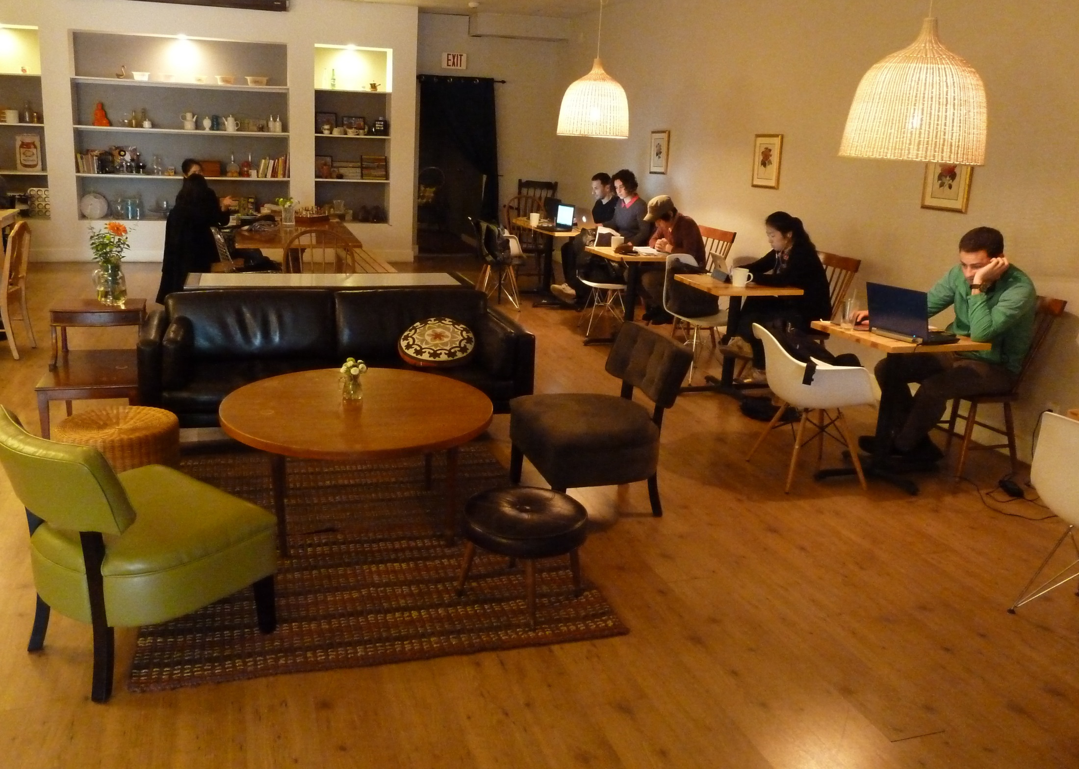
San Fransisco | YakiniQ Café

Slide 40
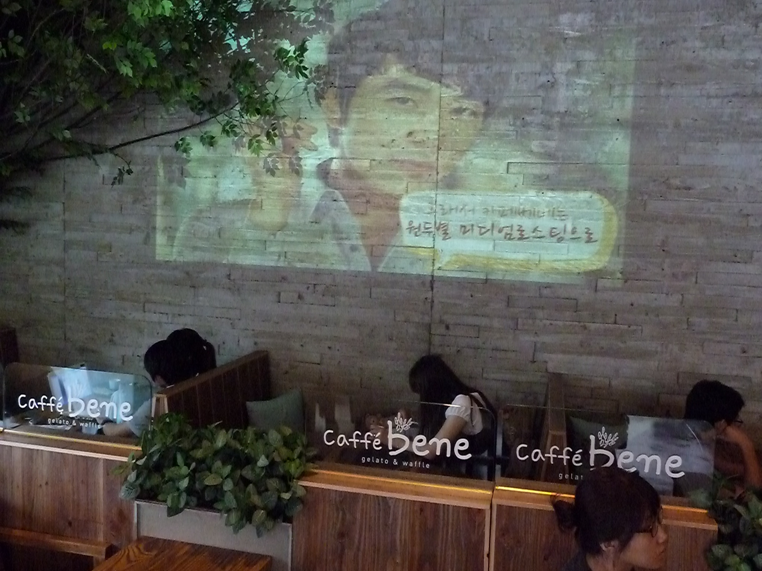
Seoul | Caffe Bene

Slide 41
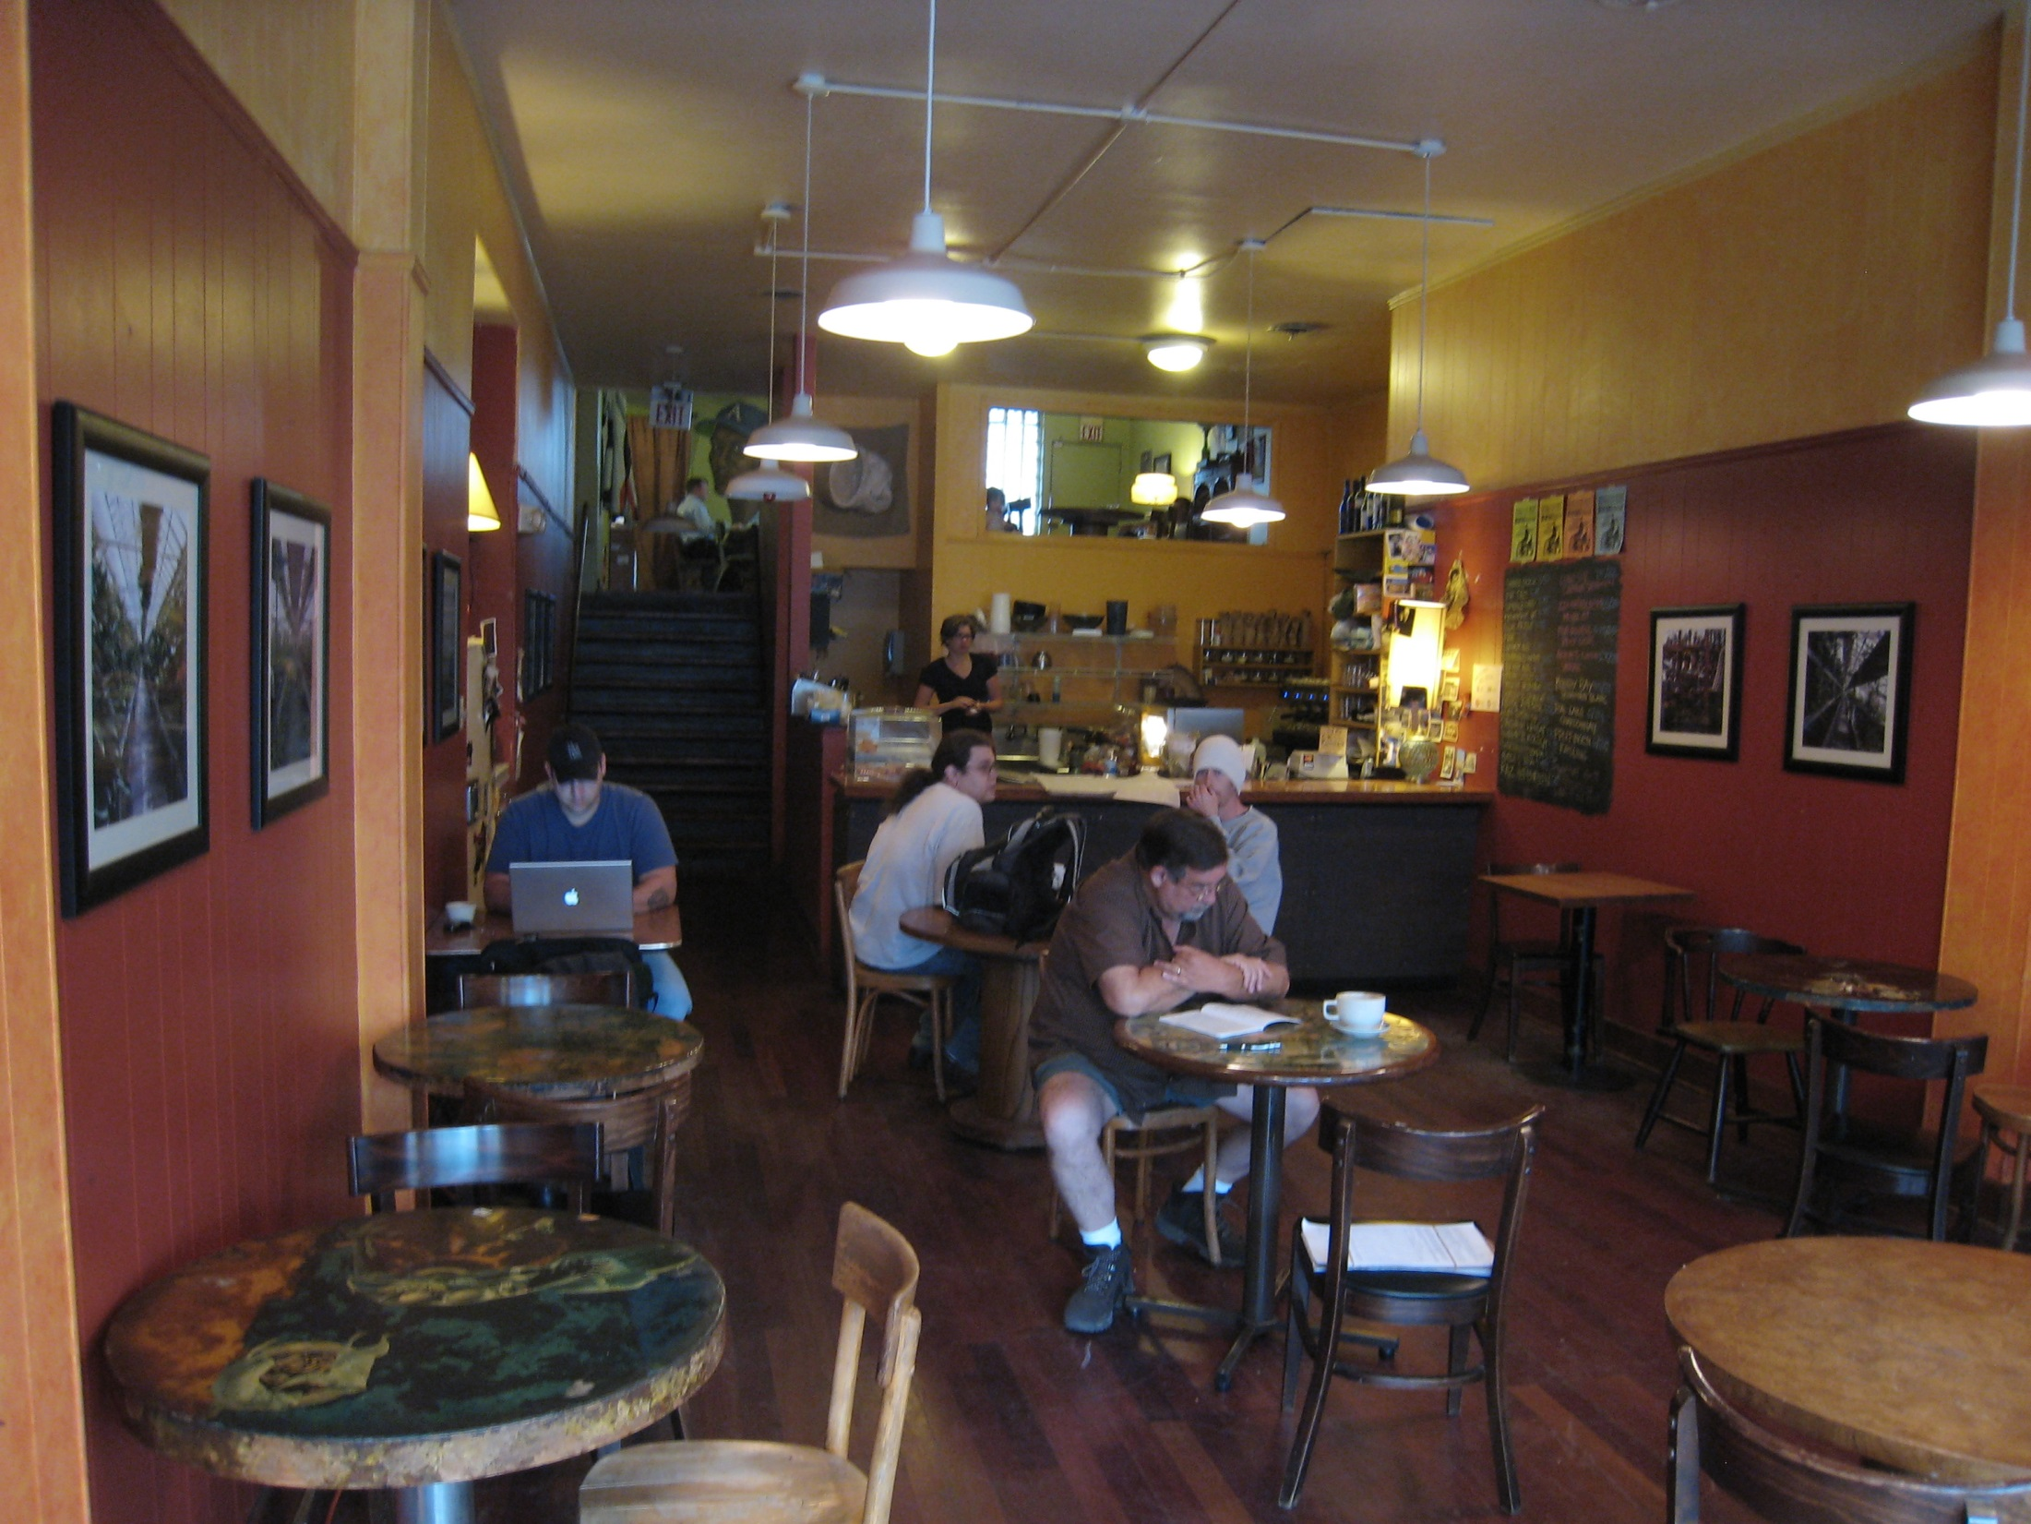
St. Louis | Meshuggah Cafe

Slide 42
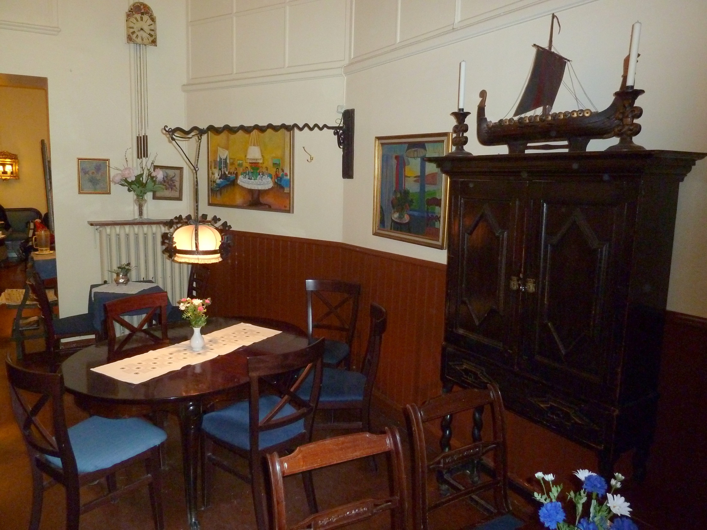
Stockholm | Vete-Katten

Slide 43
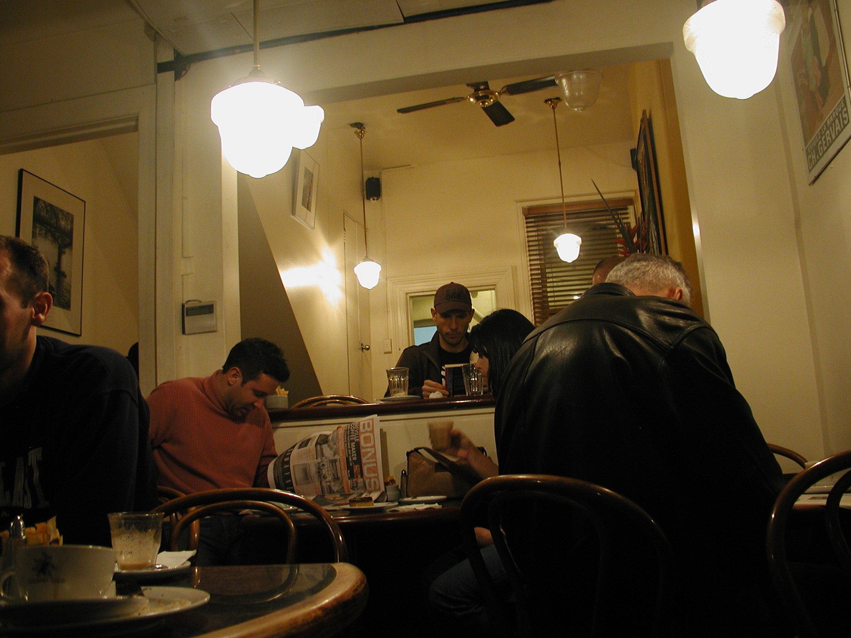
Sydney | Le Petit Tarte

Slide 44
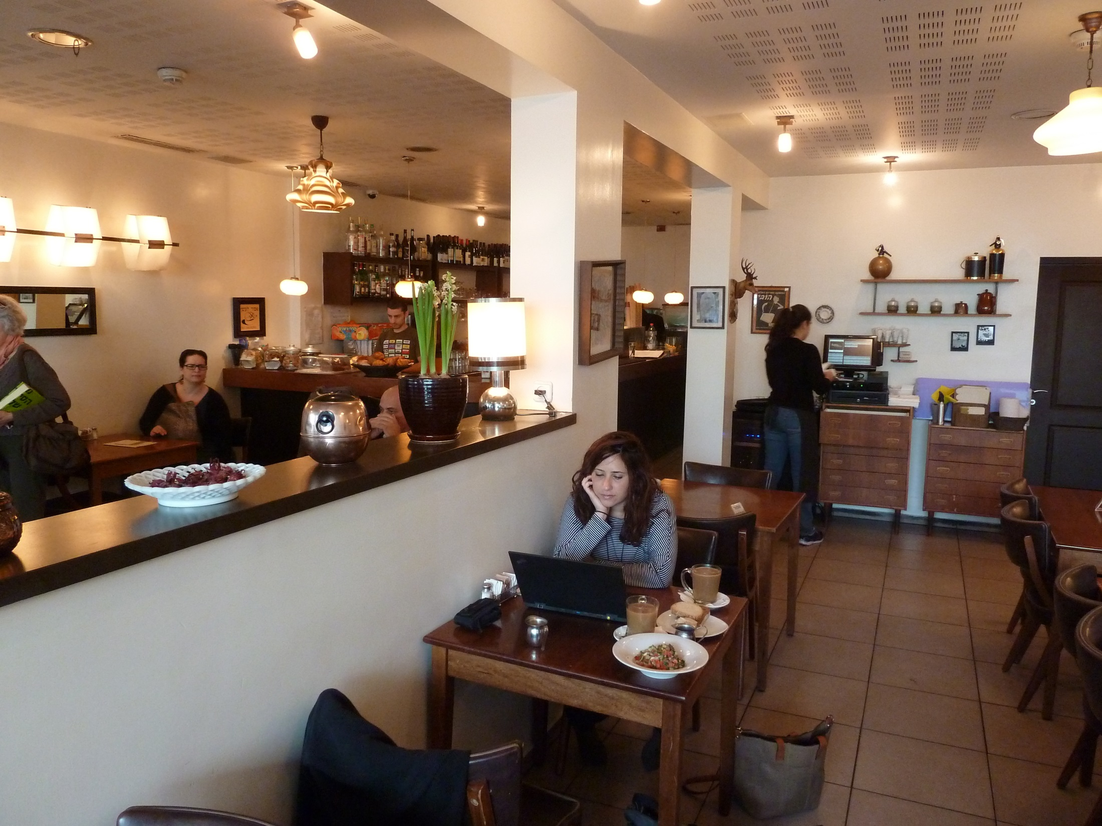
Tel Aviv | Beta Caffe

Slide 45
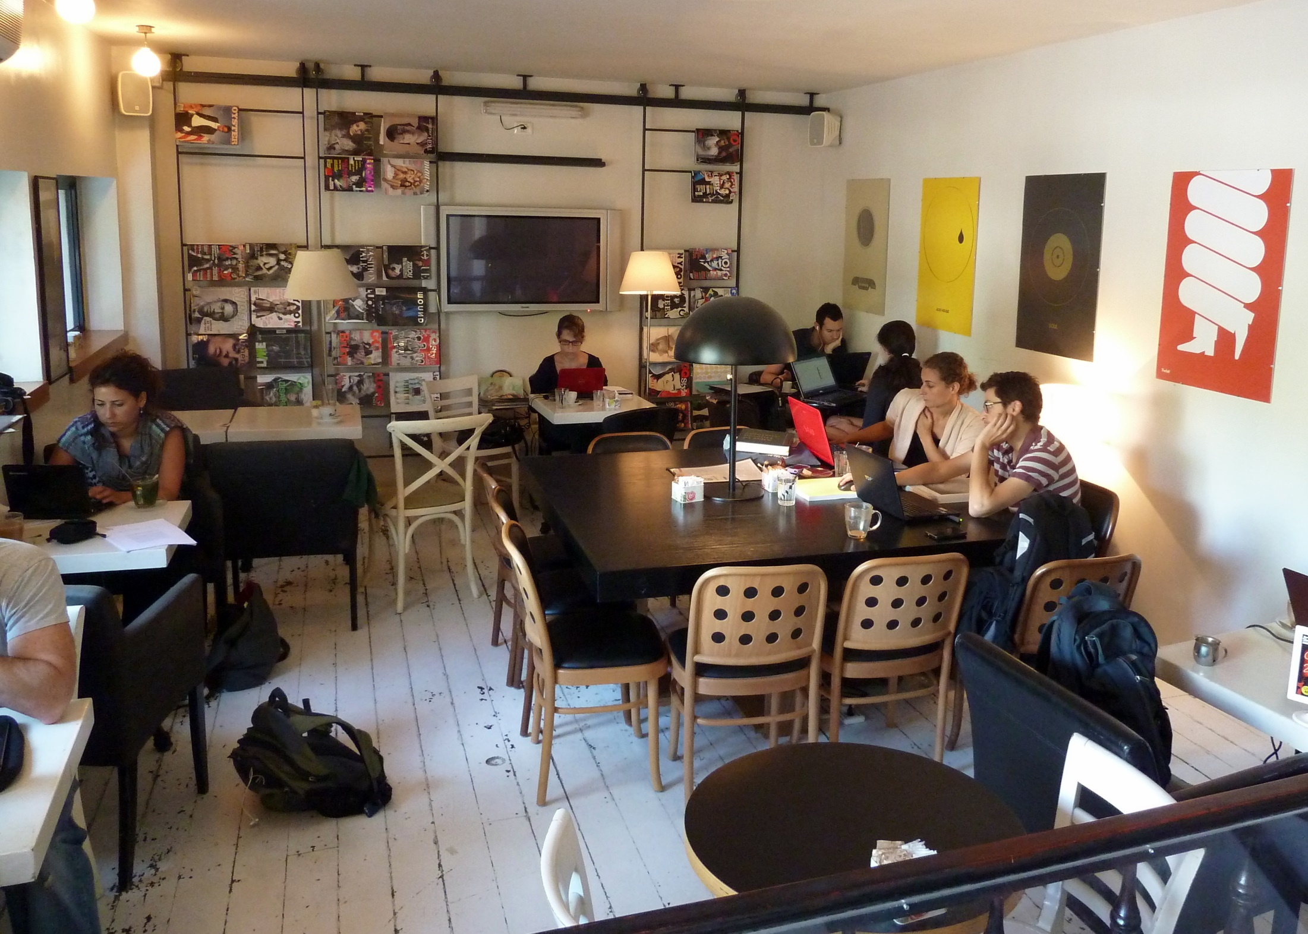
Tel Aviv | The Streets

Slide 46
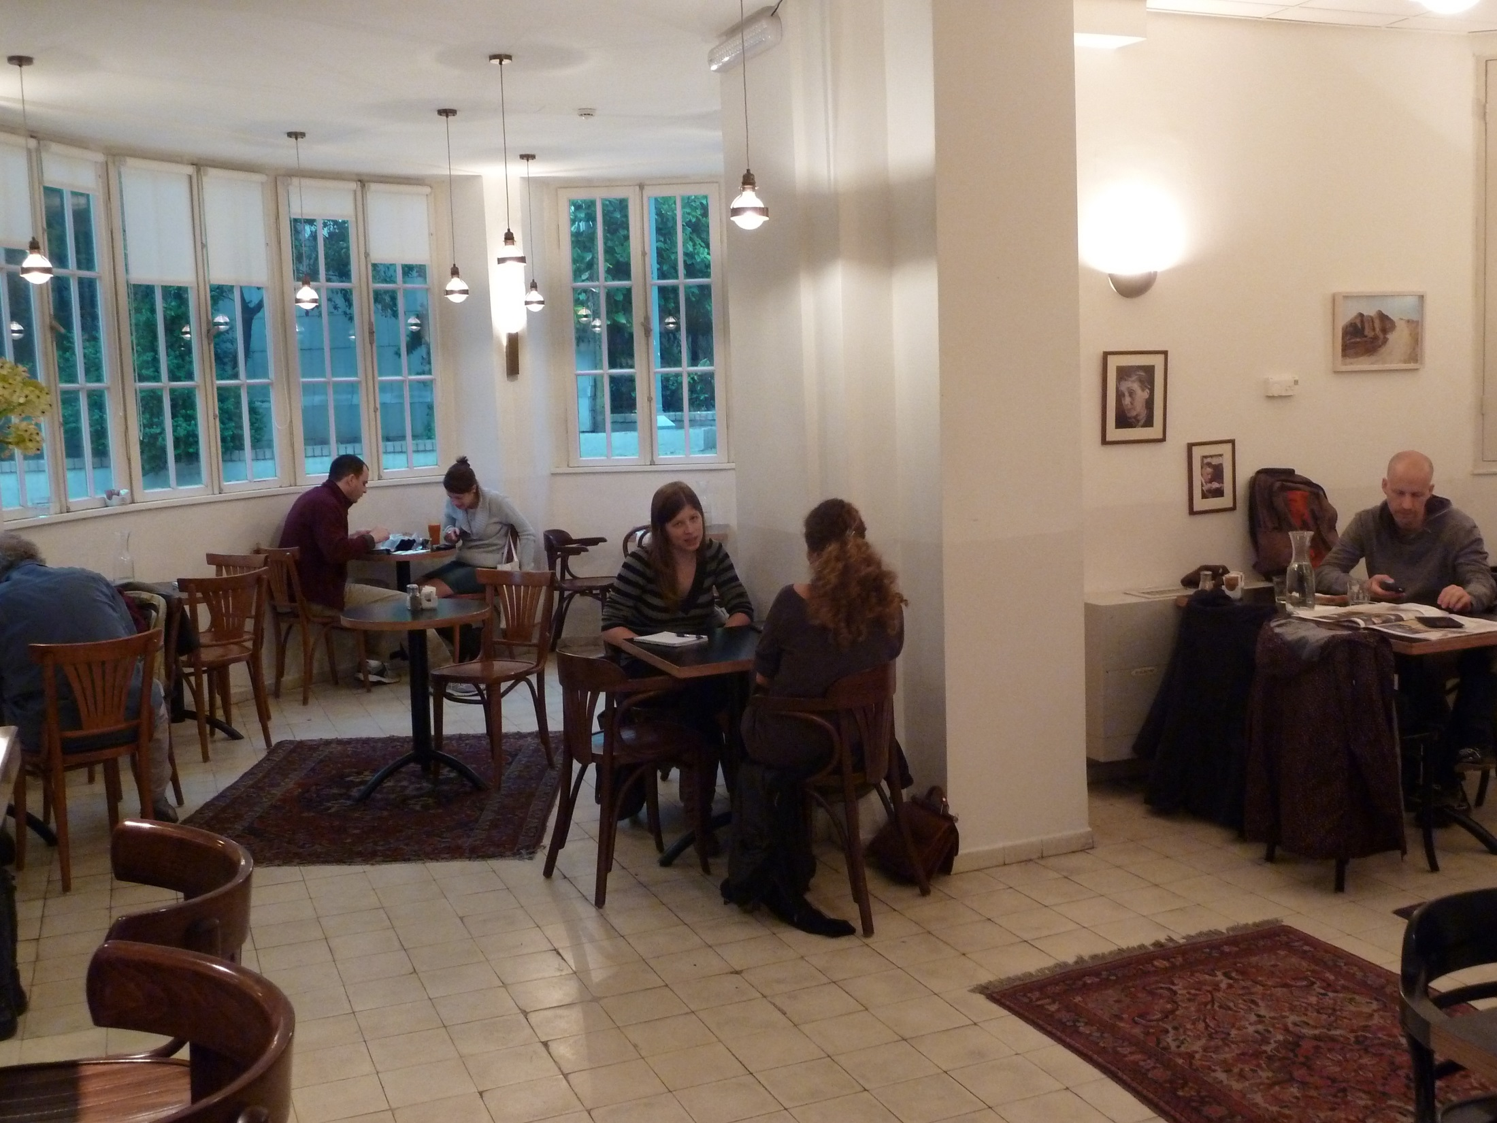
Tel Aviv | Tolaat Sfarim

Slide 47
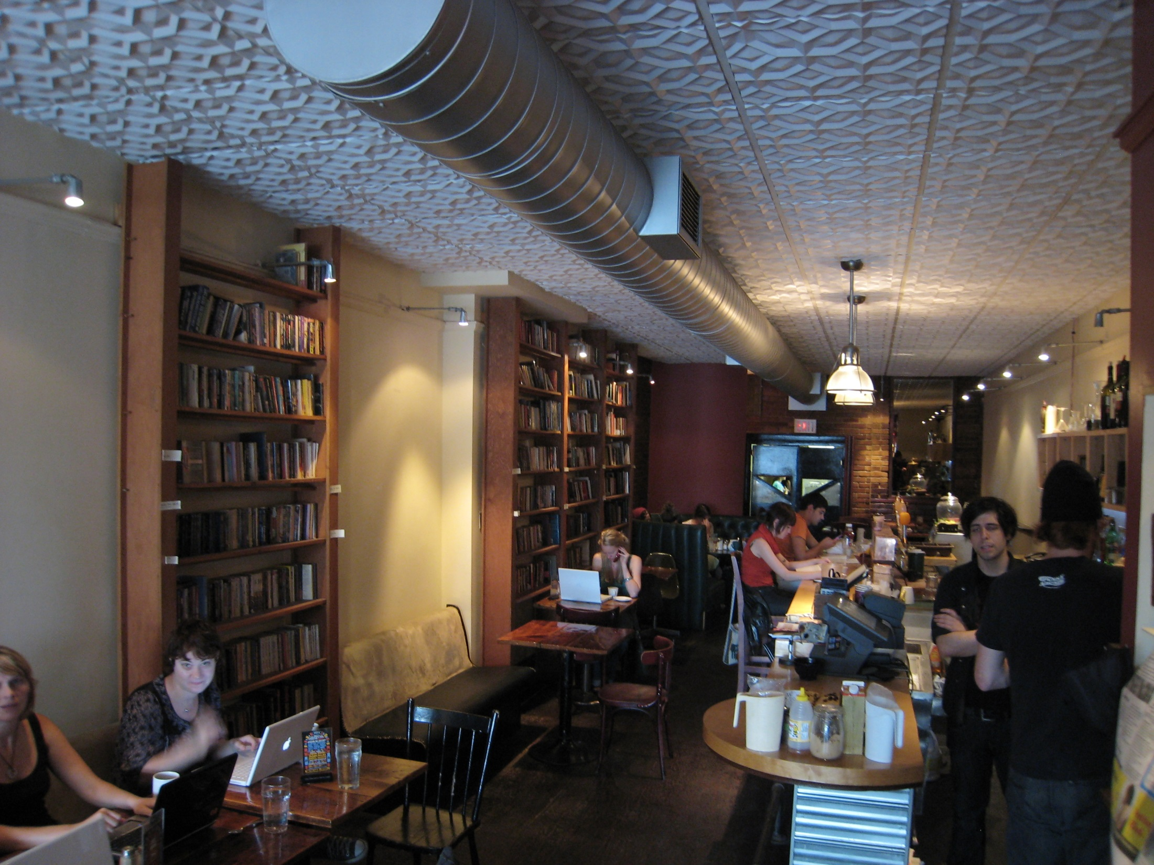
Toronto | Tequila Bookworm

Slide 48
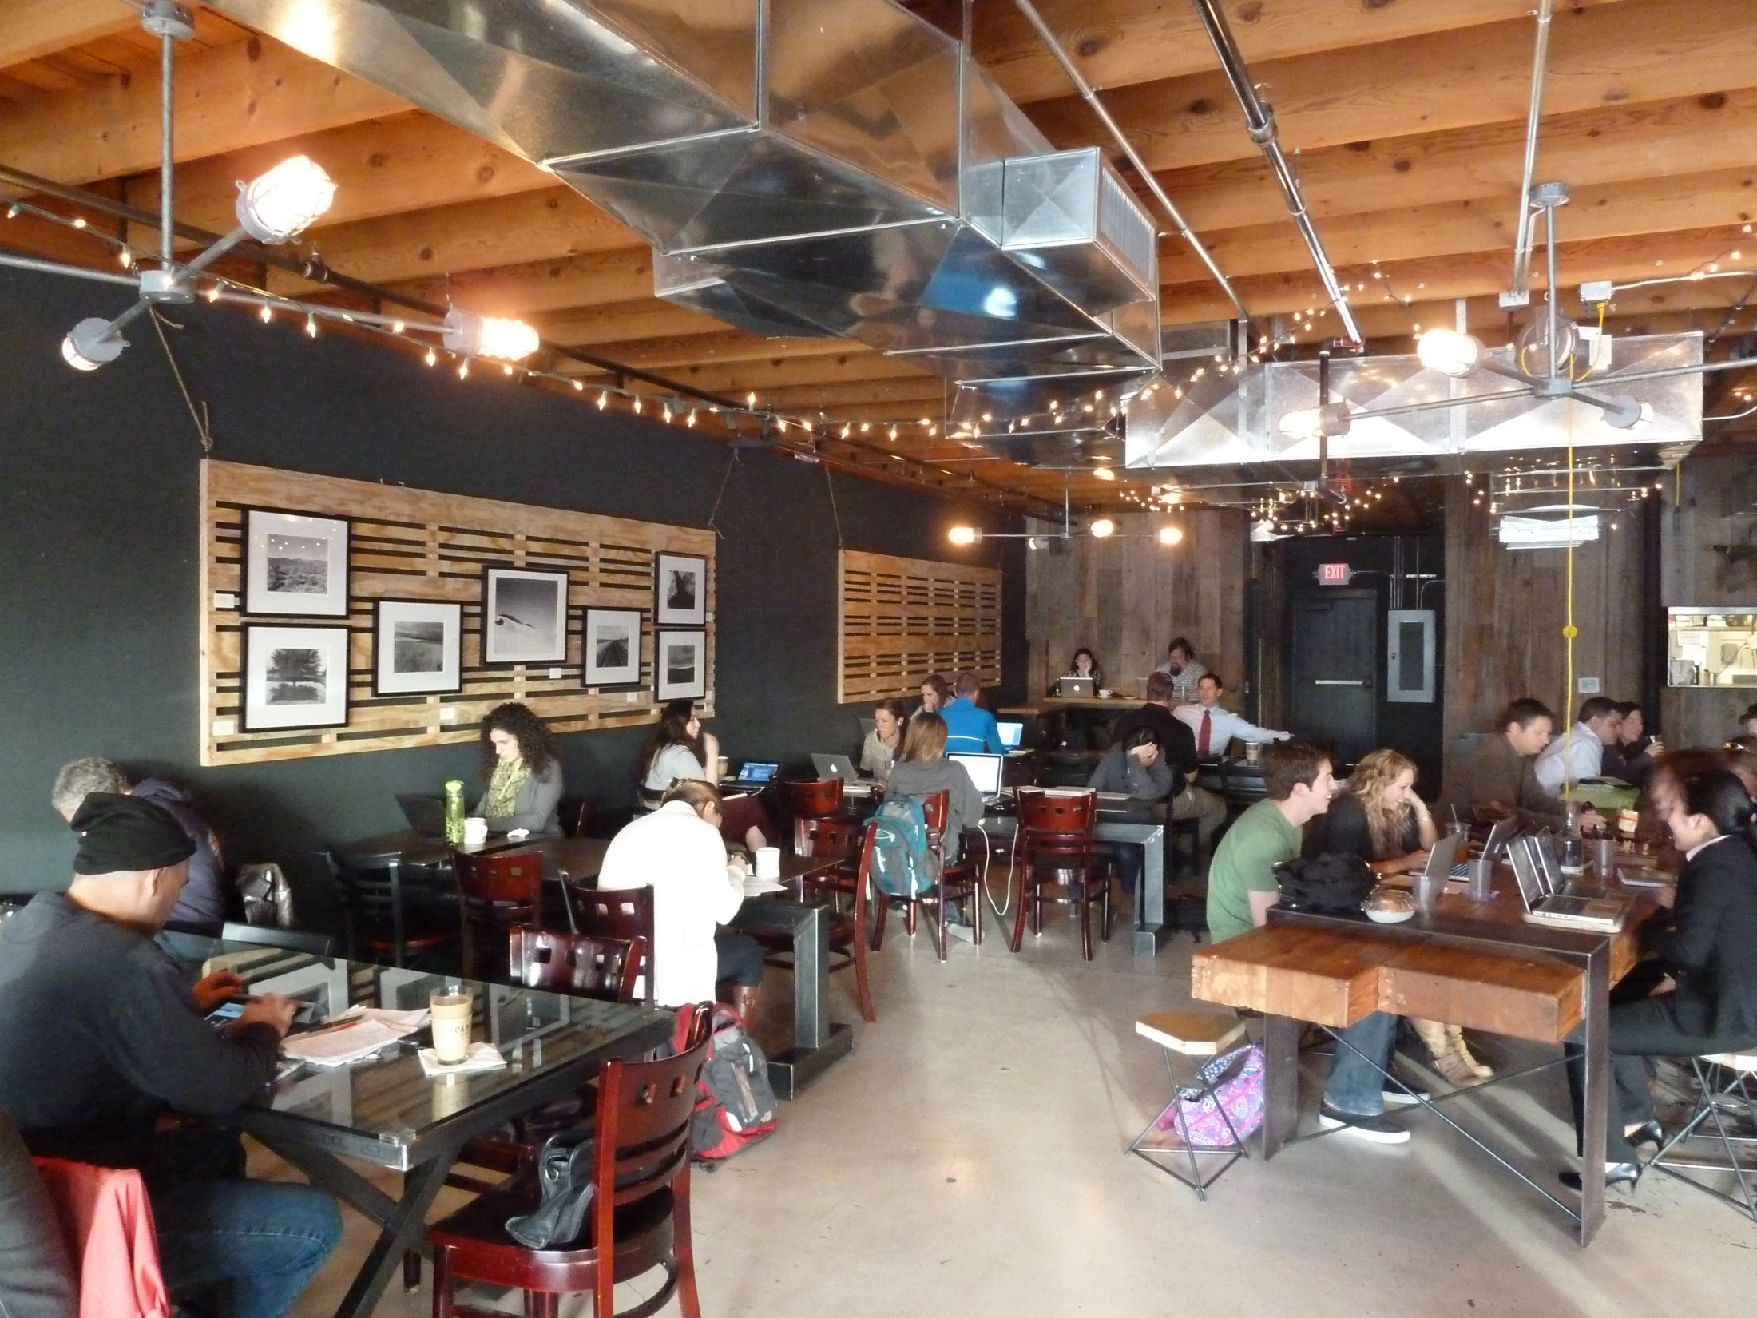
Tuscon | Cartel Coffee Lab

Slide 49
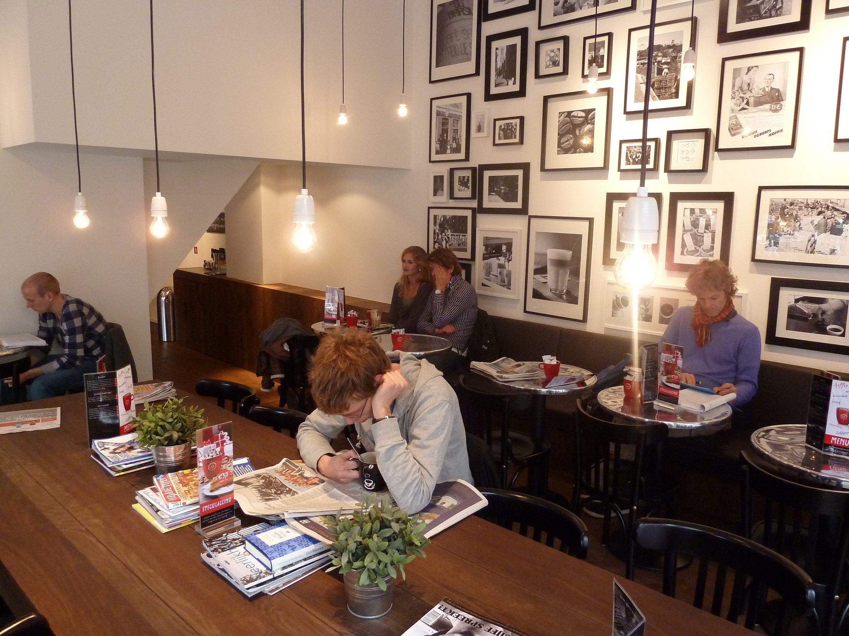
Utrecht | Douwe Egberts Café

Slide 50
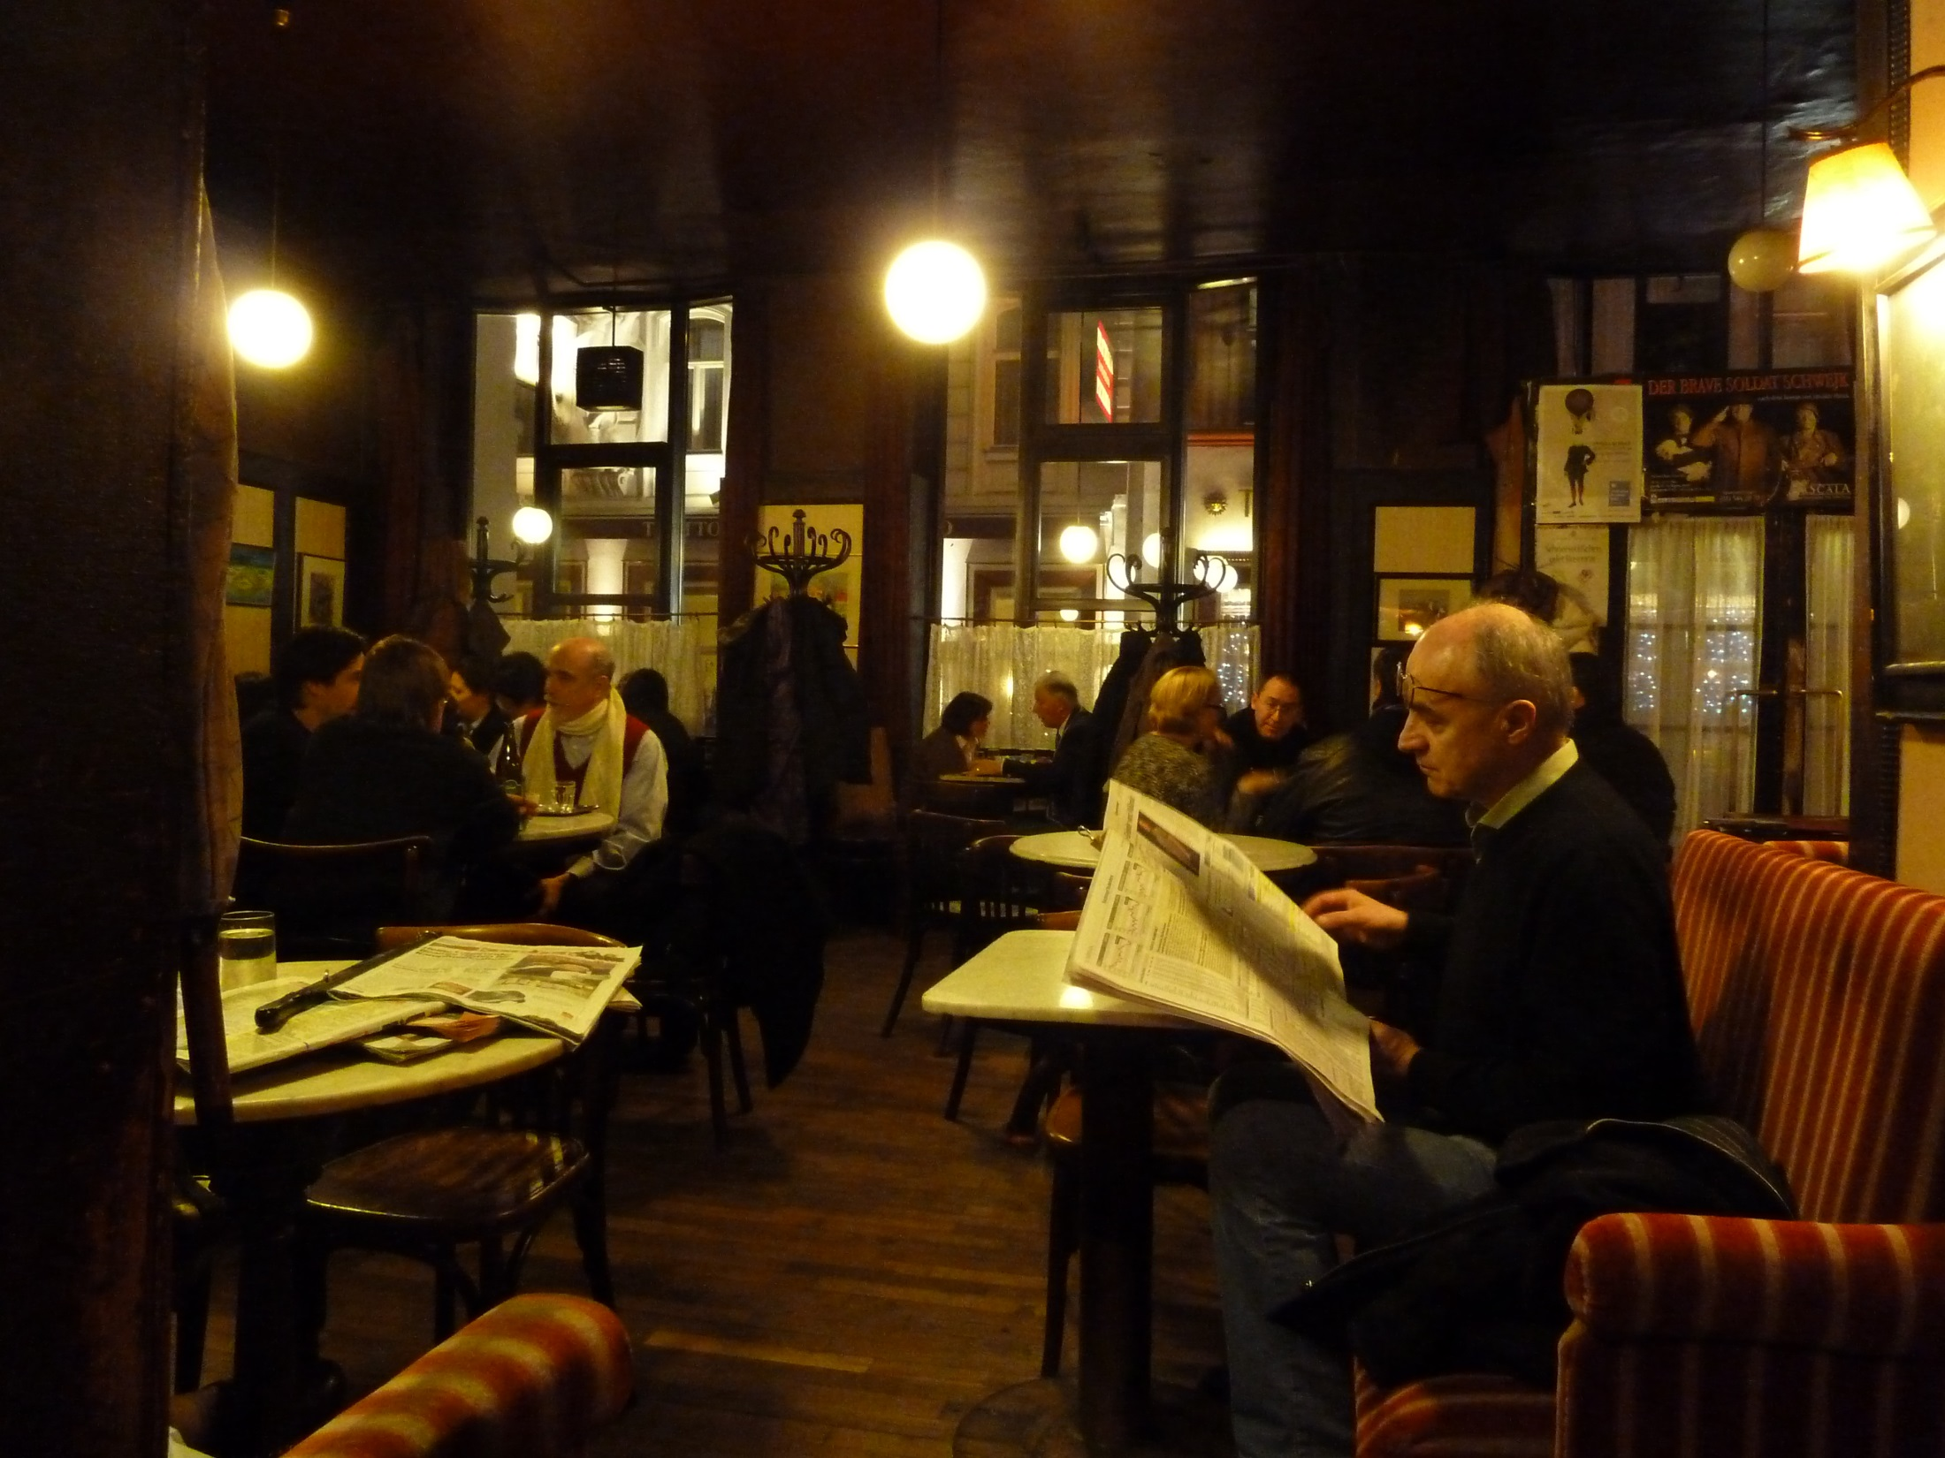
Vienna | Hawelka

Slide 51
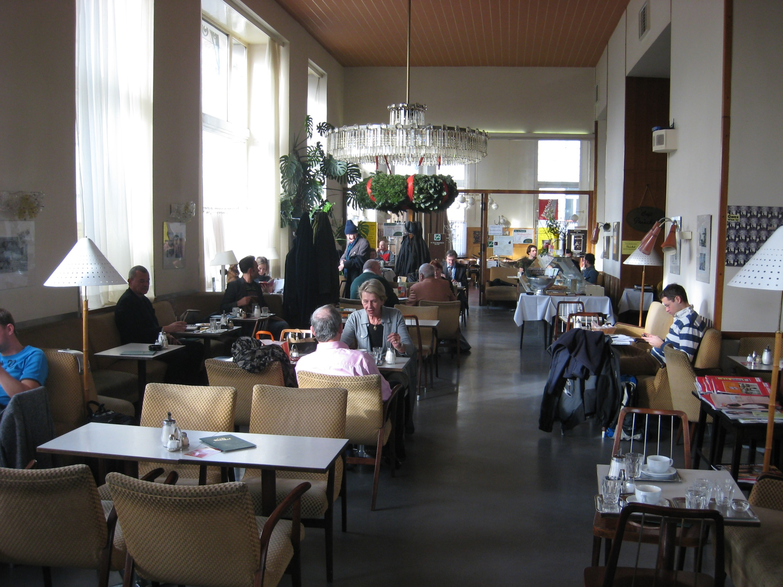
Vienna | Café Prückel

Slide 52

Washington | Afterwords Café

Slide 53

Yale | Book Trader Café

Slide 54

Zurich | KafiSchnaps

Slide 55

University of the Streets

